Slide 1
PHYS 1111K
Lectures 13-14
OpenStax Chapter 9
Youtube: https://youtu.be/z_d1VrGvrpQ

Slide 2
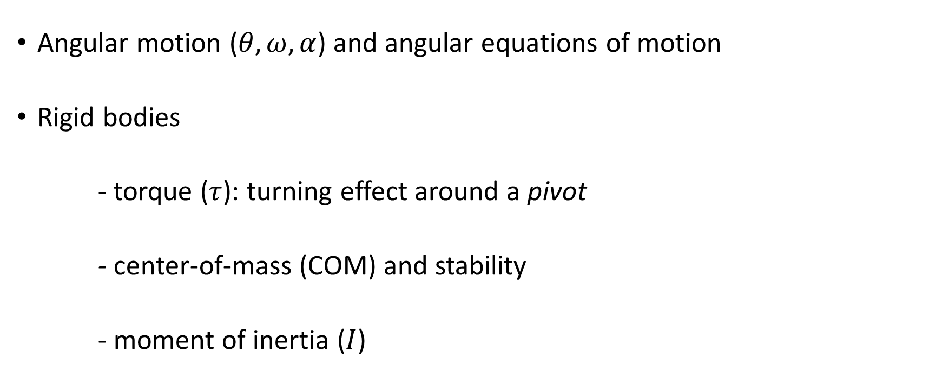
Last Class
Angular motion ($θ,ω,α$) and angular equations of motion
Rigid bodies
- torque ($τ$): turning effect around a pivot
- center-of-mass (COM) and stability
- moment of inertia ($I$)

Slide 3


Newton’s Second Law - Rotational Dynamics
Net Force
Acceleration
Net Torque
Angular Acceleration
Moment of Inertia
Mass

Slide 4
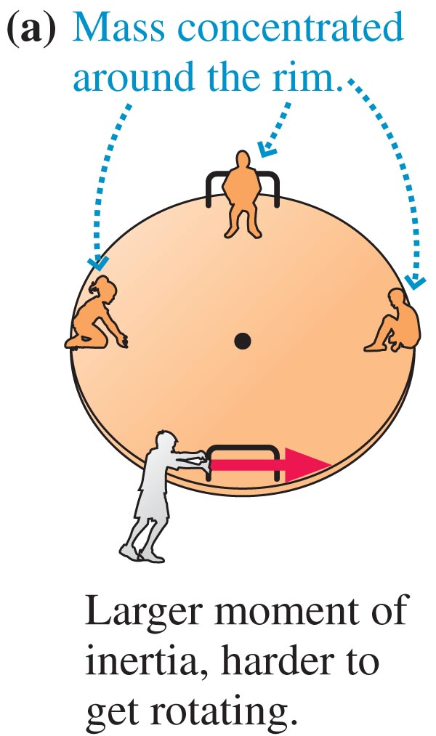
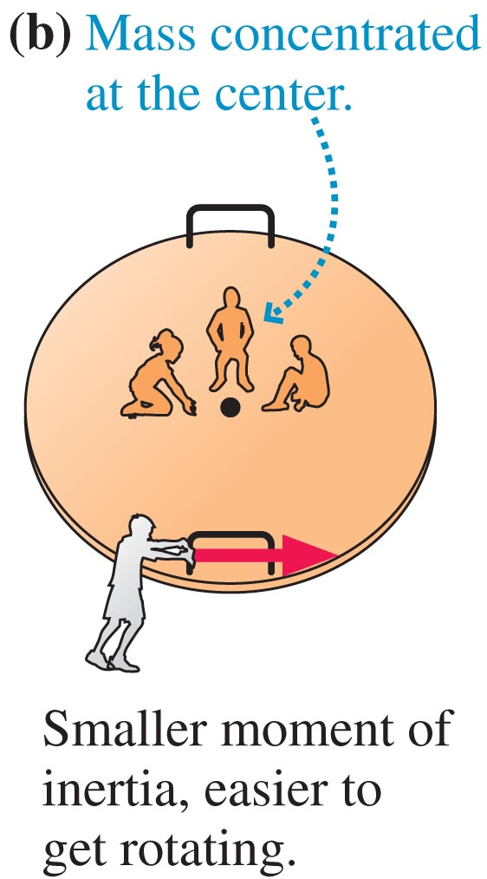
Newton’s Second Law for Rotation
I = moment of inertia. Objects with larger moments of inertia are harder to get rotating

Slide 5
Torque: Problem-solving
A 4.00 m long, 500 kg steel beam is supported 1.20 m from the right end. What is the torque about the support?

Slide 6
Problem-solving
A 4.00 m long, 500 kg steel beam is supported 1.20 m from the right end. What is the torque about the support?
4.00 m
1.20 m

Slide 7
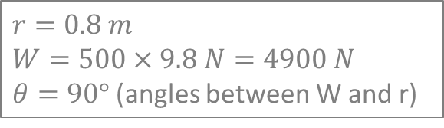
Problem-solving
A 4.00 m long, 500 kg steel beam is supported 1.20 m from the right end. What is the torque about the support?
4.00 m
1.20 m
$$r=0.8 m$$
$$W=500×9.8 N=4900 N$$
$θ=90°$(angles between W and r)
$$τ=rFsin θ=\left(0.8\right)\left(500×9.8\right)\sin{90°}Nm=−3920 Nm [CCW]$$

Slide 8
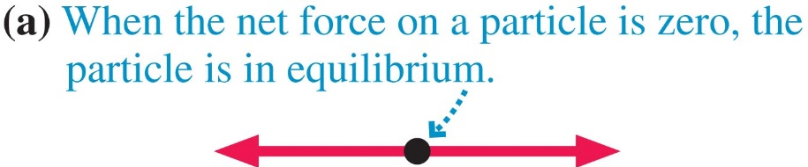
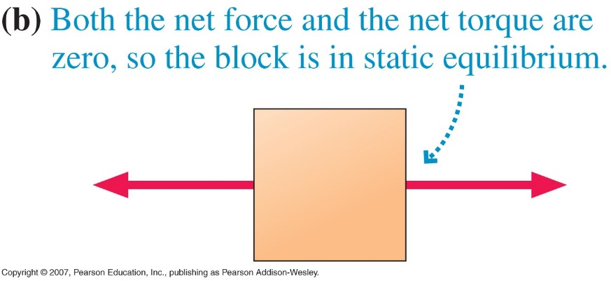
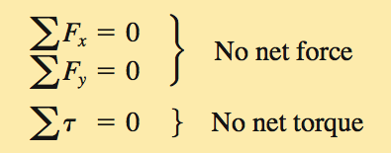
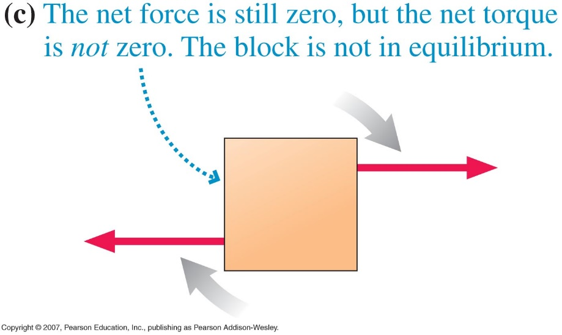
Torque and Static Equilibrium
For an extended object to be in equilibrium, the net force and the net torque must be zero.

Slide 9
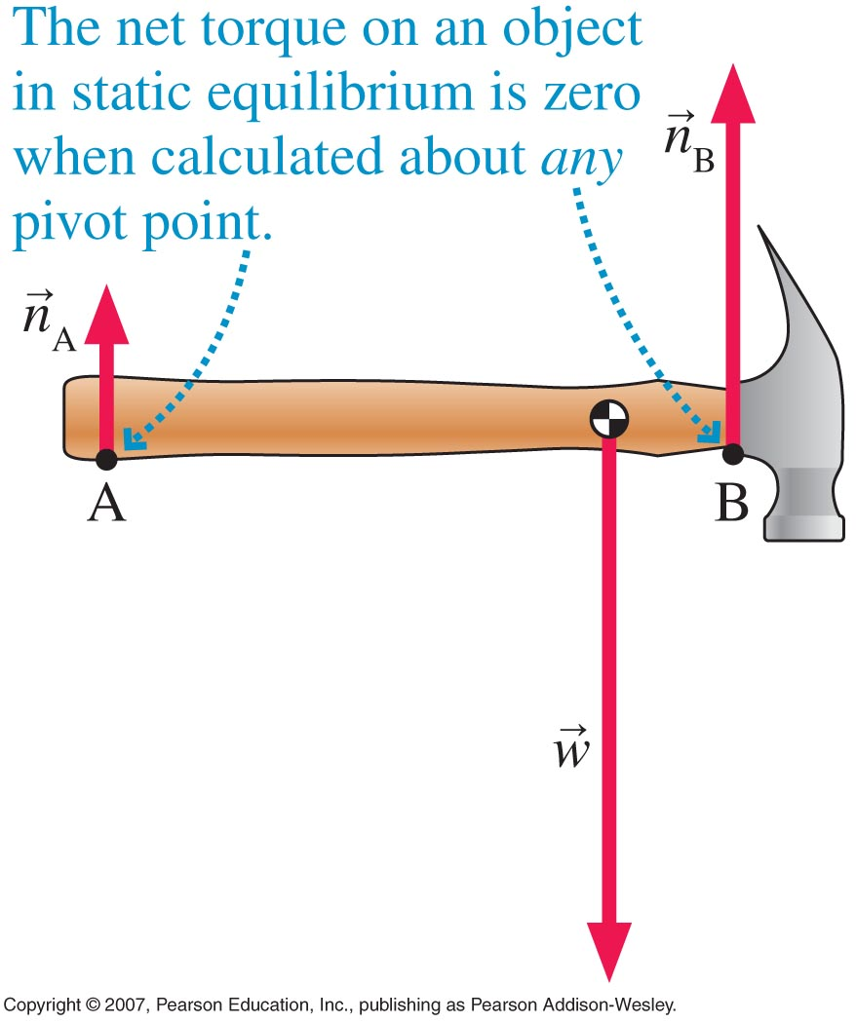
Choosing the Pivot Point

Slide 10
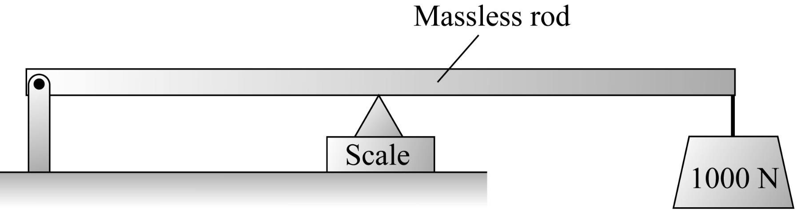

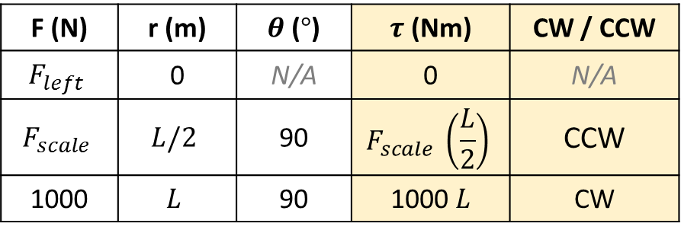
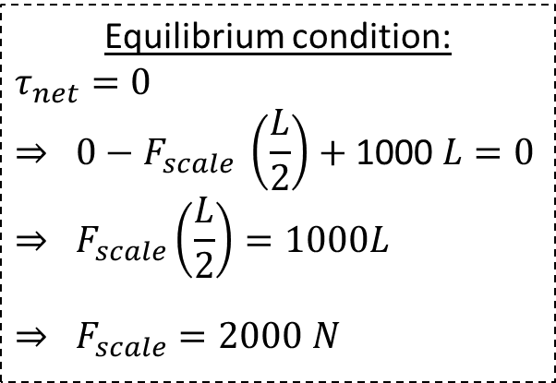

Check Your Understanding
What does the scale placed right below the center of gravity of the rod read?
  500 N
  1000 N
  2000 N
  4000 N
$$F_{scale}$$
$$F_{left}$$
Choose pivot at left end
Equilibrium condition:
$$τ_{net}=0$$
$$⇒ 0−F_{scale} \left(\frac{L}{2}\right)+\text{1000 }L=0$$
$$⇒ F_{scale}\left(\frac{L}{2}\right)=1000L$$
$$⇒ F_{scale}=2000 N$$
Torque table:
F (N) | r (m) | $θ$ ($°$) | $τ$ (Nm) | CW / CCW
$$F_{left}$$ | 0 | N/A | 0 | N/A
$$F_{scale}$$ | $$L/2$$ | 90 | $$F_{scale} \left(\frac{L}{2}\right)$$ | CCW
1000 | $$L$$ | 90 | 1000 $L$ | CW
Notes:
Answer: C

Slide 12
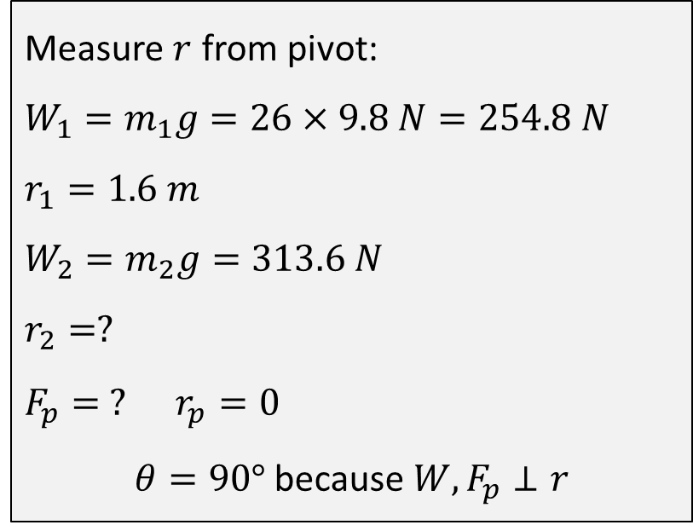
Problem 1 [1]
The two children are balanced on a seesaw of negligible mass. The first child has a mass of 26.0 kg and sits 1.60 m from the pivot. If the second child has a mass of 32.0 kg, how far is she from the pivot? What is Fp , the supporting force exerted by the pivot?
Measure $r$ from pivot:
$$W_{1}=m_{1}g=26×9.8 N=254.8 N$$
$$r_{1}=1.6 m$$
$$W_{2}=m_{2}g=313.6 N$$
$$r_{2}=?$$
$$F_{p}= ? r_{p}=0$$
$θ=90°$ because $W,F_{p}⊥r$
Notes:
Answer: C

Slide 13
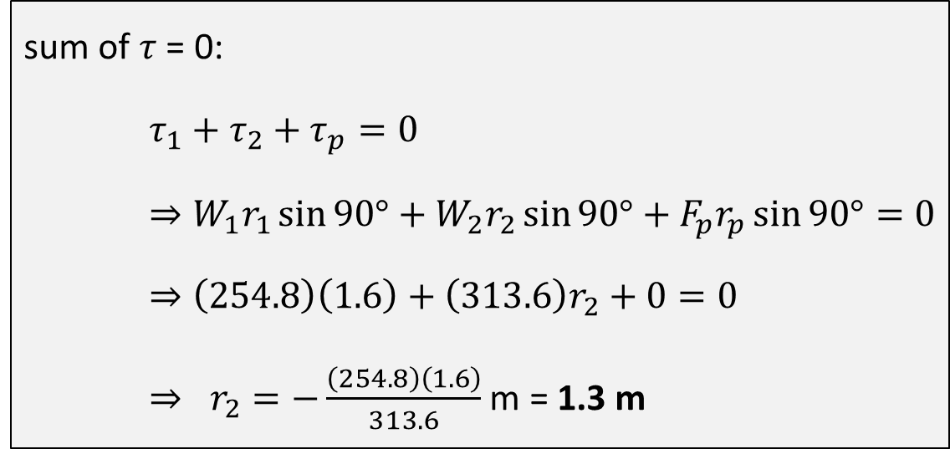
Problem 1 [2]
The two children are balanced on a seesaw of negligible mass. The first child has a mass of 26.0 kg and sits 1.60 m from the pivot. If the second child has a mass of 32.0 kg, how far is she from the pivot? What is Fp , the supporting force exerted by the pivot?
sum of $τ$ = 0:
$τ_{1}+τ_{2}+τ_{p}=0$
$⇒W_{1}r_{1}\sin{90°}+W_{2}r_{2}\sin{90°}+F_{p}r_{p}\sin{90°}=0$
$⇒\left(254.8\right)\left(1.6\right)+\left(313.6\right)r_{2}+0=0$
$⇒ r_{2}=−\frac{\left(254.8\right)\left(1.6\right)}{313.6}$ m = 1.3 m
Notes:
Answer: C

Slide 14
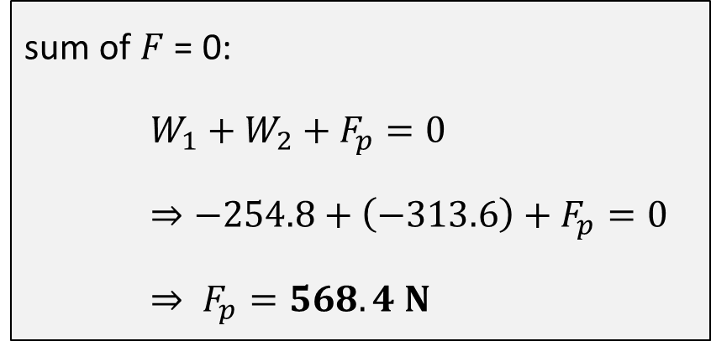
Problem 1 [3]
The two children are balanced on a seesaw of negligible mass. The first child has a mass of 26.0 kg and sits 1.60 m from the pivot. If the second child has a mass of 32.0 kg, how far is she from the pivot? What is Fp , the supporting force exerted by the pivot?
sum of $F$ = 0:
$W_{1}+W_{2}+F_{p}=0$
$⇒−254.8+\left(−313.6\right)+F_{p}=0$
$⇒ F_{p}=568.4 N$
Notes:
Answer: C

Slide 15
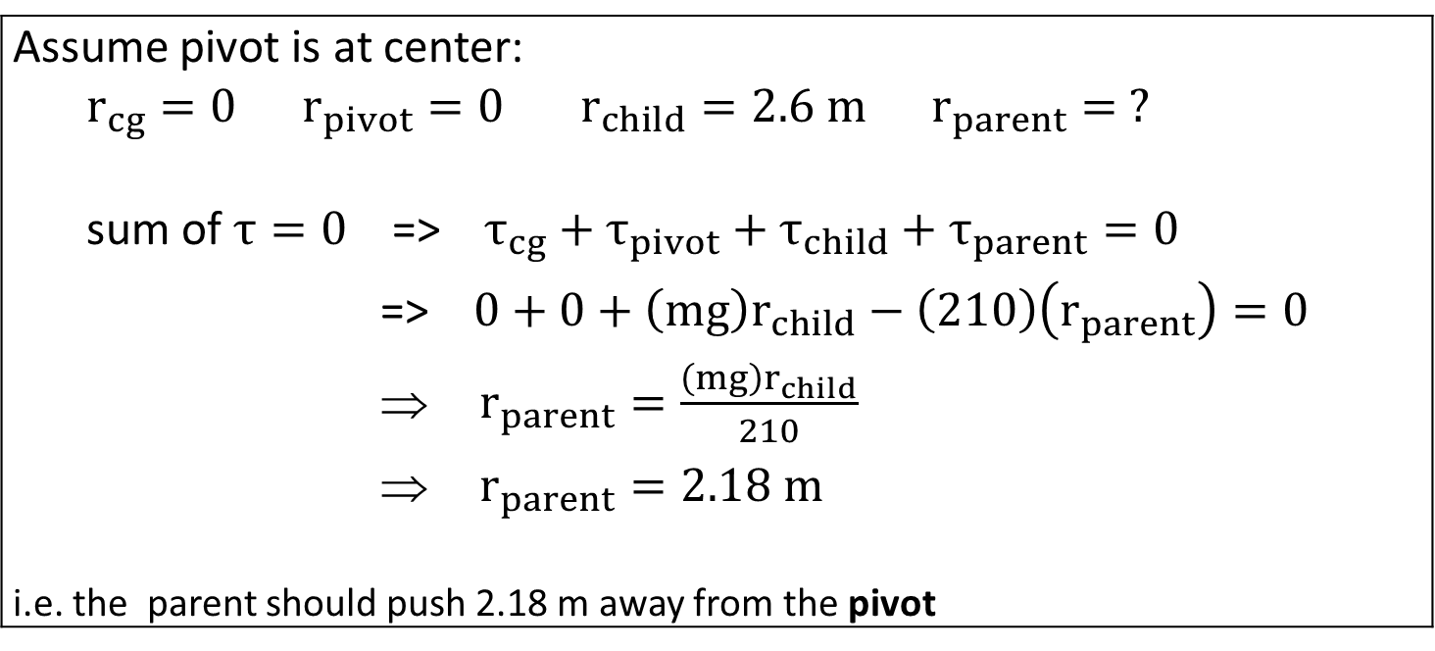
Problem 2
A schoolyard teeter totter is a beam of length 5.2 m and a mass of 26 kg, with a pivot in the center. A 18-kg child sits on one end of the teeter totter. Where should a parent push with a force of 210 N in order to hold the teeter totter level?
Assume pivot is at center: $$r_{cg}=0 r_{pivot}=0 r_{child}=2.6 m r_{parent}= ?$$ sum of $τ=0$ => $τ_{cg}+τ_{pivot}+τ_{child}+τ_{parent}=0$ => $0+0+\left(mg\right)r_{child}−\left(210\right)\left(r_{parent}\right)=0$ $r_{parent}=\frac{\left(mg\right)r_{child}}{210}$ $r_{parent}=2.18 m$ i.e. the parent should push 2.18 m away from the pivot
Notes:
Answer: C

Slide 16
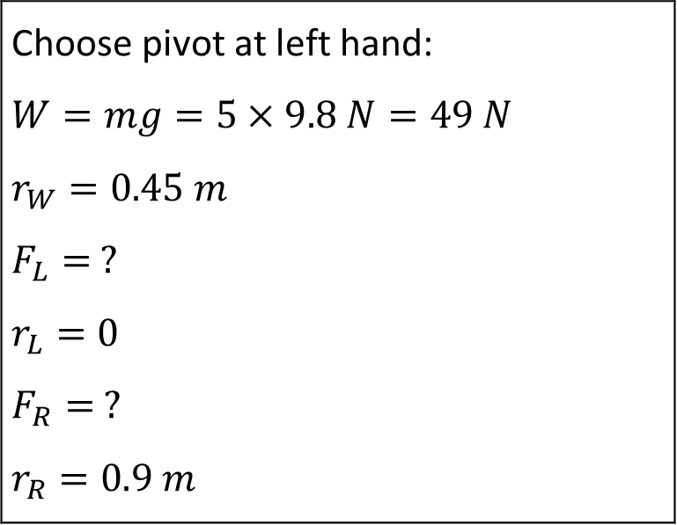
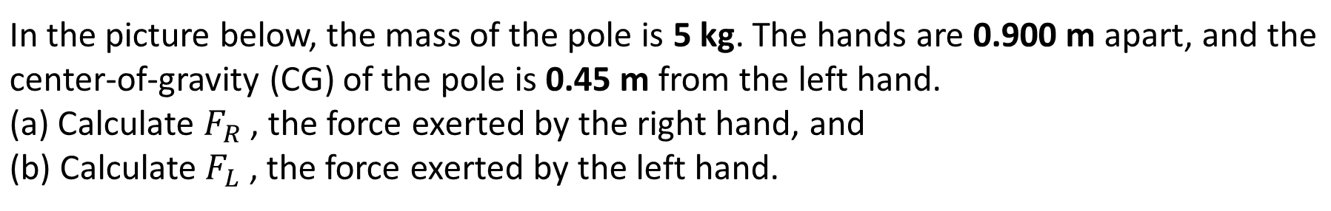
Problem 3 [1]
In the picture below, the mass of the pole is 5 kg. The hands are 0.900 m apart, and the center-of-gravity (CG) of the pole is 0.45 m from the left hand. (a) Calculate $F_{R}$ , the force exerted by the right hand, and (b) Calculate $F_{L}$ , the force exerted by the left hand.
Choose pivot at left hand: $$W=mg=5×9.8 N=49 N$$ $$r_{W}=0.45 m$$ $$F_{L}= ?$$ $$r_{L}=0$$ $$F_{R}= ?$$ $$r_{R}=0.9 m$$
Notes:
Answer: C

Slide 17



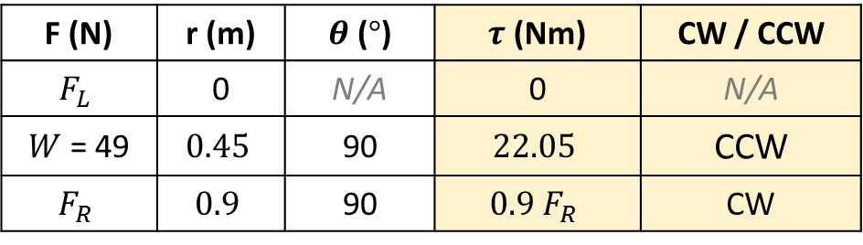

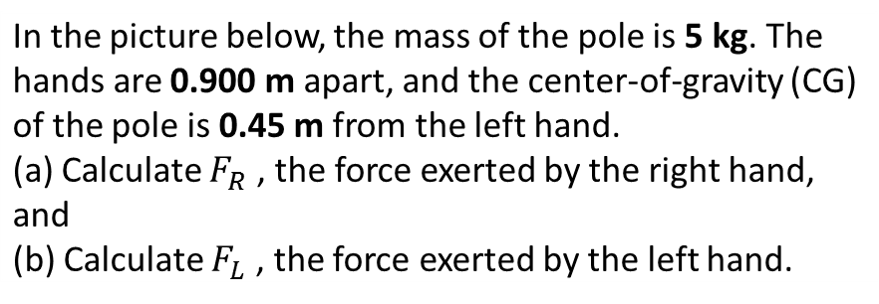

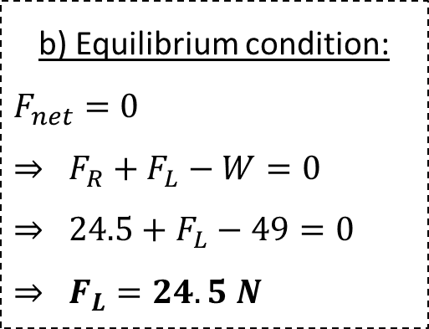


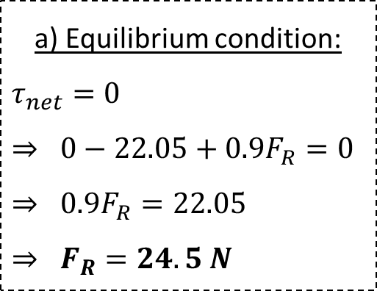
Problem 3 [2]
In the picture below, the mass of the pole is 5 kg. The hands are 0.900 m apart, and the center-of-gravity (CG) of the pole is 0.45 m from the left hand. (a) Calculate $F_{R}$ , the force exerted by the right hand, and (b) Calculate $F_{L}$ , the force exerted by the left hand.
Choose pivot at left hand ($F_{L}$)
Torque table:
F (N) | r (m) | $θ$ ($°$) | $τ$ (Nm) | CW / CCW
$$F_{L}$$ | 0 | N/A | 0 | N/A
$W$ = 49 | $$0.45$$ | 90 | $$22.05$$ | CCW
$$F_{R}$$ | $$0.9$$ | 90 | $$0.9 F_{R}$$ | CW
$$W=49 N$$
$$r_{W}=0.45 m$$
$$F_{L}$$
$$r_{R}=0.9 m$$
a) Equilibrium condition:
$$τ_{net}=0$$
$$⇒ 0−22.05+0.9F_{R}=0$$
$$⇒ 0.9F_{R}=22.05$$
$$⇒ F_{R}=24.5 N$$
b) Equilibrium condition:
$$F_{net}=0$$
$$⇒ F_{R}+F_{L}−W=0⇒ 24.5+F_{L}−49=0⇒ F_{L}=24.5 N$$
pivot
$$F_{R}$$
i.e. $F_{L}=F_{R}$ because $r_{L}=r_{R}$
Notes:
Answer: C

Slide 18
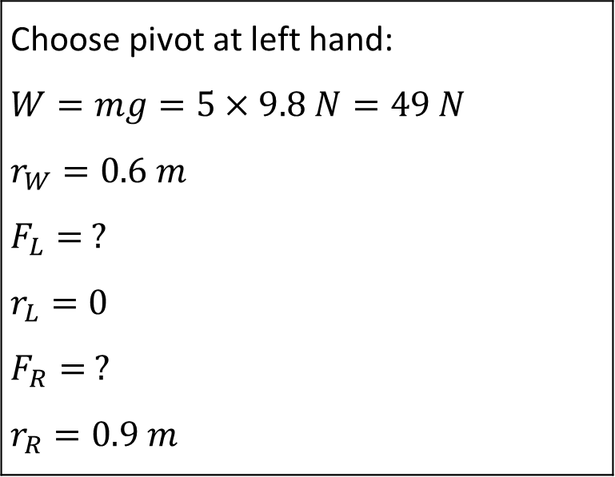
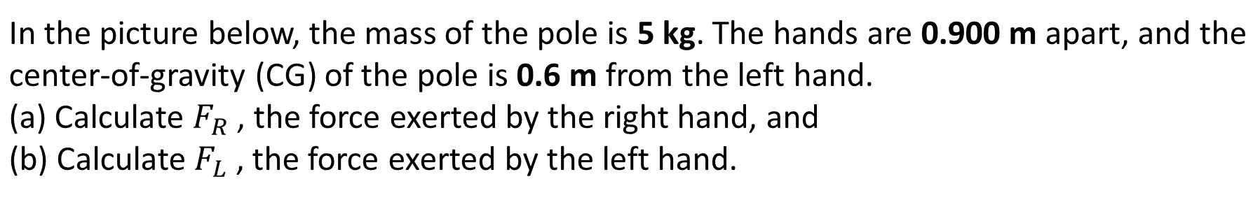
Problem 4 [1]
In the picture below, the mass of the pole is 5 kg. The hands are 0.900 m apart, and the center-of-gravity (CG) of the pole is 0.6 m from the left hand. (a) Calculate $F_{R}$ , the force exerted by the right hand, and (b) Calculate $F_{L}$ , the force exerted by the left hand.
Choose pivot at left hand: $$W=mg=5×9.8 N=49 N$$ $$r_{W}=0.6 m$$ $$F_{L}= ?$$ $$r_{L}=0$$ $$F_{R}= ?$$ $$r_{R}=0.9 m$$
Notes:
Answer: C

Slide 19


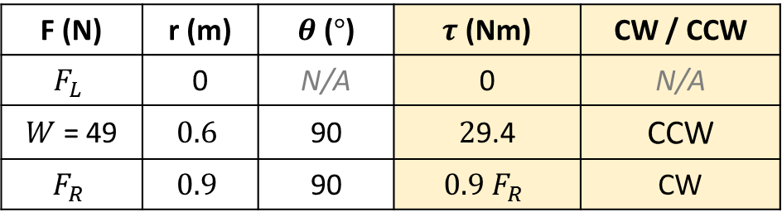



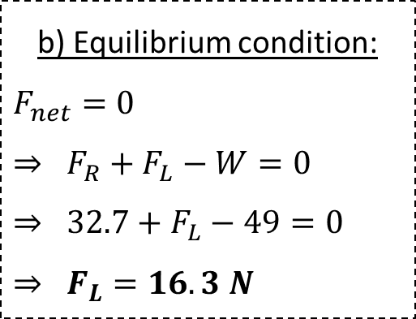


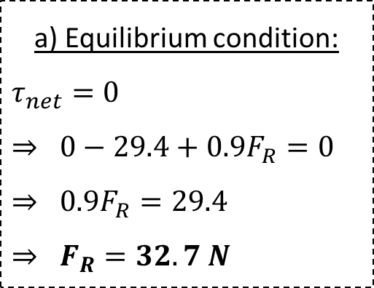
Problem 4 [2]
In the picture below, the mass of the pole is 5 kg. The hands are 0.900 m apart, and the center-of-gravity (CG) of the pole is 0.6 m from the left hand. (a) Calculate $F_{R}$ , the force exerted by the right hand, and (b) Calculate $F_{L}$ , the force exerted by the left hand.
Choose pivot at left hand ($F_{L}$)
Torque table:
F (N) | r (m) | $θ$ ($°$) | $τ$ (Nm) | CW / CCW
$$F_{L}$$ | 0 | N/A | 0 | N/A
$W$ = 49 | $$0.6$$ | 90 | $2$9.4 | CCW
$$F_{R}$$ | $$0.9$$ | 90 | $$0.9 F_{R}$$ | CW
$$W=49 N$$
$$F_{L}$$
$$r_{W}=0.6 m$$
$$r_{R}=0.9 m$$
a) Equilibrium condition:
$$τ_{net}=0$$
$$⇒ 0−29.4+0.9F_{R}=0$$
$⇒ 0.9F_{R}=2$9.4
$$⇒ F_{R}=32.7 N$$
b) Equilibrium condition:
$$F_{net}=0$$
$$⇒ F_{R}+F_{L}−W=0⇒ 32.7+F_{L}−49=0⇒ F_{L}=16.3 N$$
pivot
$$F_{R}$$
i.e. $F_{L}=\frac{1}{2}F_{R}$ because $r_{L}=2r_{R}$
Notes:
Answer: C

Slide 20
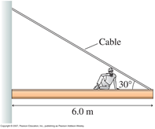





Problem 5 [1]: Wall Support
a) An 80-kg construction worker sits down 2.0 m from the end of a 150 kg steel beam to eat his lunch. The cable supporting the beam is rated at 15,000 N. Should the worker be worried? b) Find the horizontal and vertical forces of the wall on the beam.
Choose pivot at A: $$W_{beam}=m_{beam}g=150×9.8 N=1470 N$$ $r_{beam}=3.0 m$ , $θ=90°$ $$W_{worker}=m_{worker}g=80×9.8 N=784 N$$ $r_{worker}=4.0 m$ , $θ=90°$ $T= ?$ , $r_{T}=6 m$ , $θ=30°$ $F_{wall}= ?$ , $r_{wall }=0 m$ i.e. $τ_{wall}$ = 0
$$F_{wall}$$
$$T$$
A
B
$$W_{worker}=80×9.8 N$$
$$W_{beam}=150×9.8 N$$
Notes:
Answer: C

Slide 21


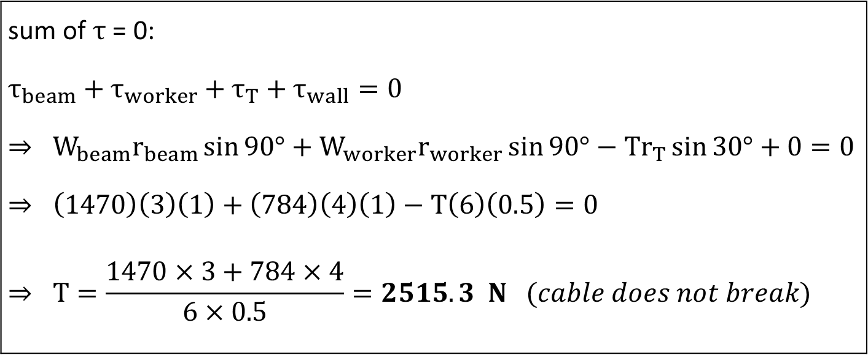


Problem 5 [2]: Wall Support
a) An 80-kg construction worker sits down 2.0 m from the end of a 150 kg steel beam to eat his lunch. The cable supporting the beam is rated at 15,000 N. Should the worker be worried? b) Find the horizontal and vertical forces of the wall on the beam.
sum of $τ$ = 0: $$τ_{beam}+τ_{worker}+τ_{T}+τ_{wall}=0$$ $⇒ W_{beam}r_{beam}\sin{90°}$ $+$ $W_{worker}r_{worker}\sin{90°}$ $−$ $Tr_{T}\sin{30°}+0=0$ $$⇒ \left(1470\right)\left(3\right)\left(1\right)+\left(784\right)\left(4\right)\left(1\right)−T\left(6\right)\left(0.5\right)=0$$ $$⇒ T=\frac{1470×3+784×4}{6×0.5}=2515.3 N (cable does not break)$$
$$F_{wall}$$
$$T$$
A
B
$$W_{worker}$$
$$W_{beam}$$
Notes:
Answer: C

Slide 22
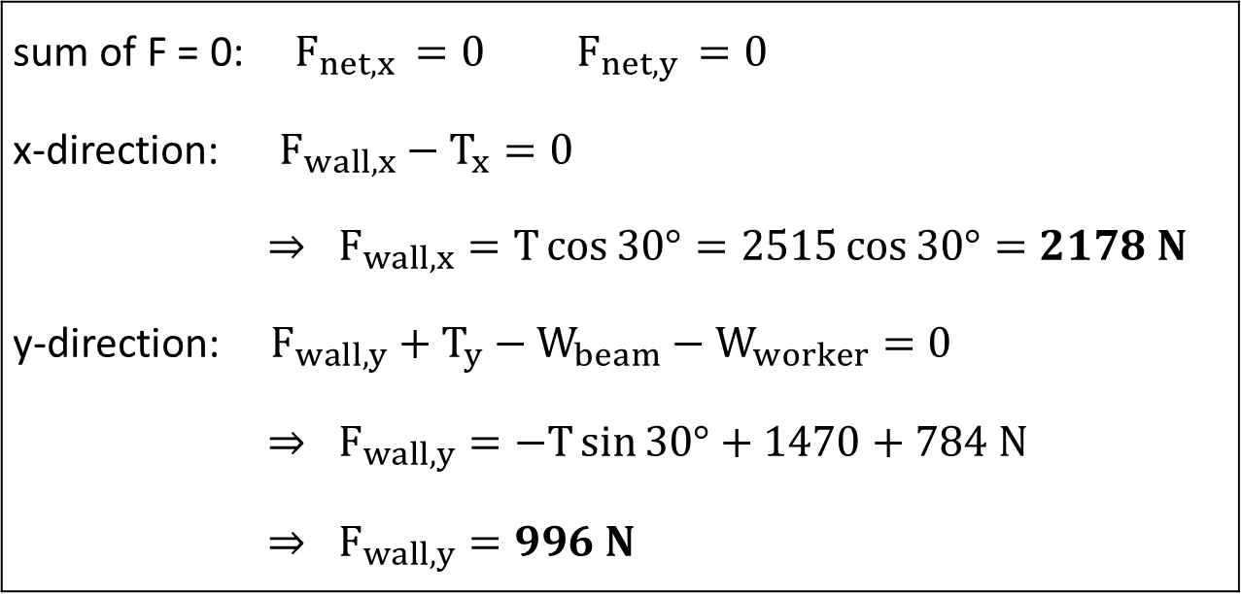
Problem 5 [3]: Wall Support
a) An 80-kg construction worker sits down 2.0 m from the end of a 150 kg steel beam to eat his lunch. The cable supporting the beam is rated at 15,000 N. Should the worker be worried? b) Find the horizontal and vertical forces of the wall on the beam.
sum of F = 0: $F_{net,x }=0$ $F_{net,y }=0$ x-direction: $F_{wall,x}−T_{x}=0$ $$⇒ F_{wall,x}=T\cos{30°}=2515\cos{30°}=2178 N$$ y-direction: $F_{wall,y}+T_{y}−W_{beam}−W_{worker}=0$ $$⇒ F_{wall,y}=−T\sin{30°}+1470+784 N$$ $$⇒ F_{wall,y}=996 N$$
$$F_{wall}$$
$$T$$
A
B
$$W_{worker}$$
$$W_{beam}$$
Notes:
Answer: C

Slide 23
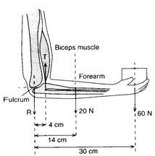


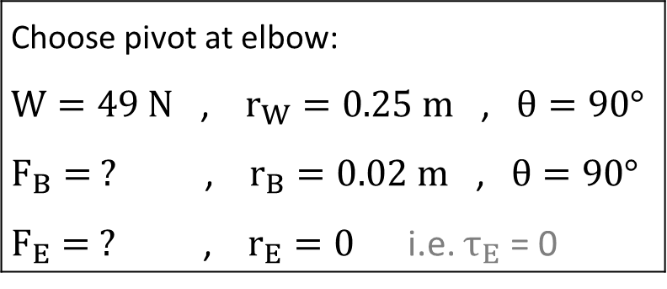

Problem 6 [1]: Human Arm
The lower arm is supported by forces from the bicep and elbow muscles. The elbow is located at the end of the lower arm and the bicep muscle connects to the lower arm very close to the elbow. When the upper arm is vertical and the lower arm is held horizontally at equilibrium, the bicep pulls up on it and the elbow pushes down on it. Suppose a lower arm of mass 5 kg has its center-of-mass located 0.25 m from the elbow, and the bicep muscle connects 0.02 m away from the elbow. Find the forces exerted by the elbow and the bicep muscle when the lower arm is held horizontally.
$$F_{B}$$
$$F_{E}$$
$$W=5×9.8 N=49 N$$
Choose pivot at elbow: $W=49 N$ , $r_{W}=0.25 m$ , $θ=90°$ $F_{B}= ?$ , $r_{B}=0.02 m$ , $θ=90°$ $F_{E}= ?$ , $r_{E}=0$ i.e. $τ_{E}$ = 0
Notes:
Answer: C

Slide 24


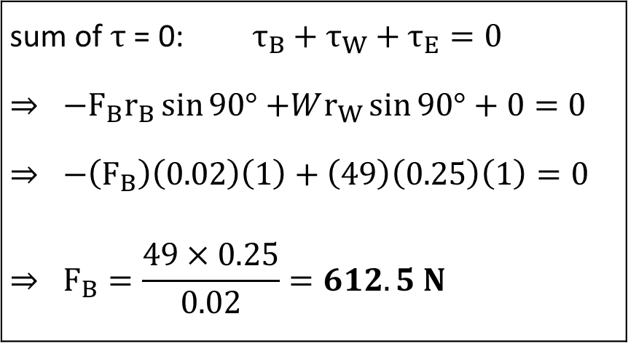
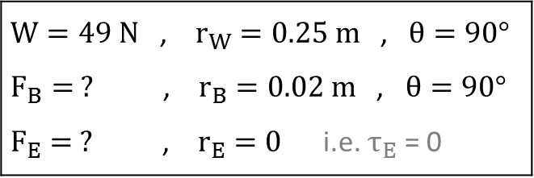

Problem 6 [2]: Human Arm
$W=49 N$ , $r_{W}=0.25 m$ , $θ=90°$ $F_{B}= ?$ , $r_{B}=0.02 m$ , $θ=90°$ $F_{E}= ?$ , $r_{E}=0$ i.e. $τ_{E}$ = 0
The lower arm is supported by forces from the bicep and elbow muscles. The elbow is located at the end of the lower arm and the bicep muscle connects to the lower arm very close to the elbow. When the upper arm is vertical and the lower arm is held horizontally at equilibrium, the bicep pulls up on it and the elbow pushes down on it. Suppose a lower arm of mass 5 kg has its center-of-mass located 0.25 m from the elbow, and the bicep muscle connects 0.02 m away from the elbow. Find the forces exerted by the elbow and the bicep muscle when the lower arm is held horizontally.
$$F_{B}$$
$$F_{E}$$
$$W=49 N$$
sum of $τ$ = 0: $τ_{B}+τ_{W}+τ_{E}=0$ $⇒ −F_{B}r_{B}\sin{90°}$ $+Wr_{W}\sin{90°}+$ $0=0$ $$⇒ −\left(F_{B}\right)\left(0.02\right)\left(1\right)+\left(49\right)\left(0.25\right)\left(1\right)=0$$ $$⇒ F_{B}=\frac{49×0.25}{0.02}=612.5 N$$
Notes:
Answer: C

Slide 25


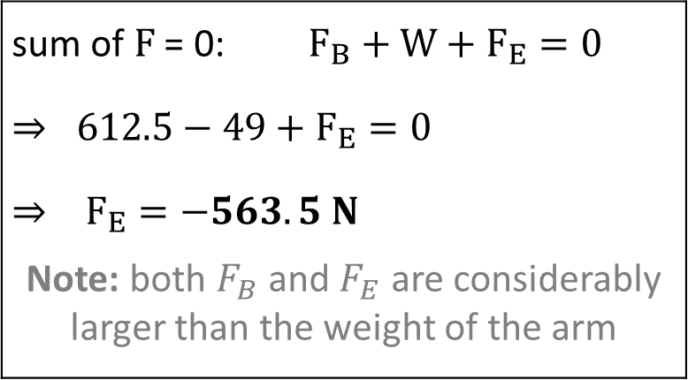

Problem 6 [3]: Human Arm
$W=49 N$ , $r_{W}=0.25 m$ , $θ=90°$ $F_{B}= ?$ , $r_{B}=0.02 m$ , $θ=90°$ $F_{E}= ?$ , $r_{E}=0$ i.e. $τ_{E}$ = 0
The lower arm is supported by forces from the bicep and elbow muscles. The elbow is located at the end of the lower arm and the bicep muscle connects to the lower arm very close to the elbow. When the upper arm is vertical and the lower arm is held horizontally at equilibrium, the bicep pulls up on it and the elbow pushes down on it. Suppose a lower arm of mass 5 kg has its center-of-mass located 0.25 m from the elbow, and the bicep muscle connects 0.02 m away from the elbow. Find the forces exerted by the elbow and the bicep muscle when the lower arm is held horizontally.
$$F_{B}$$
$$F_{E}$$
$$W=49 N$$
sum of $F$ = 0: $F_{B}+W+F_{E}=0$ $$⇒ 612.5−49+F_{E}=0$$ $$⇒ F_{E}=−563.5 N$$ Note: both $F_{B}$ and $F_{E}$ are considerably larger than the weight of the arm
Notes:
Answer: C

Slide 26
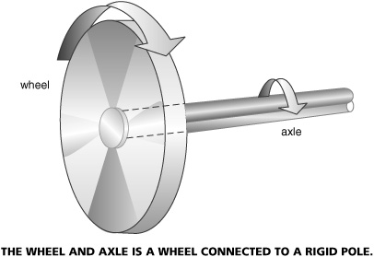

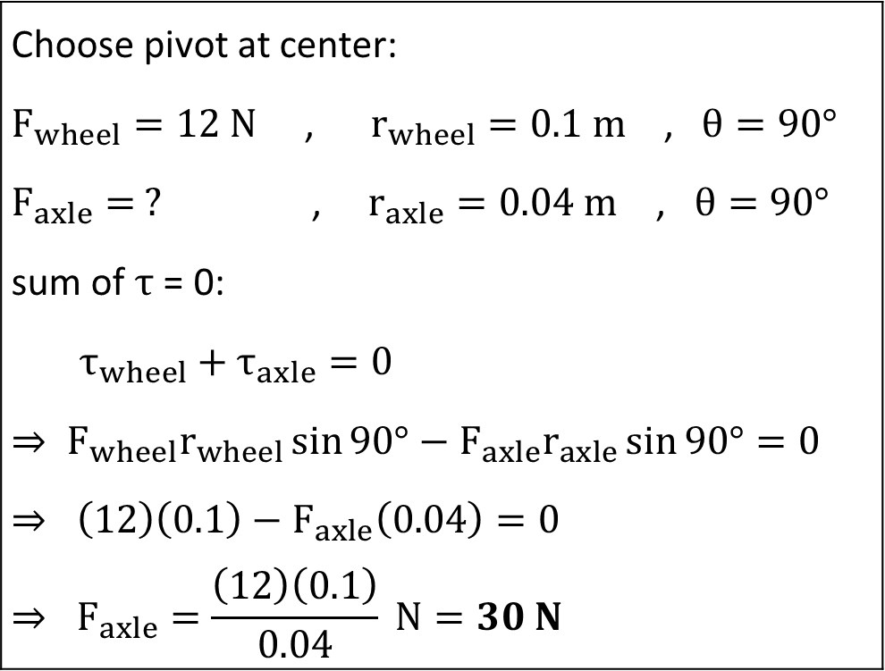



Problem 7: Wheel and Axle
A wheel of radius 10 cm is connected to an axle of radius 4 cm. If a force of 12 N is applied to the wheel, what force must be applied to the axle to keep the system at equilibrium?
Choose pivot at center: $F_{wheel}=12 N$ , $r_{wheel}=0.1 m$ , $θ=90°$ $F_{axle}= ?$ , $r_{axle}=0.04 m$ , $θ=90°$ sum of $τ$ = 0: $$τ_{wheel}+τ_{axle}=0$$ $$⇒ F_{wheel}r_{wheel}\sin{90°}−F_{axle}r_{axle}\sin{90°}=0$$ $$⇒ \left(12\right)\left(0.1\right)−F_{axle}\left(0.04\right)=0$$ $$⇒ F_{axle}=\frac{\left(12\right)\left(0.1\right)}{0.04} N=30 N$$
$$F_{axle}$$
$$r_{axle}$$
$$r_{wheel}$$
$$F_{wheel}$$
Notes:
Answer: C

Slide 27
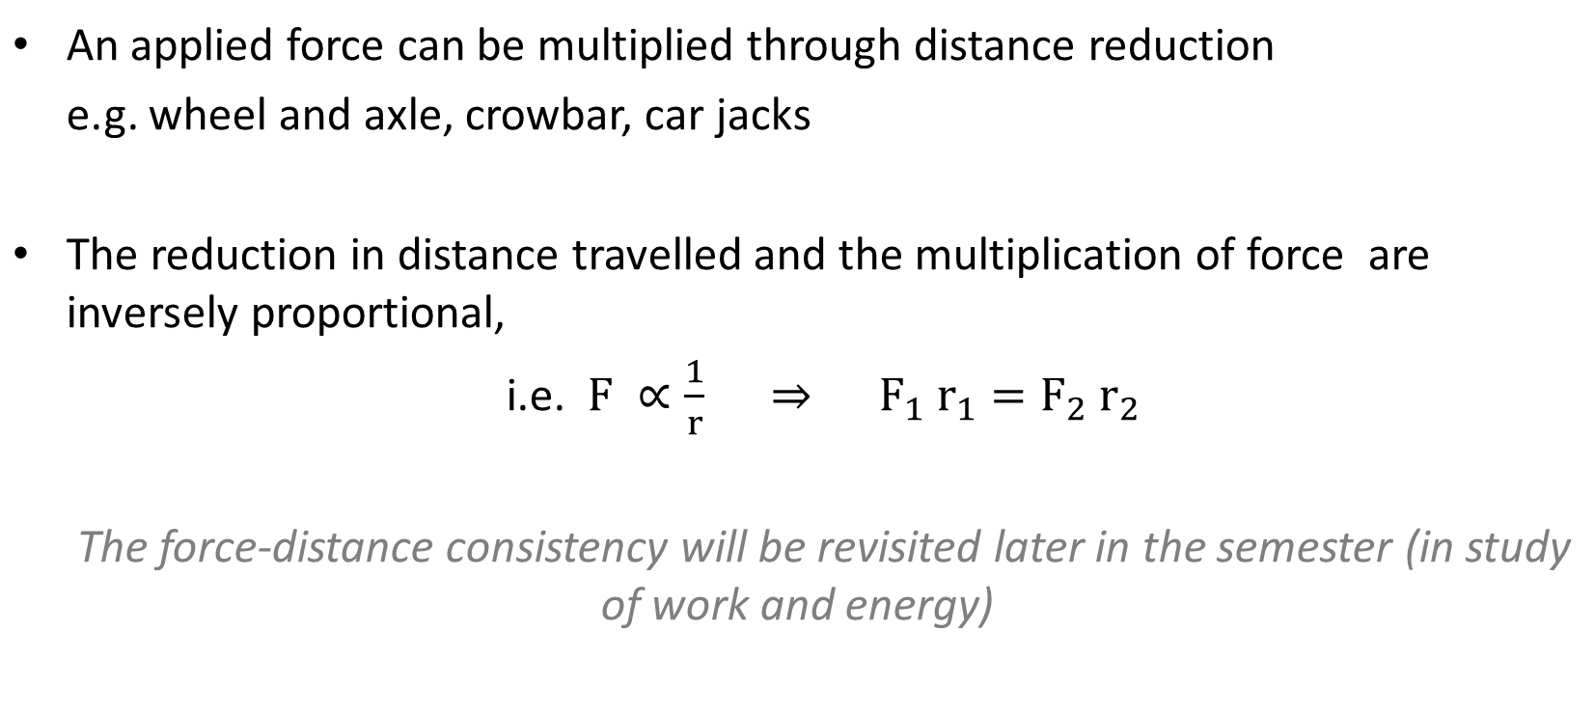
Force multiplication
An applied force can be multiplied through distance reduction e.g. wheel and axle, crowbar, car jacks The reduction in distance travelled and the multiplication of force are inversely proportional, i.e. $F ∝\frac{1}{r} ⇒ F_{1} r_{1}=F_{2} r_{2}$ The force-distance consistency will be revisited later in the semester (in study of work and energy)
Notes:
Answer: C

