Slide 1

WARNING!
This presentation contains PowerPoint. Slides may contain more than 7 lines of text, with more than 7 words per line. Images displayed may or may not pertain directly to whatever is being said. Persons under the age of 14 and those with heart conditions must keep hands and feet inside the ride at all times. In case of a water landing or boredom, remember that the nearest exit may be behind you. Aisle lights will illuminate to indicate when it is safe to remove the pizza from the microwave. Contents are extremely hot. Seek immediate medical advice if you experience Universal Design for Learning knowledge lasting more than four hours. Use caution when applying these UDL principles at your own institution.
[music playing: Star Wars Emperor’s theme]

Slide 2
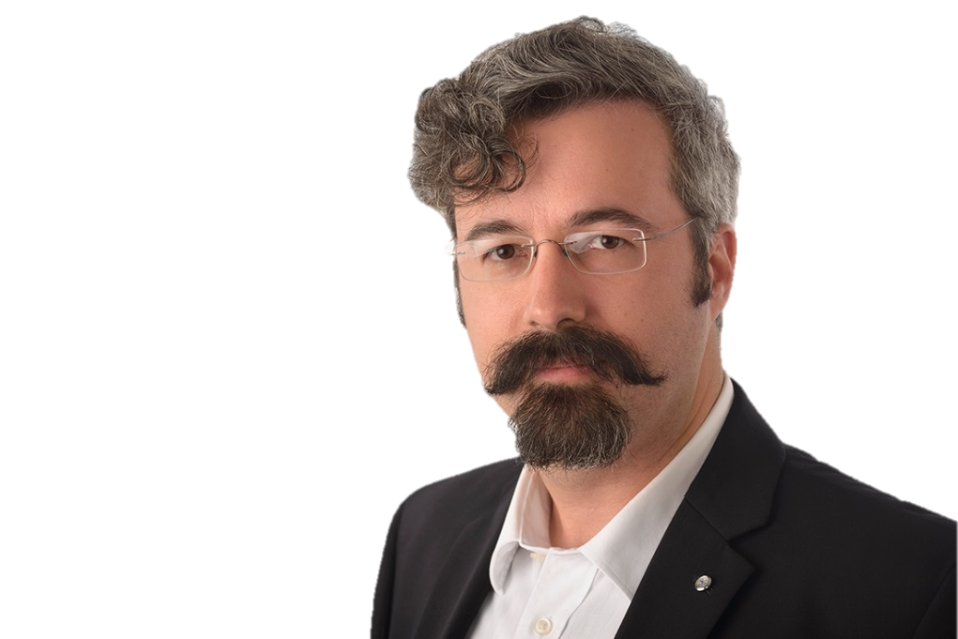

Reach Everyone, Teach Everyone through Universal Design for Learning
(and your phone)
Thomas J. Tobin
Northeastern Illinois University

Slide 3
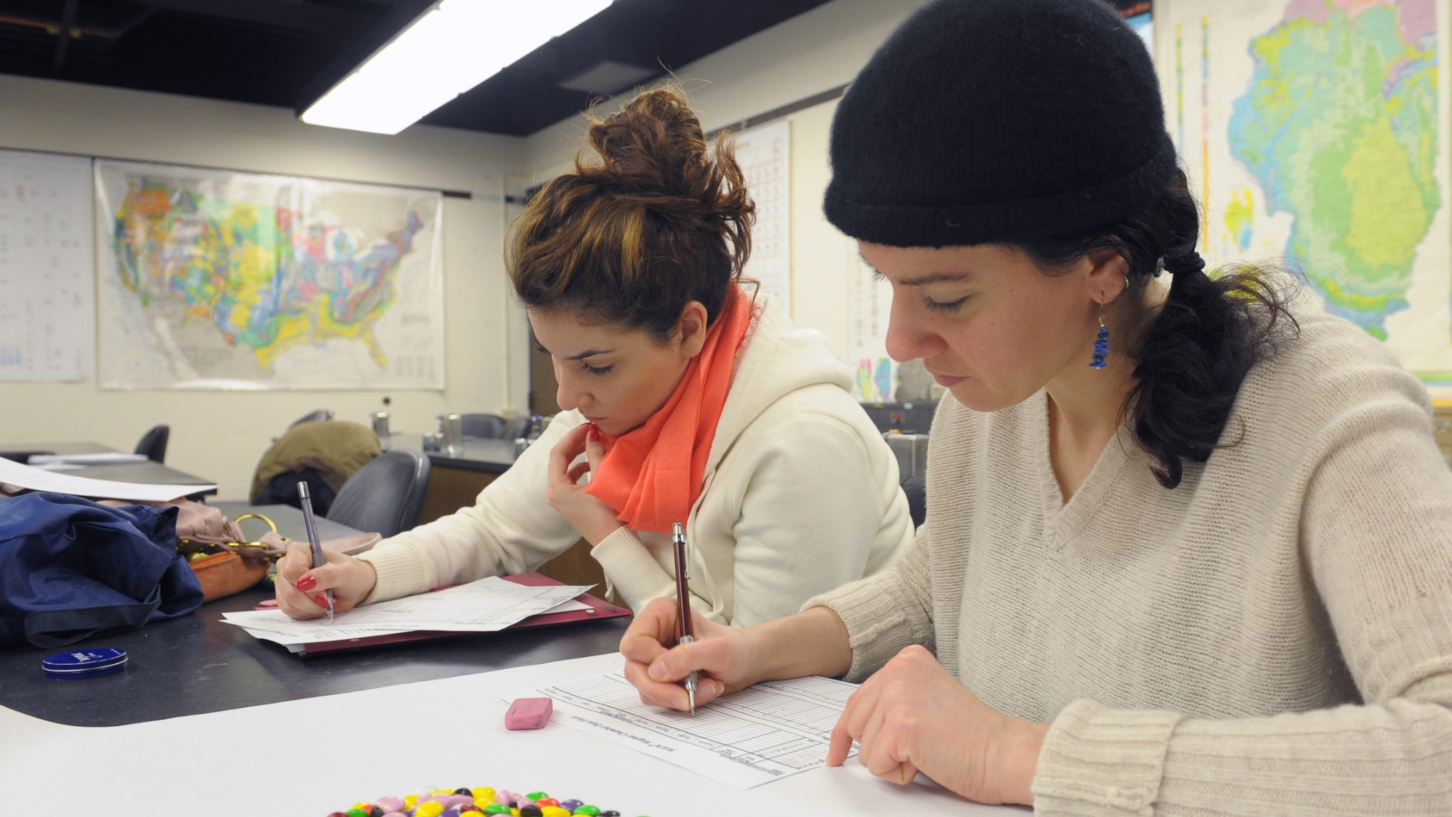
This is Katie.
Image ©2014 Northeastern Illinois University

Slide 4
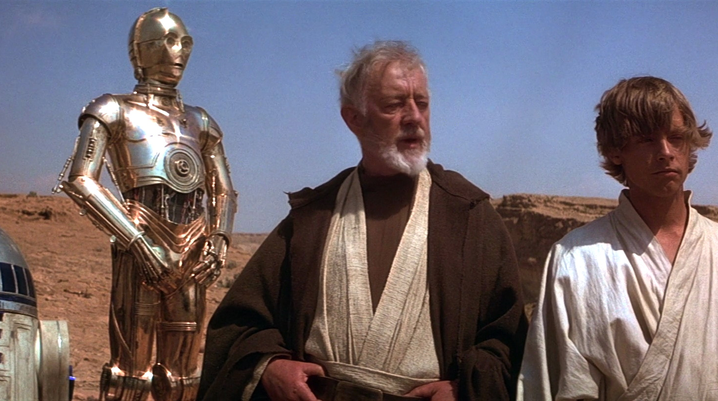
[Han Solo: I got a bad feeling about this!]
Image ©1977 LucasFilm, used with permission from starwarsscreecaps.com

Slide 5
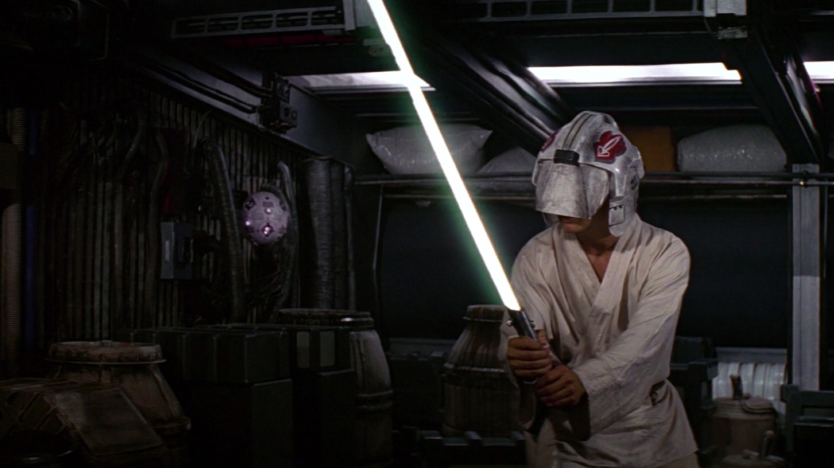
[Obi-Wan Kenobi: Luke, trust your feelings.]
Image ©1977 LucasFilm, used with permission from starwarsscreecaps.com

Slide 6
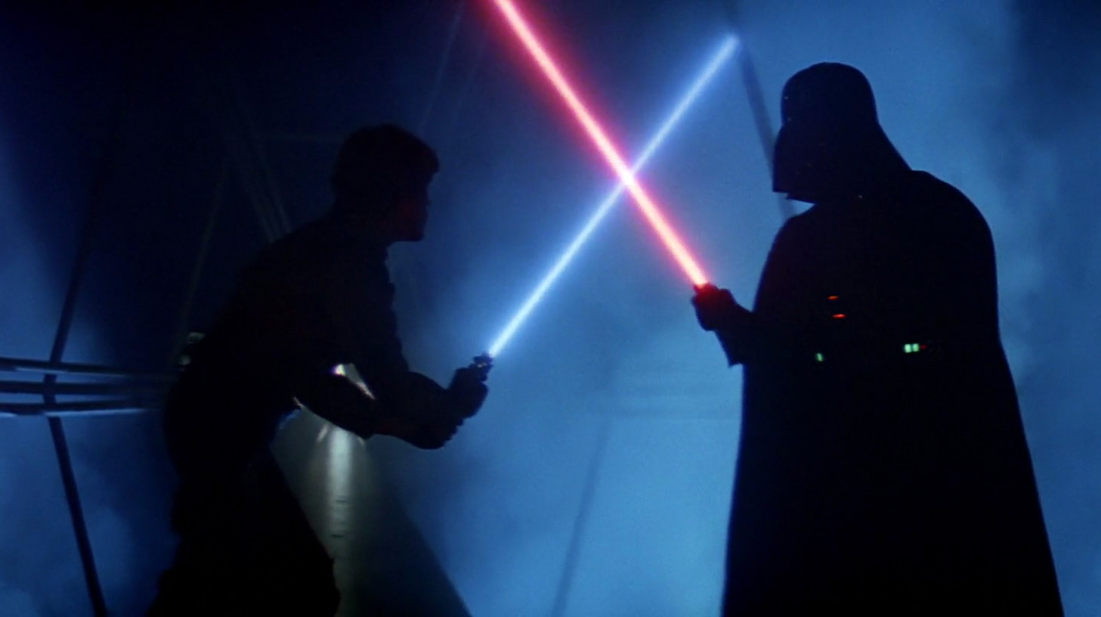
[Darth Vader: Release your anger!]
Image ©1980 LucasFilm, used with permission from starwarsscreecaps.com

Slide 7
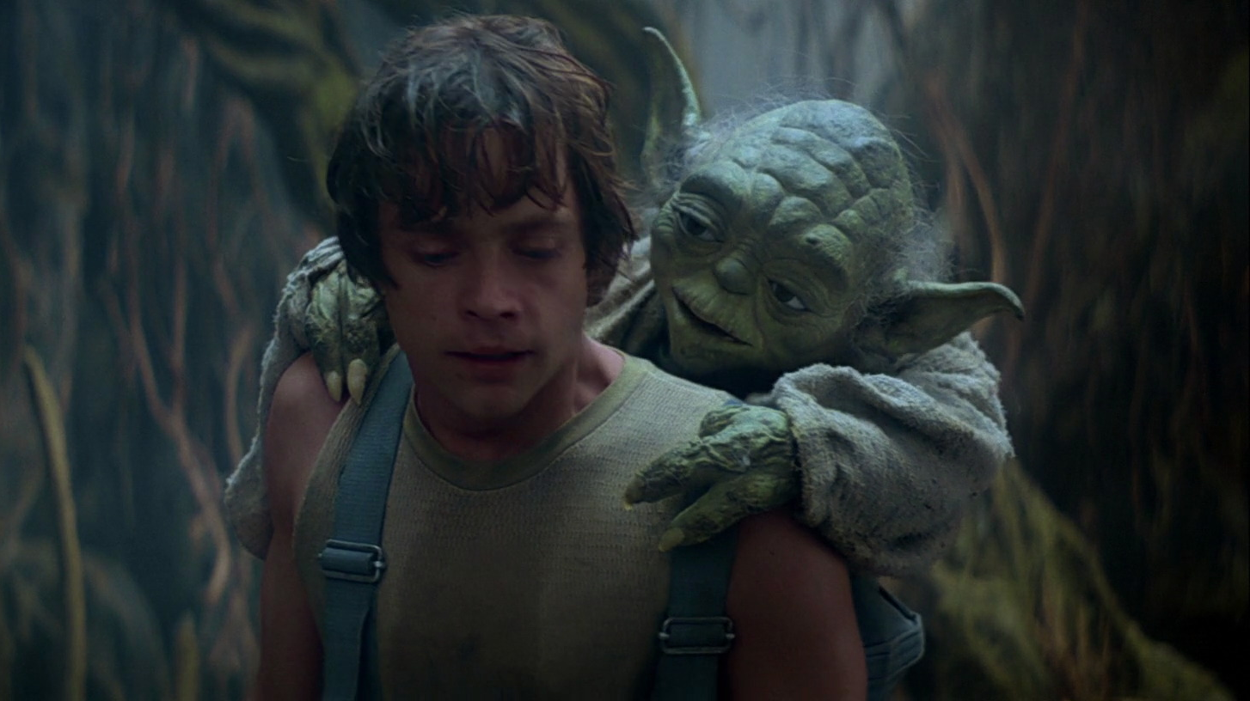
[Yoda: No different! Only different in your mind.
You must unlearn what you have learned.]
Image ©1980 LucasFilm, used with permission from starwarsscreecaps.com

Slide 8
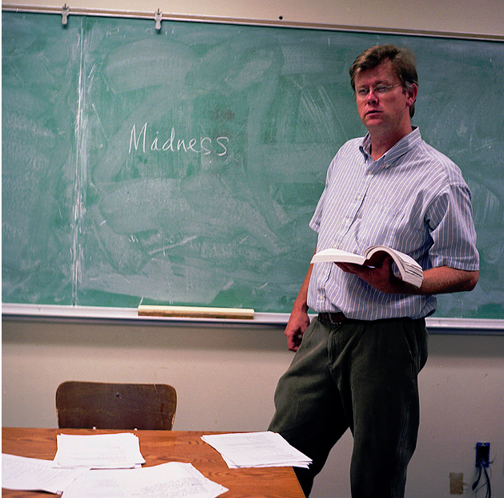
Meet Reed Moore-Büx
Notes:
Reed is based on an actual colleague who teaches in the comparative-literature department of a large Midwestern university.

Slide 9
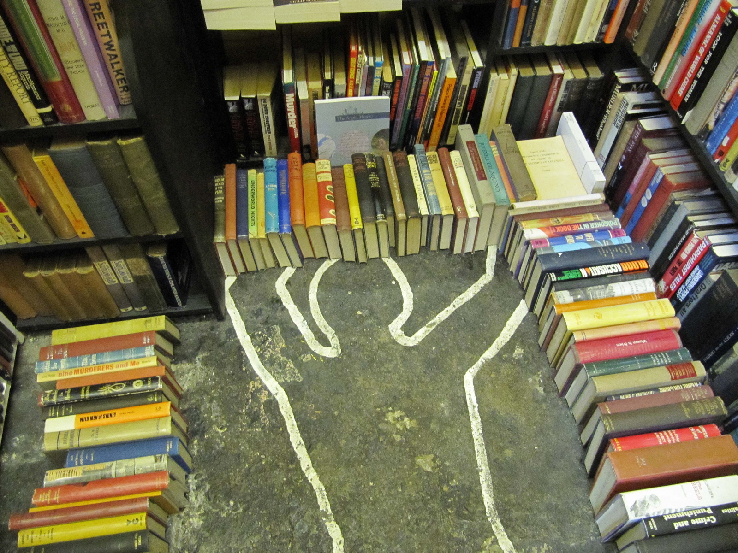
Reed teaches detective fiction
Notes:
From Reed’s course description: San Francisco detective novelist Dashiell Hammett wryly observes in _The Thin Man_, “The problem with putting two and two together is that sometimes you get four, and sometimes you get twenty-two.” Only the detective, the investigator of knowledge en route to solving a crime, would judiciously perceive that the same evidence could add up in (at least) two entirely different ways.

Slide 10

What Reed wants his students to do
Notes:
Christina Hendricks
Students reading/not reading the texts
Creative Commons "BY" license (OK to use for commercial publication)
http://blogs.ubc.ca/chendricks/2012/08/05/students-readingnot-reading-the-texts/

Slide 11
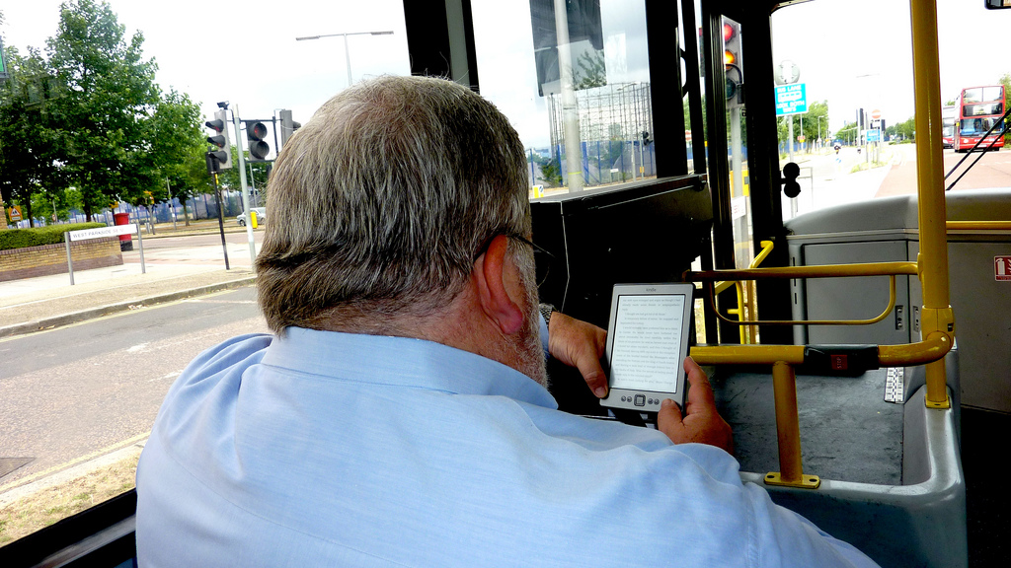
What his students actually do
Notes:
Research chat: Information scientist Alison Head on student habits
Creative Commons "BY" license (OK to use for commercial publication)
http://journalistsresource.org/skills/research/research-chat-information-scientist-alison-head

Slide 12
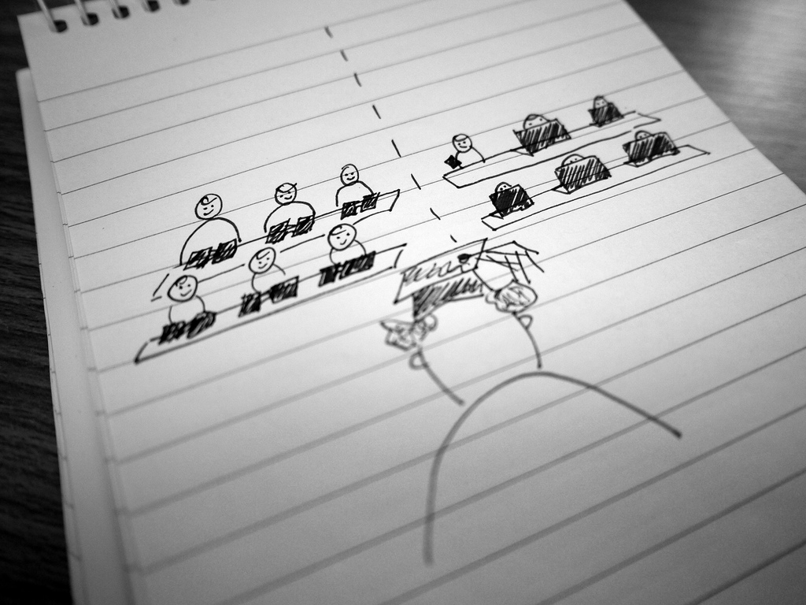
Reed is recasting his course for mobile learners
Notes:
Samia Kamal
Crossing the E-borders: The Road to Developing Online Courses
Creative Commons "BY-SA" license (OK to use for commercial publication)
http://bejlt.brookes.ac.uk/paper/crossing-the-e-boarders-the-road-to-developing-online-courses/

Slide 13
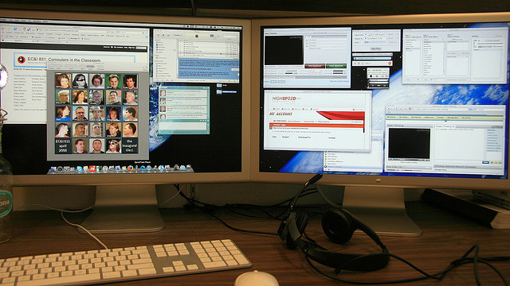
Reed’s always-on course nightmare
Notes:
24/7, always-on, technology overload
Leigh Blackall
Looking Back on FOC08
Creative Commons "BY" license (OK to use for commercial publication)
https://learnonline.wordpress.com/2008/12/19/looking-back-on-foc08/

Slide 14
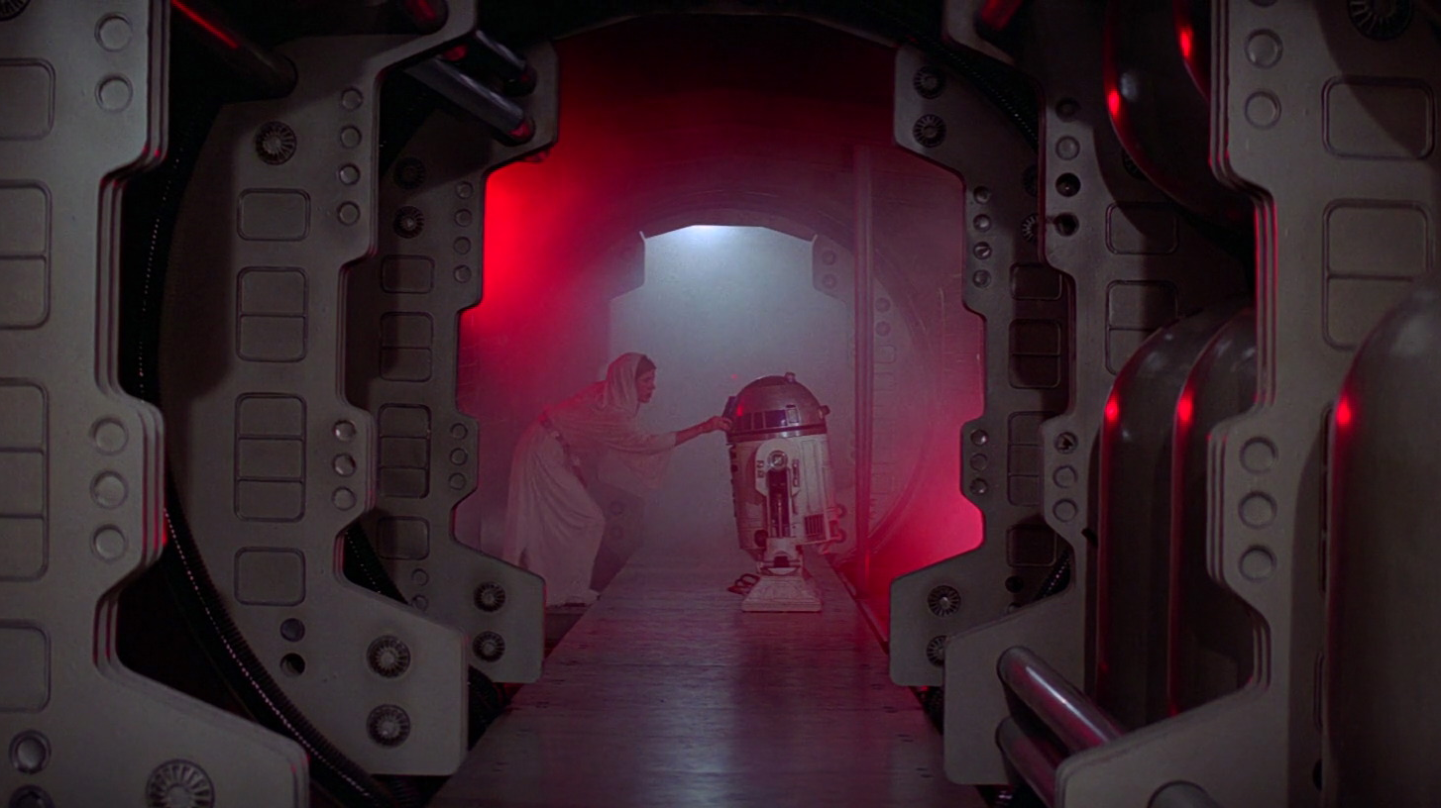
[Princess Leia: I have placed information vital to the survival of the rebellion into the memory systems of this R2 unit.]
Image ©1977 LucasFilm, used with permission from starwarsscreecaps.com

Slide 15
Help Reed connect to his students who are on mobile devices.
What one strategy could he adopt to supplement—or even replace—his face-to-face teaching?

Slide 16
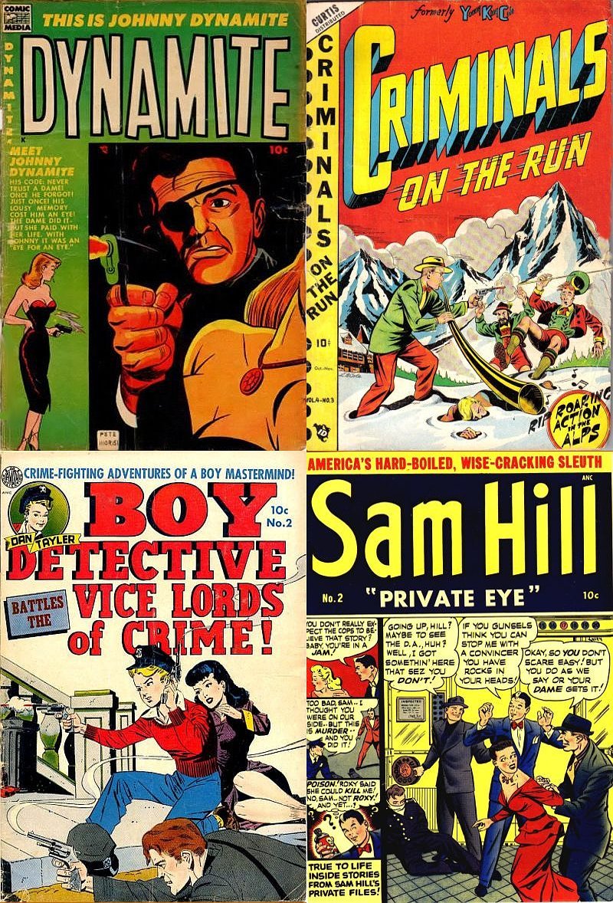
Let’s Help Reed
Universal Design for Learning = +1 ...
… learner engagement
… representing info
… action choices
Notes:
Sidebar about Center for Applied Special Technology: how developed, how spread, how adopted.
CAST: Center for Applied Special Technology
About UDL
http://www.cast.org/udl/

Slide 17
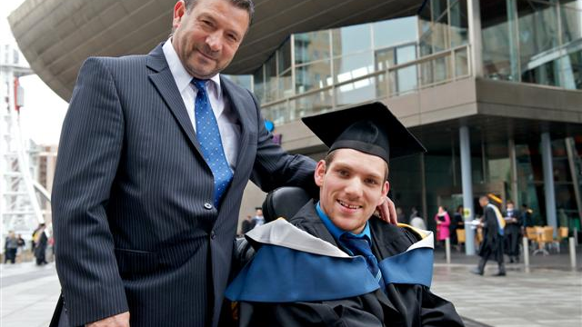

Wait a second...
Notes:
Difference between
Assistive technology (AT) = addresses specific challenges for individual learners.
Universal Design = strategies that benefit all learners through improved accessibility.
Section 508.gov
Academic Community Member
http://www.section508.gov/academic-community-member

Slide 18
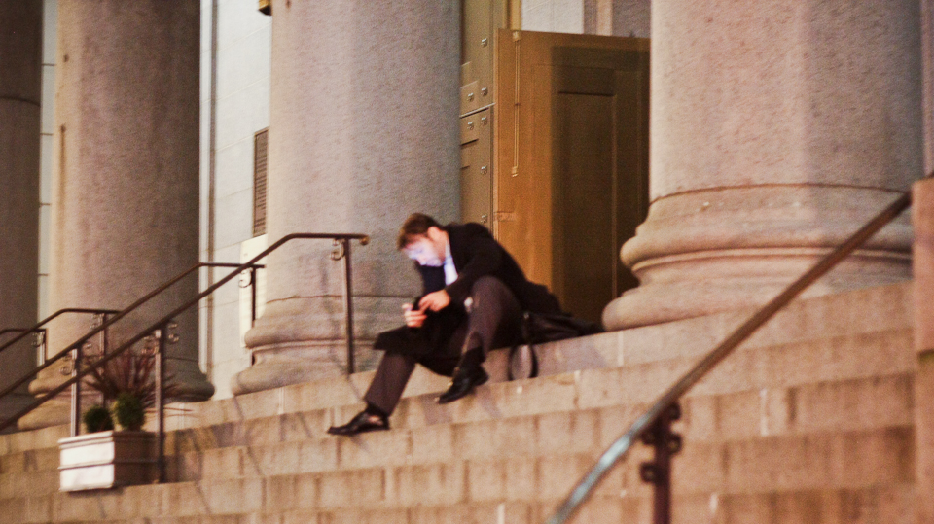
UDL = access (no matter why)
Notes:
Lots of different reasons to want universal-design elements:
Smaller screens (iPads, tablets, smart phones, laptops, desktop computers)
Differing operating systems (Mac, PC, Android, Linux)
Freedom from specific applications (PowerPoint versus PDF/web pages)
Bandwidth concerns (mobile users, remote/rural users, there are still dial-up users)
Learners-with-disability access (vision, hearing, navigation)
Susan Asselin
Universal Design for Access and Equity
Creative Commons "BY" license (OK to use for commercial publication)
http://cnx.org/content/m42278/latest/?collection=col11375/latest

Slide 19
“We want a situation that is good for everybody . . . part of it is thinking about what has to happen at the level of design that makes accommodation less necessary.”
-- Sam Johnston, CAST
Notes:
Sam Johnston, research scientist at CAST.
Conversation November 2013.
“I don’t think we have a magic bullet here, and that’s a good thing.”
Community colleges spending $2B before 2023 to build out curricula and courses with high labor-force demand.
Partnership among CAST, Carnegie Mellon U, Stanford, Creative Commons, Washington State Board of Community & Technical Colleges: new open-learning initiative.
Five areas of focus:
1. assessment (getting beyond multiple choice)
2. optimize the learning climate (policy & legal applications)
3. UDL tools & features (planning & strategy)
4. planning individual courses (syllabus and design)
5. media & technology (close to completed during 2014)

Slide 20

Reed’s Video
Notes:
Reed sat in front of the camera and talked about one of the books the class was reading. That was just the start of the process.
HowTo.gov
Create Section 508-Compliant Videos on Your Government Websites
http://www.howto.gov/social-media/video/508-compliant-video-guide

Slide 21

Five strategies for UDL
Notes:
Text
Alternative formats
Multiple student-work formats
Break concepts into steps/chunks
Set content free (of local applications)

Slide 22
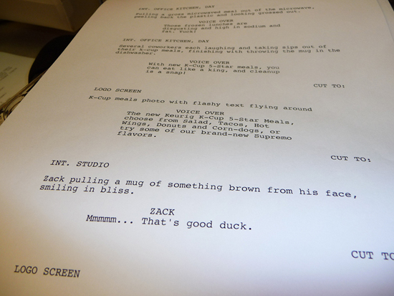
Strategy 1: start with text.
Notes:
Using text as a foundation creates an instant accessible version, and avoids the “um, uh” and off-topic “bird walking” that profs are prone to.
CTL: Welcome to NEIU - Course Modes - Promo Video
http://homepages.neiu.edu/~ctl/Script.html

Slide 23
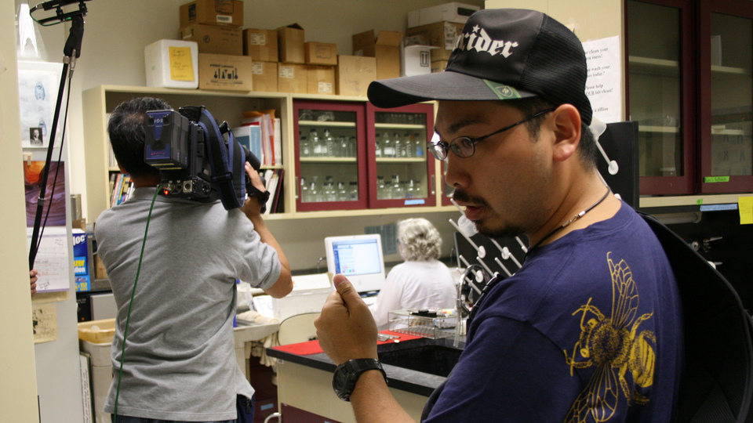

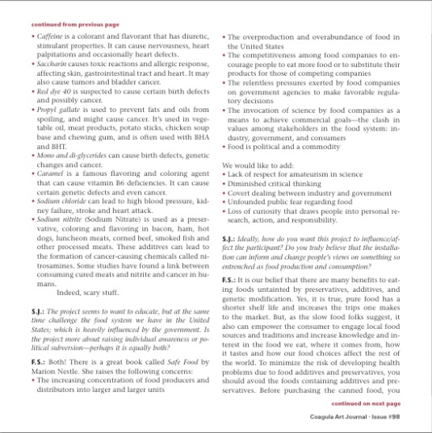
Strategy 2: make alternatives.
Notes:
Video provides still images.
Screen demos refer to scripts.
A good example is the federal government—the IRS offers its tax forms in text-only and Braille formats.
IRS Accessible Tax Forms (in Braille and Text Formats)
http://www.irs.gov/uac/IRS-Accessible-Tax-Forms-(in-Braille-and-Text-Formats)

Slide 24
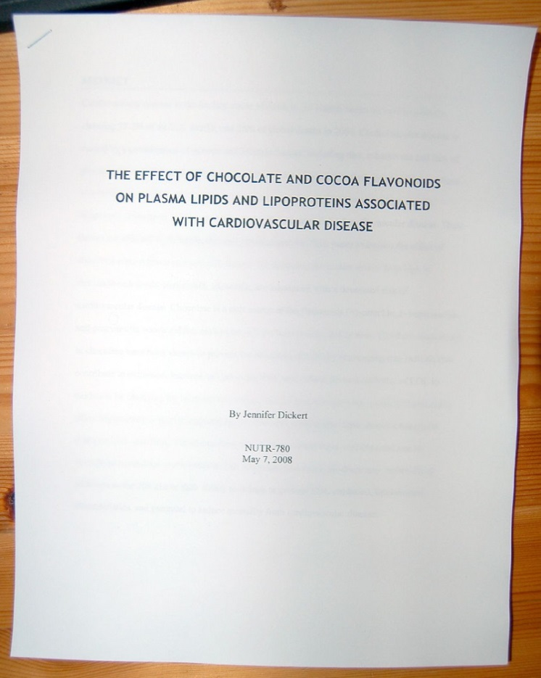
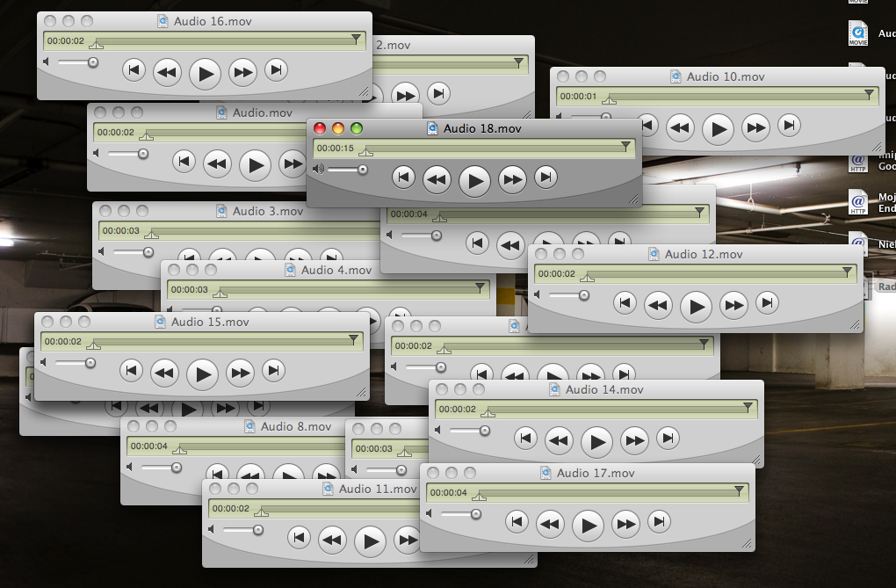
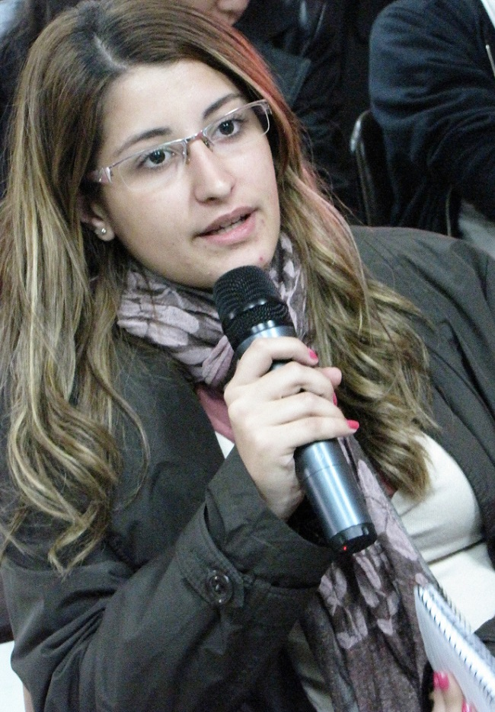
Strategy 3: let ‘em do it their way.
= =
Notes:
In most Learning Management Systems, the dropbox tool can accept any kind of file.
This is sometimes a hindrance (asking for written work produces, doc, .docx, .wps, WordPad, OpenOffice, etc).
However, defining formats for various media can offer students multiple paths to demonstrating skills.
If the same criteria are applied to evaluating student work, the format should not be a consideration for many assignments.

Slide 25
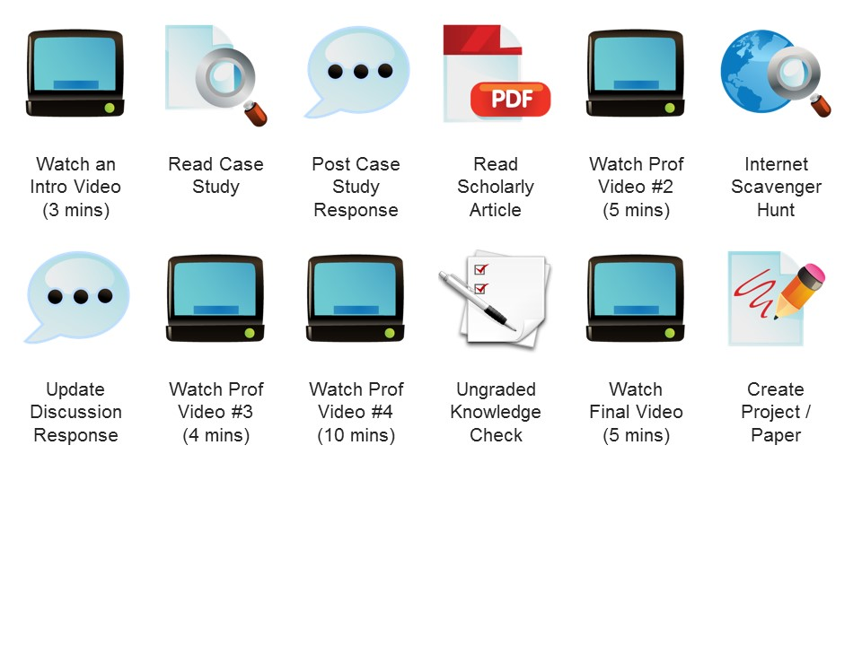
Strategy 4: go step by step.
Notes:
Chunking content into discrete one-concept pieces helps students to consume smaller files (helps with bandwidth).
Also helps with information retention.
Also helps if you have to re-record or update (just 3 minutes, rather than an hour).
Showing the structure to students helps them to anticipate, prepare, experience, and review.
Wikipedia
Instructional scaffolding
Creative Commons "AT-SA" license (OK to use for commercial publication)
http://en.wikipedia.org/wiki/Instructional_scaffolding

Slide 26



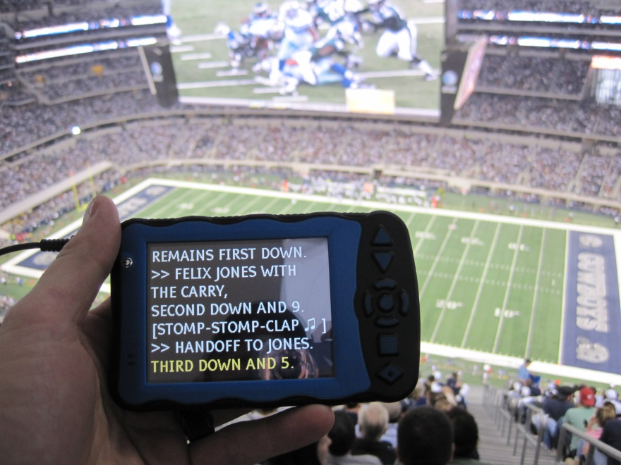



Strategy 5: set content free.
X
Notes:
Universal design asks us to set content free from the clock—students can review on their own time, repeatedly if need be.
Also, set content free from specific applications: use formats that do not require specific programs for use (PDF vs PowerPoint), or that stream via web pages (YouTube videos).
Products like Audacity, Jing, Screencast-o-Matic, Screenr, and VoiceThread.

Slide 27
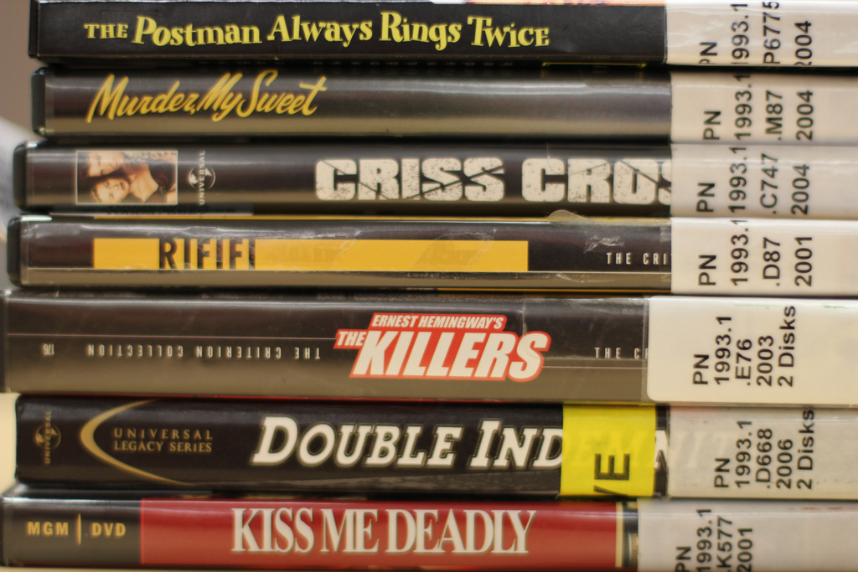
Checking in with Reed
Notes:
Review participant strategies from Thought Exercise 1.

Slide 28
Start new design processes with text.
Create alternatives for all multimedia.
Design alternate ways for learners to demonstrate each course objective.
Break up tasks into separate components.
Expand, document, and share interactions in online courses using free or low-cost tools.

Slide 29
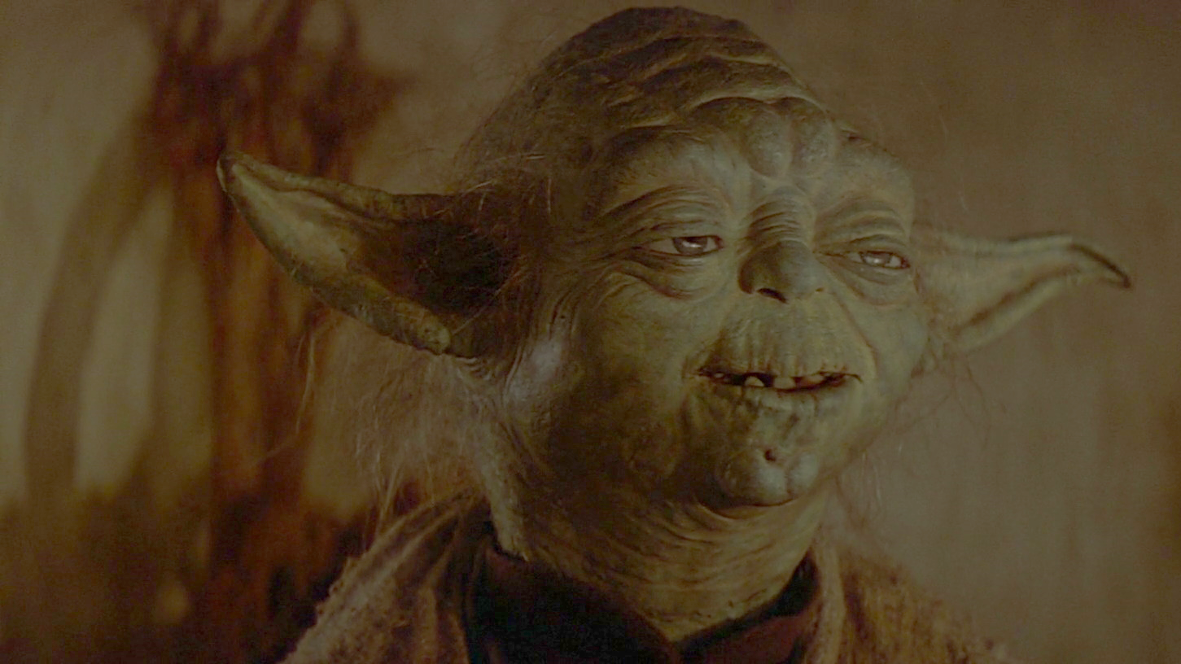
[Yoda: No more training you require.
Already know you that which you need.]
Image ©1980 LucasFilm, used with permission from starwarsscreecaps.com

Slide 30
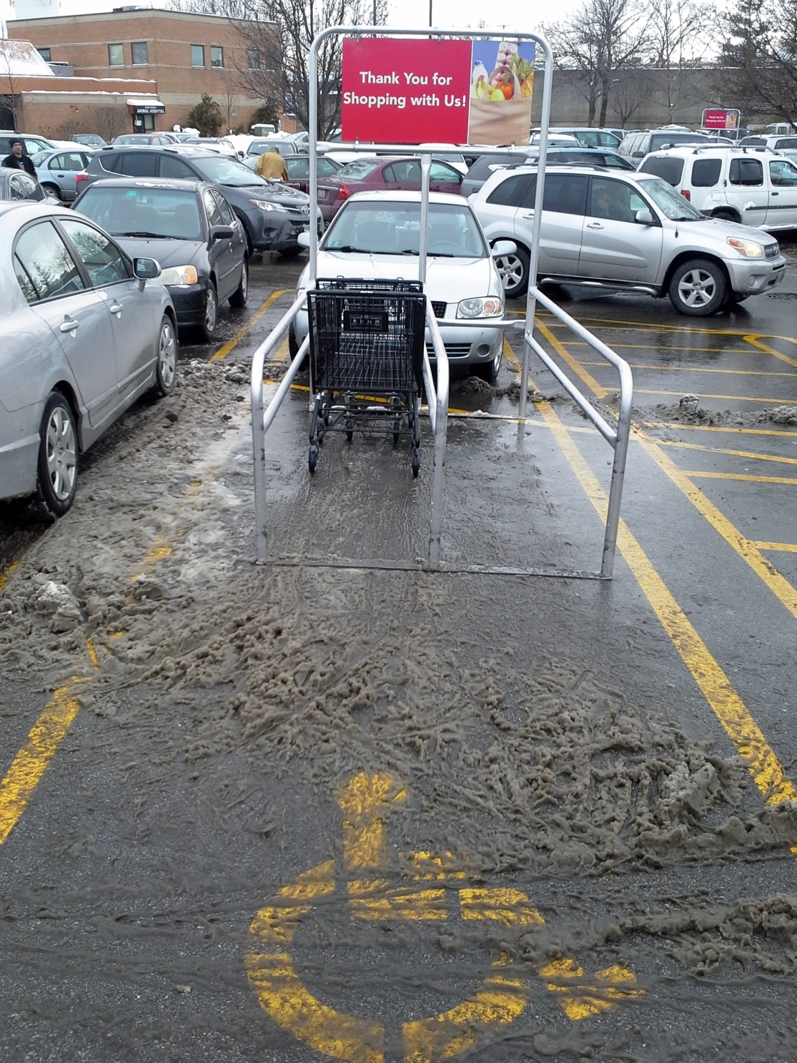
The need to make changes is not always this obvious.
Image ©2014 Thomas J. Tobin

Slide 31
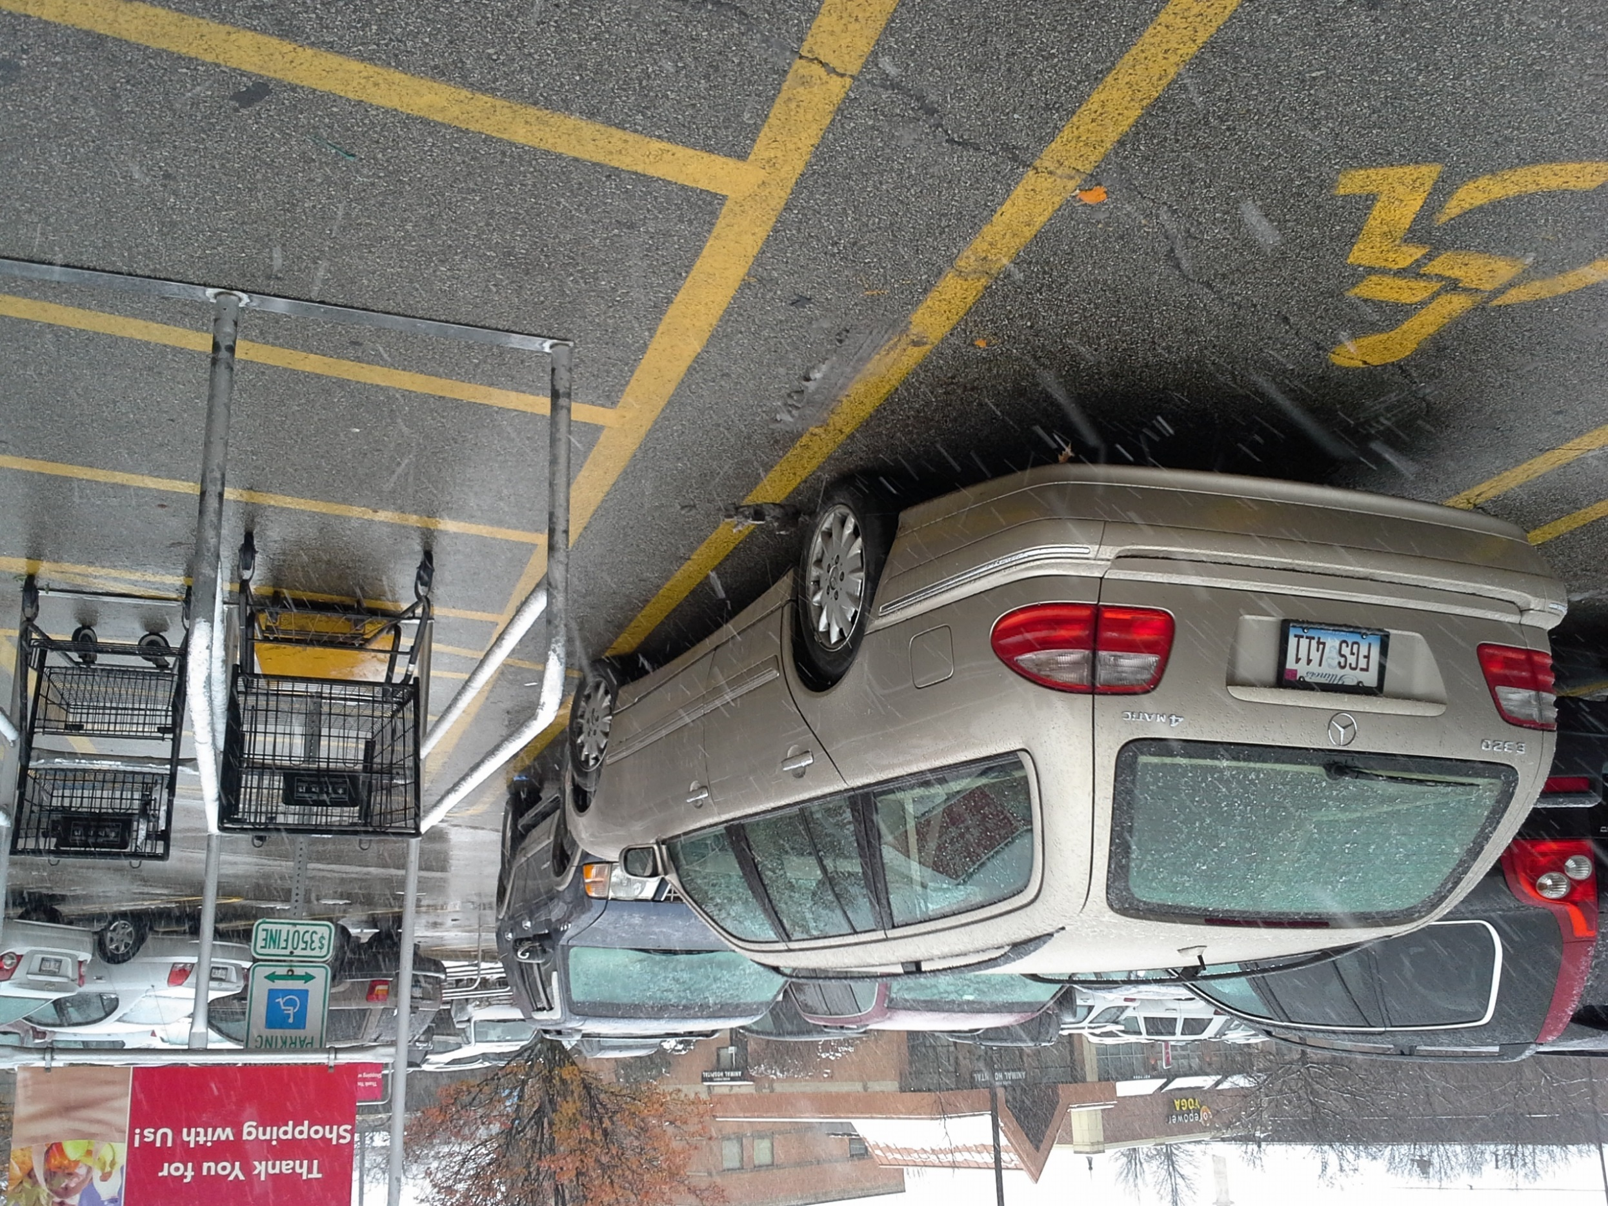
Image ©2015 Thomas J. Tobin

Slide 32
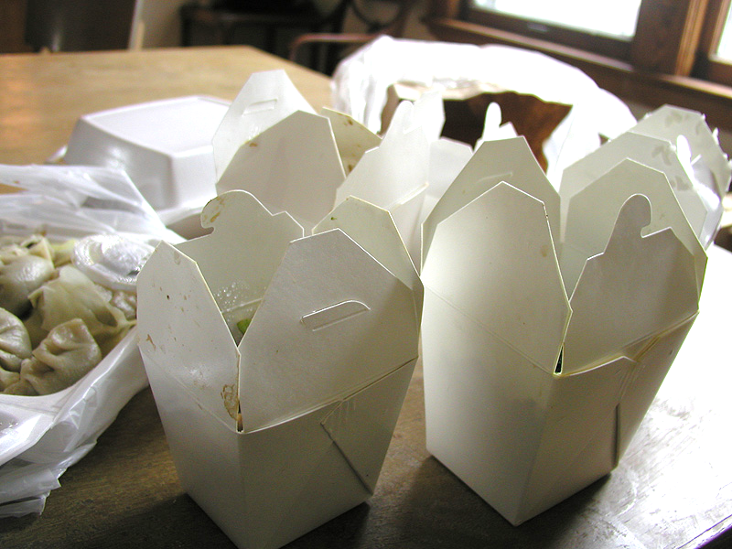
Take-Aways
Image © 2007 Scott J. Waldron, used under CC-BY license from Flickr.com

Slide 33
THANK YOU!
t-tobin@neiu.edu

