Slide 1
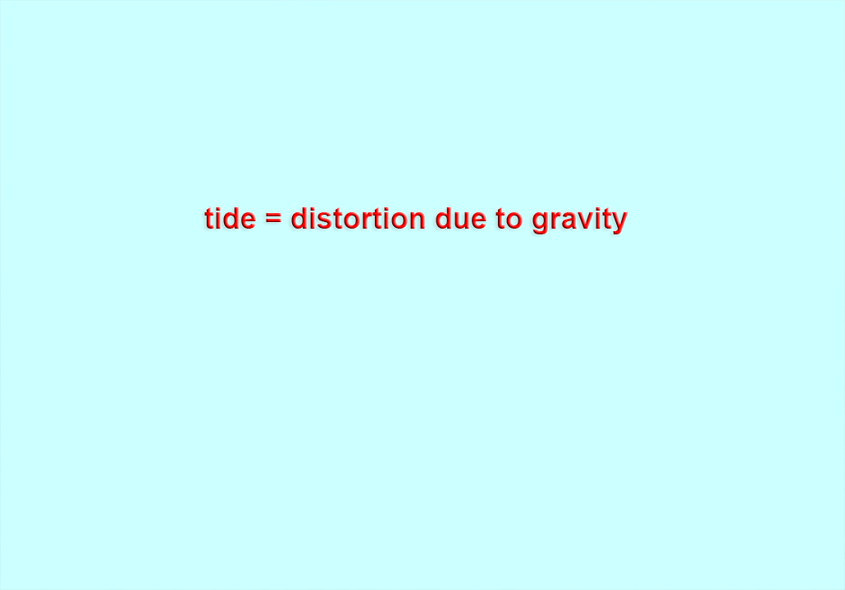
Physics of Tides: https://youtu.be/3RdkXs8BibE

Slide 2
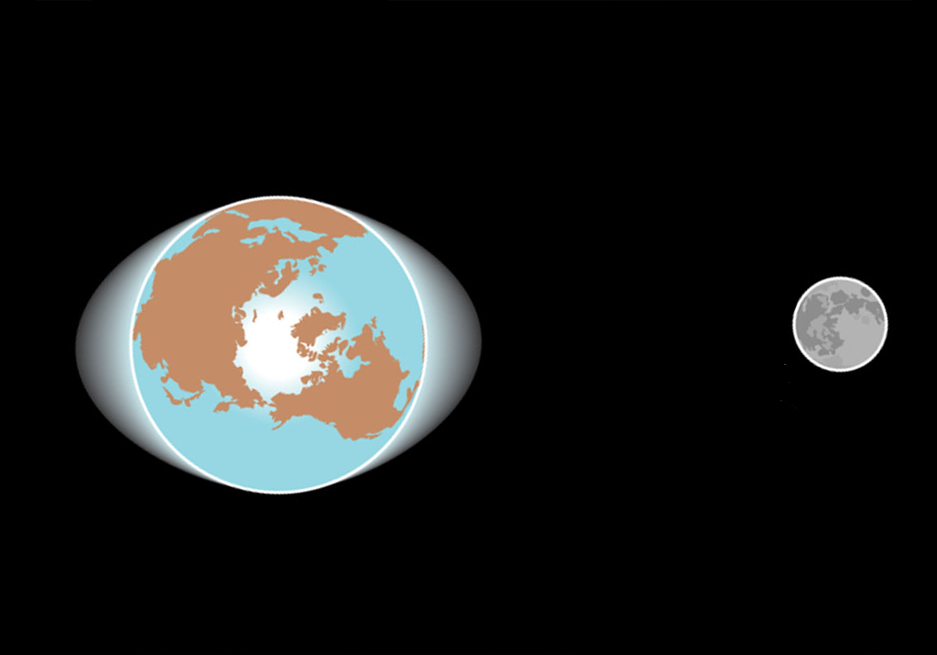
scale greatly exagerated!

Slide 3
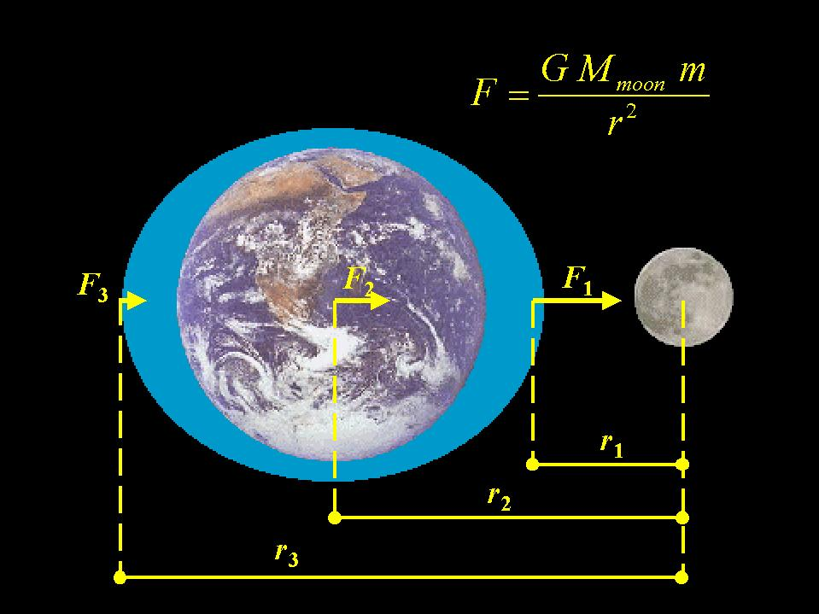
earth

Slide 4
earth
r_{near}
r_{middle}
r_{far}

Slide 5
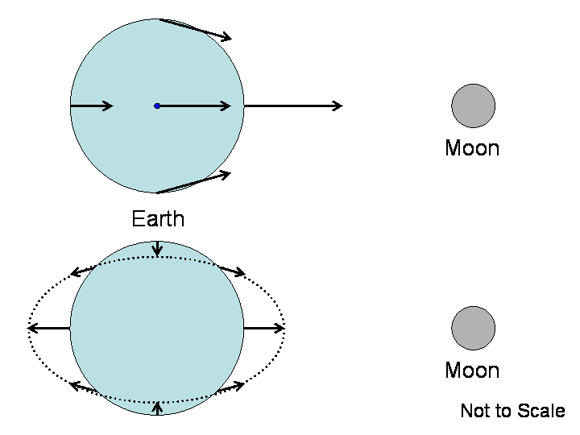
This bulging on both sides of the Earth can be shown mathematically by VECTORS
Consider the arrows which represent the force of the Moon on different parts of Earth. These are called vectors. Their length indicates gravitational strength. Their direction is toward the center of the Moon.

Slide 6
If you subtract the center vector in the diagram from all the other vectors,

Slide 7
If you subtract the center vector in the top diagram from all the other vectors,
this puts you in Earth's rest frame.

Slide 8
Earth spins but the bulge always points toward the Moon,
so we experience 2 low tides and 2 high tides in 24 hrs

Slide 9
this person would experience a low tide

Slide 10
At sunset, this person would experience a high tide

Slide 11
At midnight, this person would experience a low tide

Slide 12
At sunrise, this person would experience a high tide

Slide 13
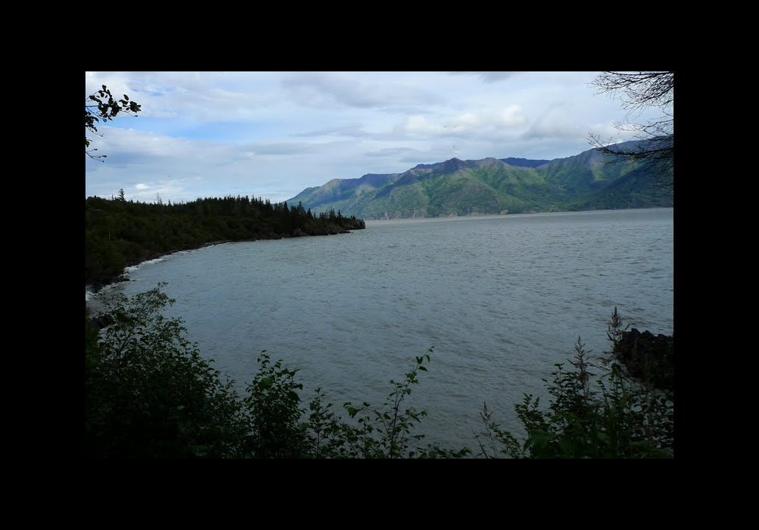
high tide

Slide 14
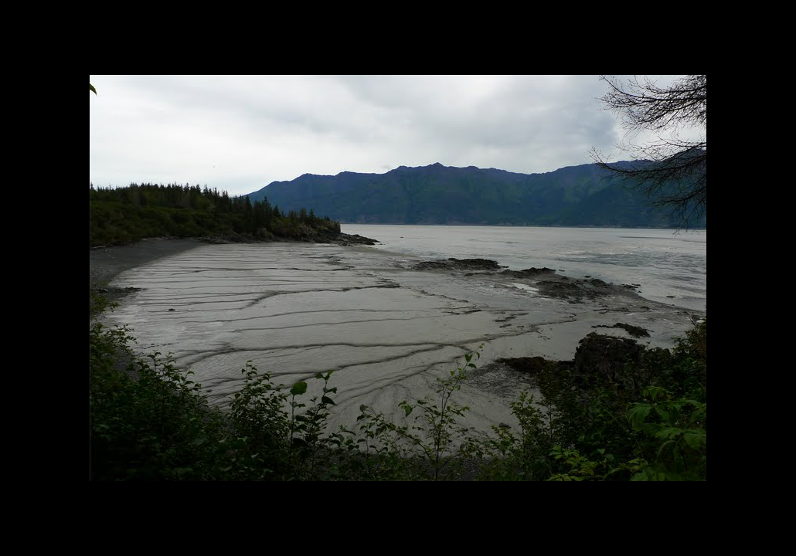
low tide

Slide 15
But the Sun plays a role, too, in tides on Earth, although only about half as much as the Moon

Slide 16
If Sun and Moon pull in different directions it affects the height and depth of the tides — the bulge must face toward the Moon at all times

Slide 17
When Moon and Sun are in a straight line through Earth — either at New Moon or…

Slide 18
… at Full Moon the highs will be extreme and the lows will be extreme —
Spring Tides

Slide 19
When Moon and Sun are at 90 degrees relative to Earth — either at 3rd Quarter or…

Slide 20
At 1st Quarter the highs are weak and the lows are weak
Neap Tides

Slide 21
Earth spins 29 times for each time the Moon goes around once, yet Earth's bulge faces toward the Moon at all times

Slide 22
This causes FRICTION and the Earth is slowing its rotation

Slide 23
Our 24 hr day is getting longer by 0.0017 sec per century

Slide 24
Fossil evidence shows that about 400 million yrs ago, one day was 22 hrs!

Slide 25
The Moon's spin slowed fast a long time ago — the result is that now the Moon's rotation rate = orbital period

Slide 26
Video:
https://youtu.be/6jUpX7J7ySo
This is why the SAME side of the Moon always faces EARTH — we call this phenomenon TIDAL LOCK

Slide 27
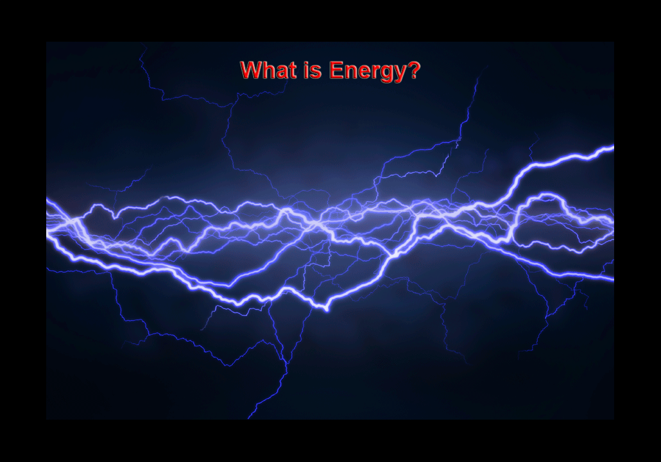

Slide 28
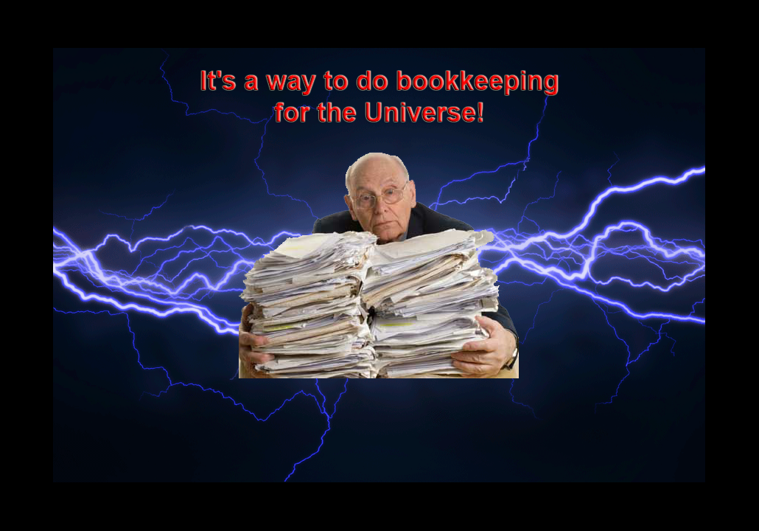

Slide 29
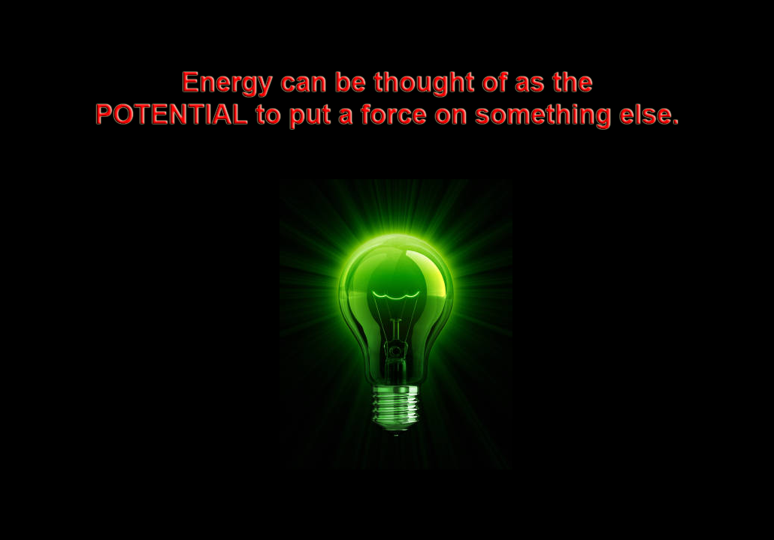

Slide 30

For example, MONEY has the POTENTIAL to buy things

Slide 31
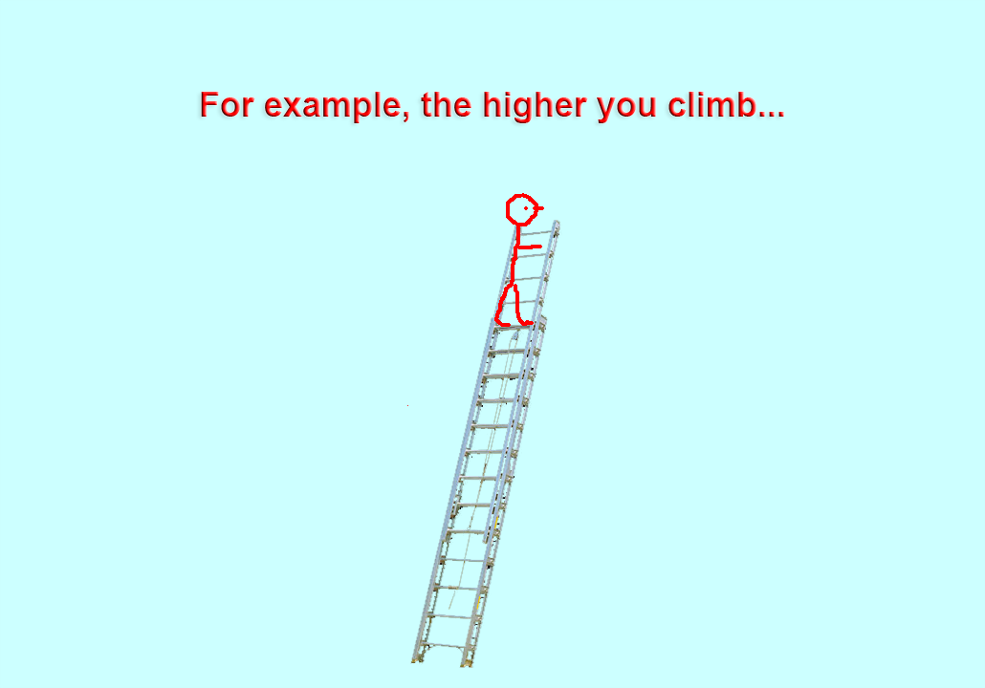

Slide 32
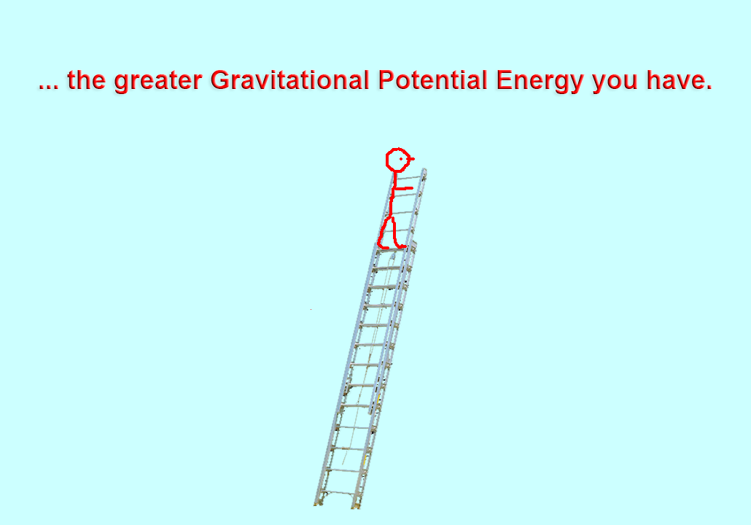

Slide 33
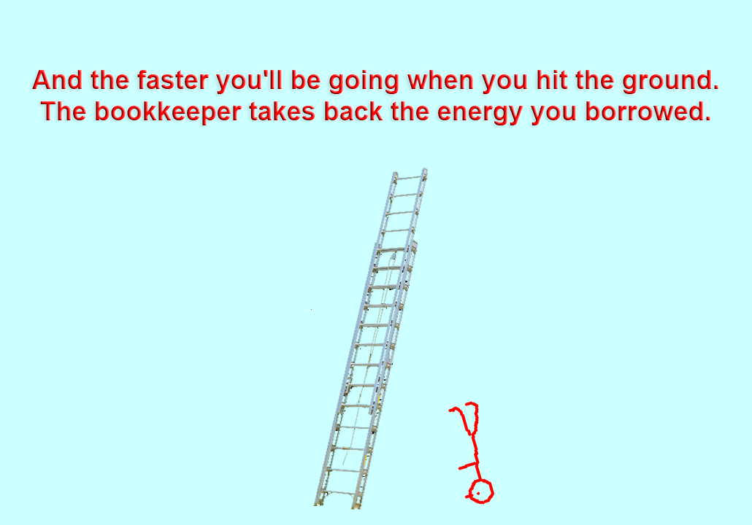

Slide 34
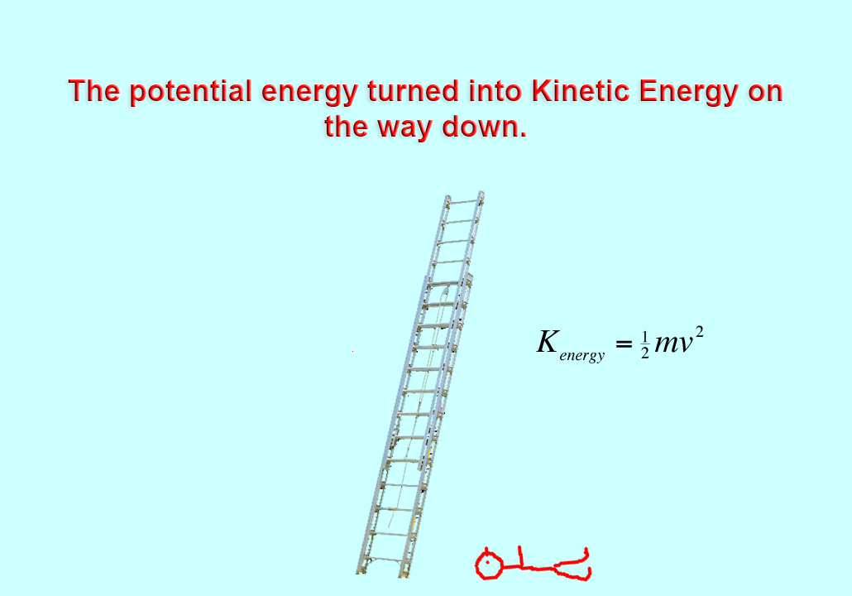

Slide 35
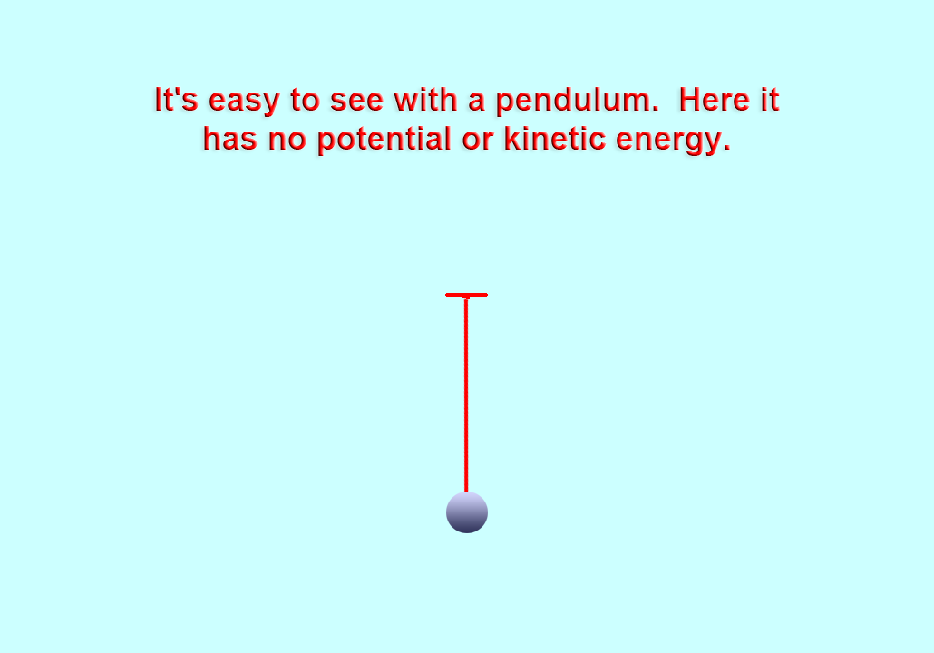

Slide 36
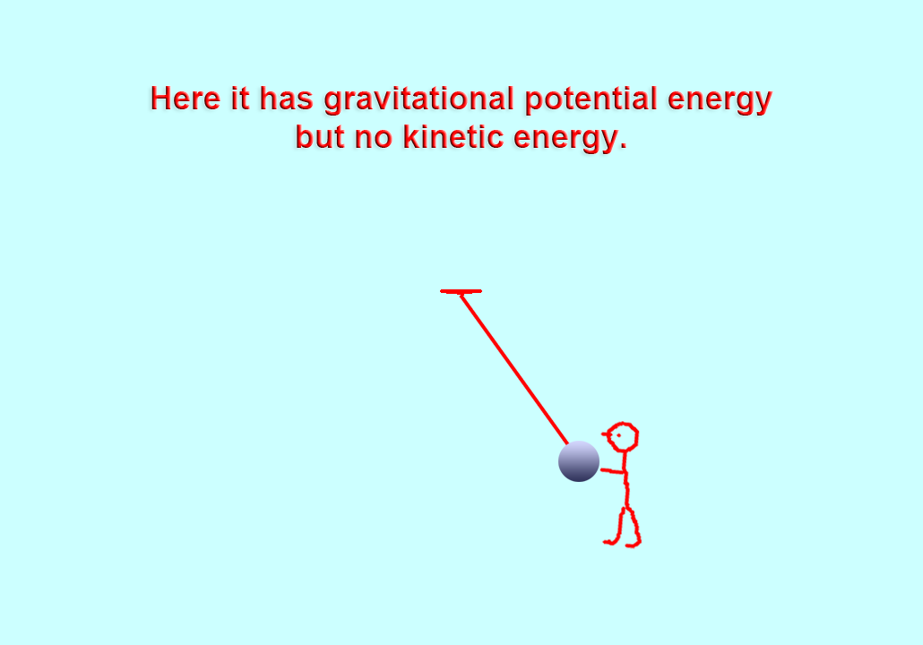

Slide 37
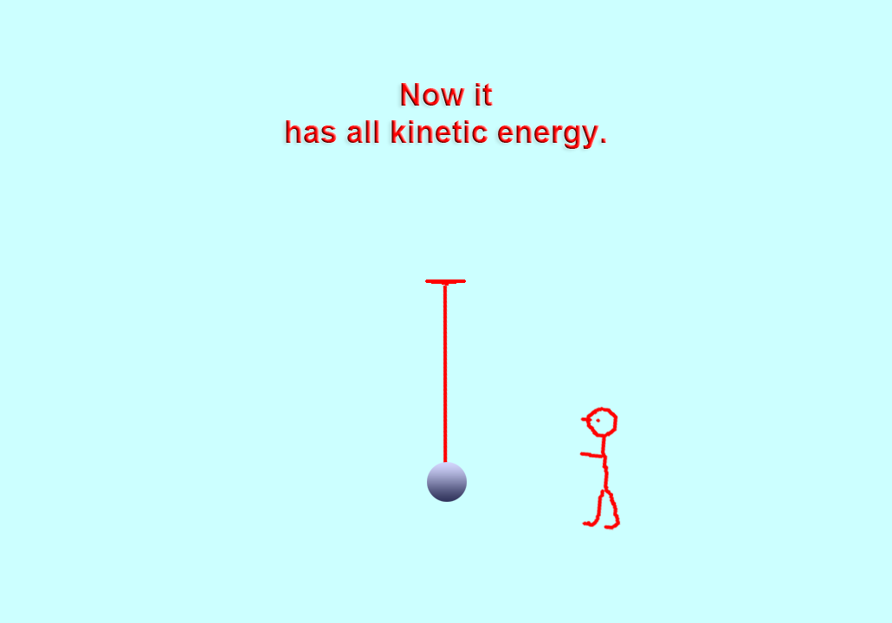

Slide 38
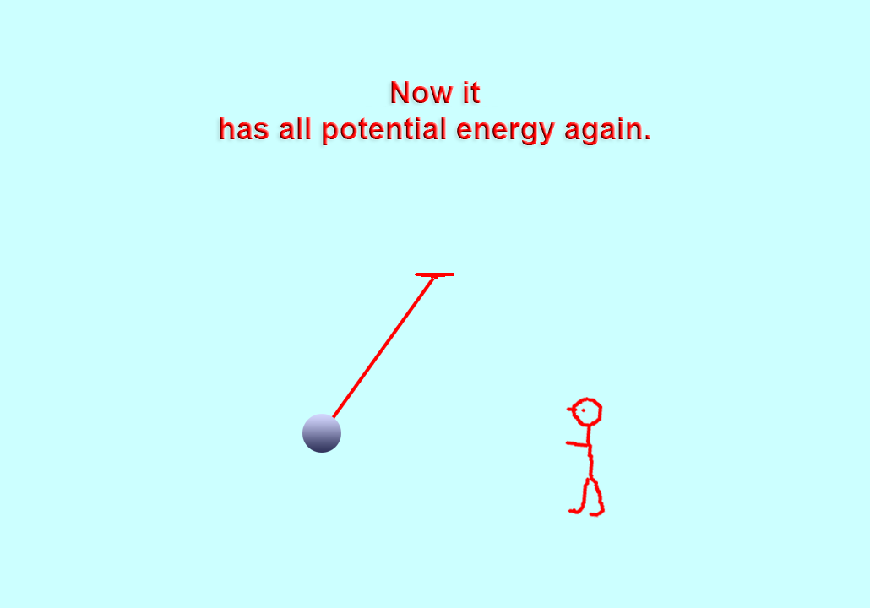

Slide 39


Slide 40
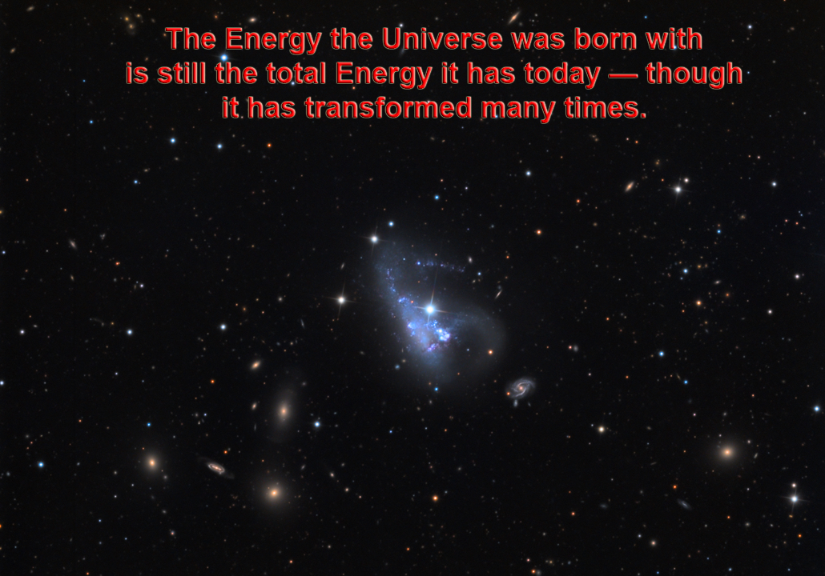

Slide 41
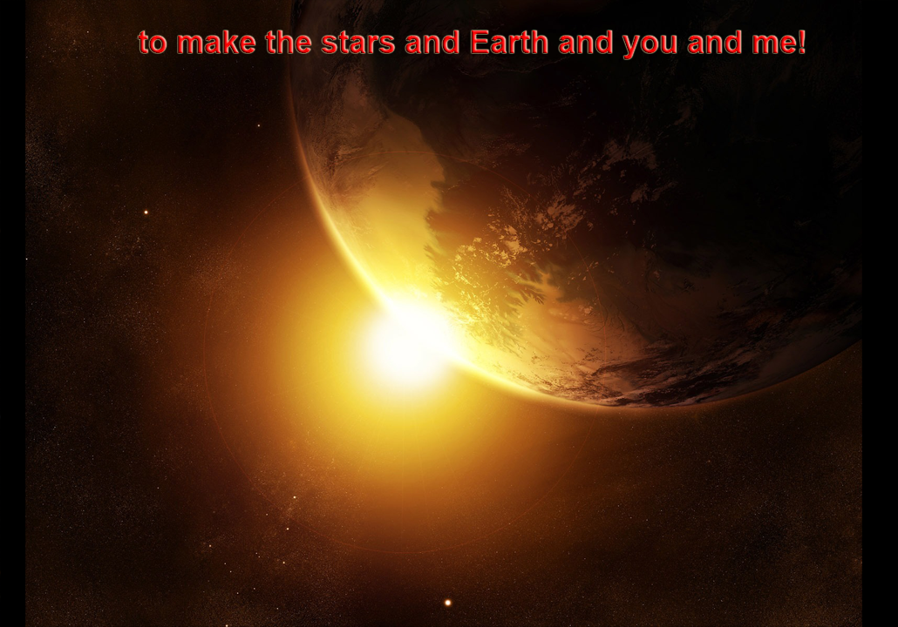

Slide 42
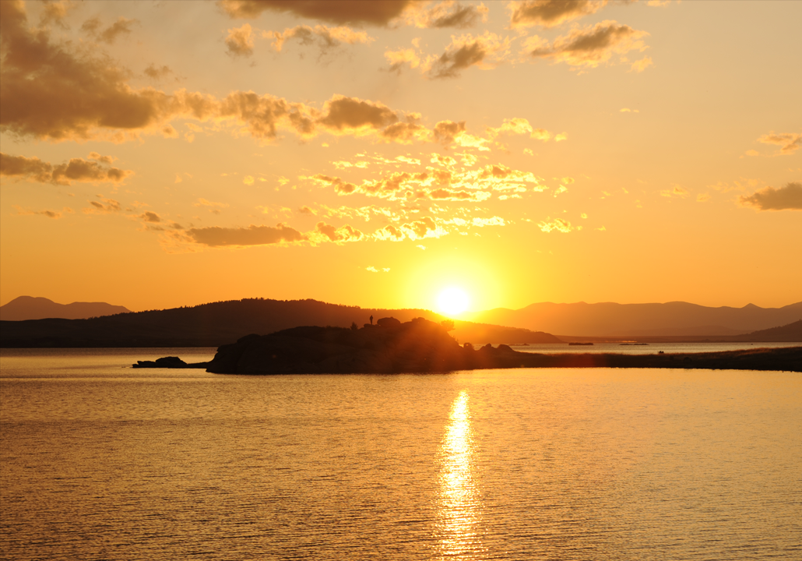

Slide 43
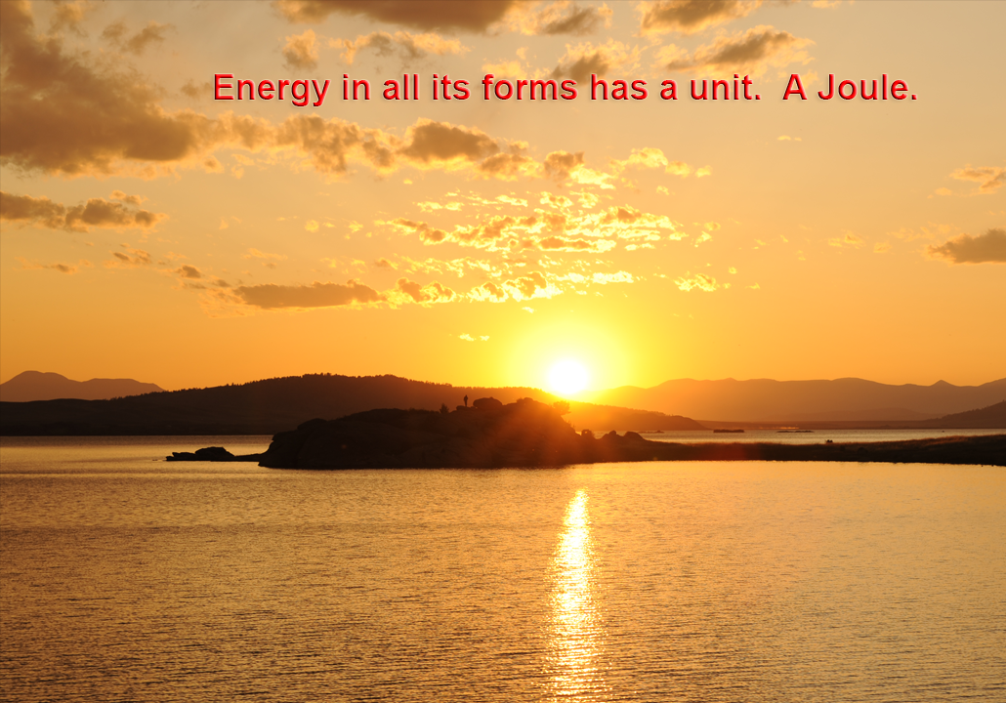

Slide 44
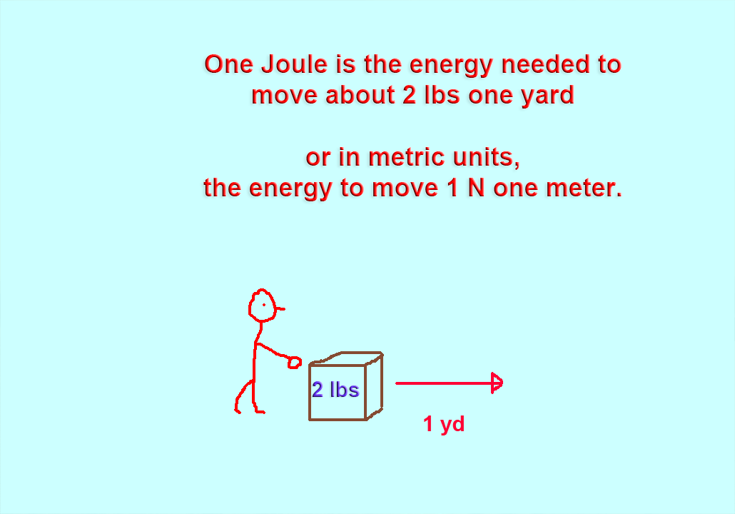

Slide 45
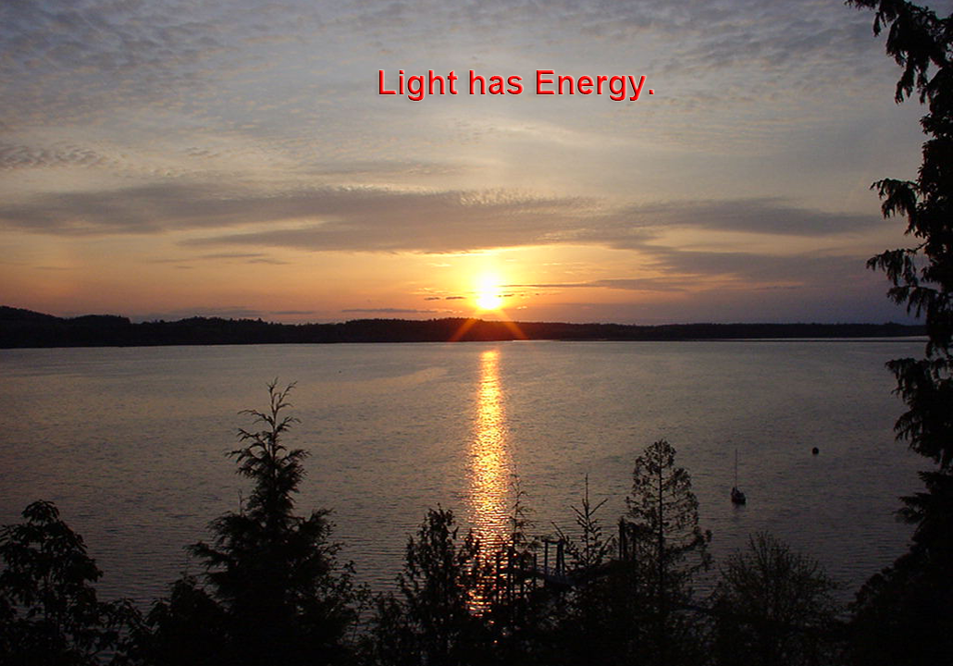

Slide 46
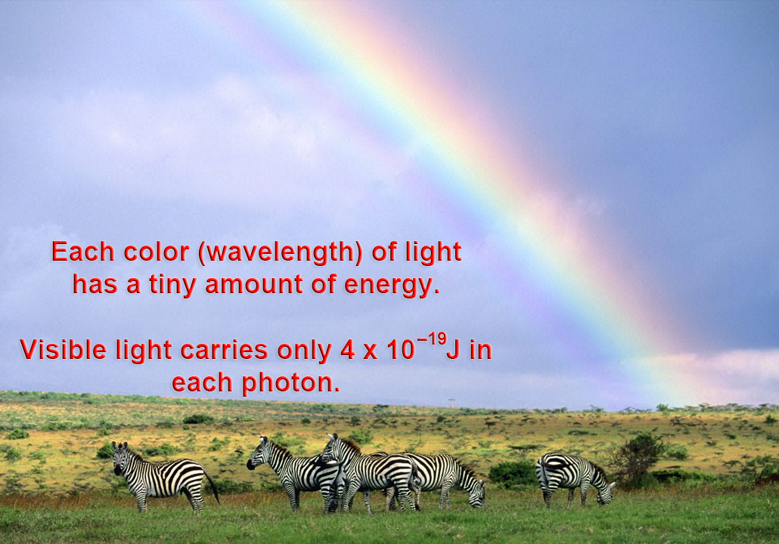

Slide 47
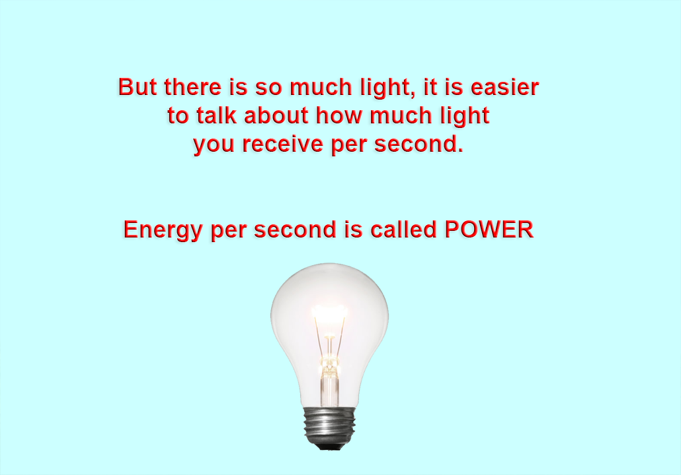

Slide 48
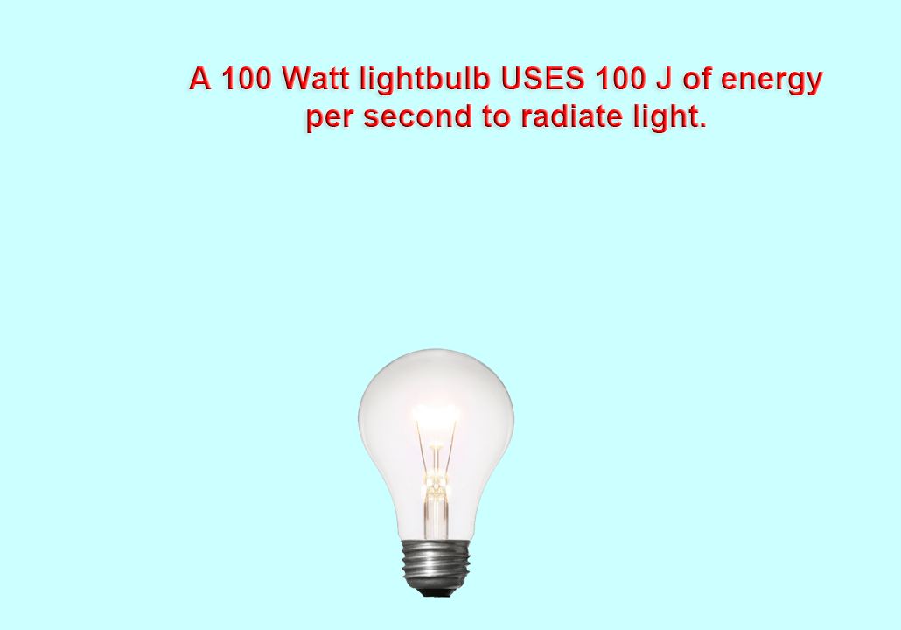

Slide 49
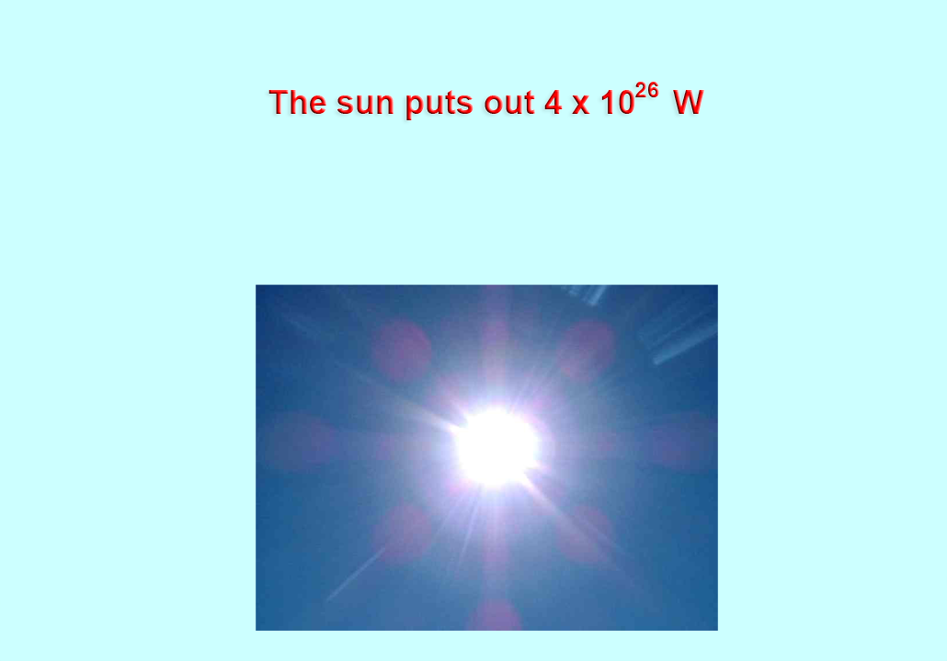

Slide 50
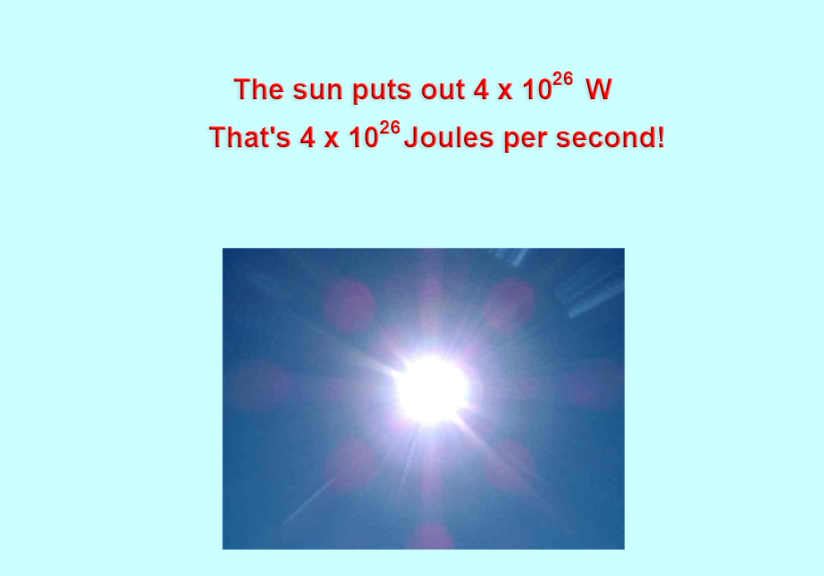

Slide 51
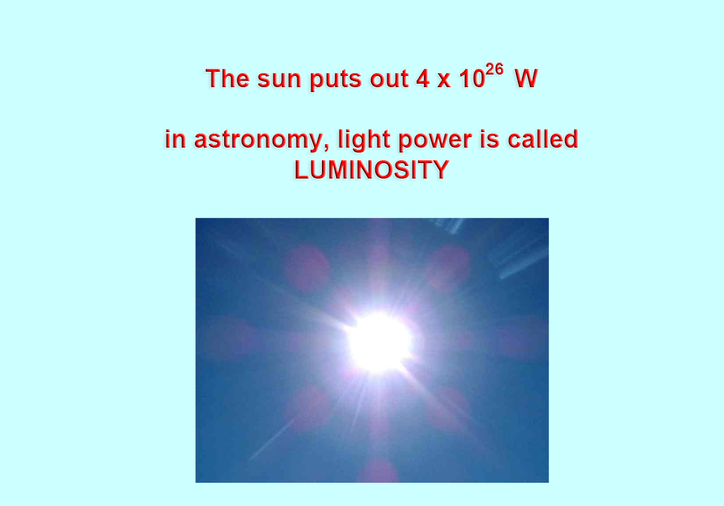

Slide 52
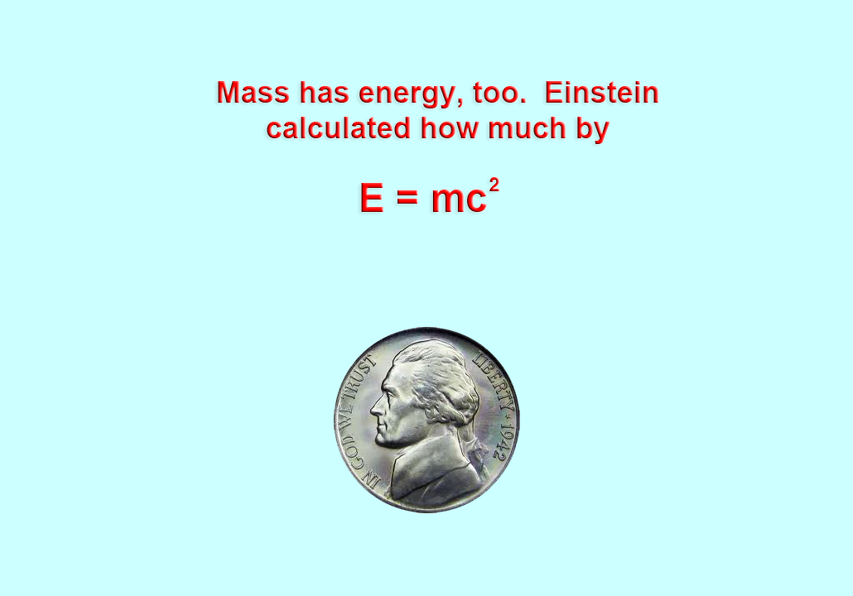

Slide 53
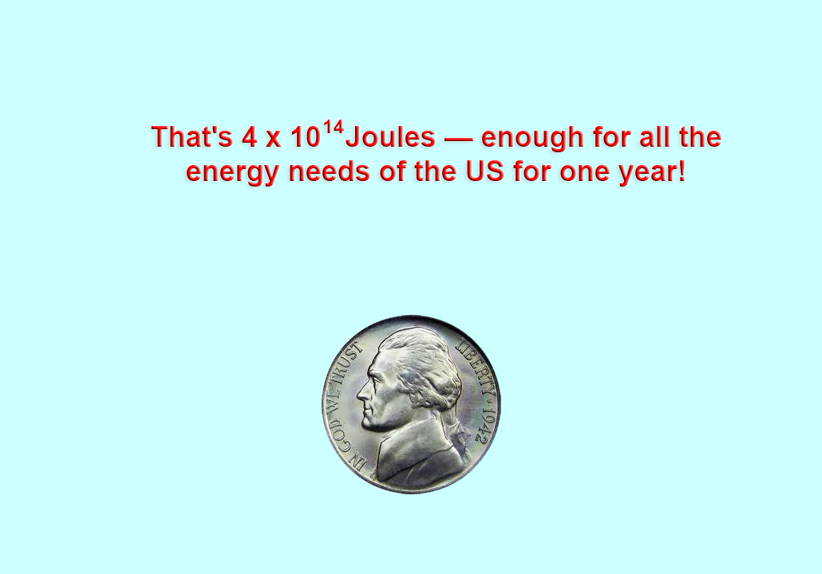

Slide 54
$ 40 x 10¹² 40 trillion dollars!!

Slide 55
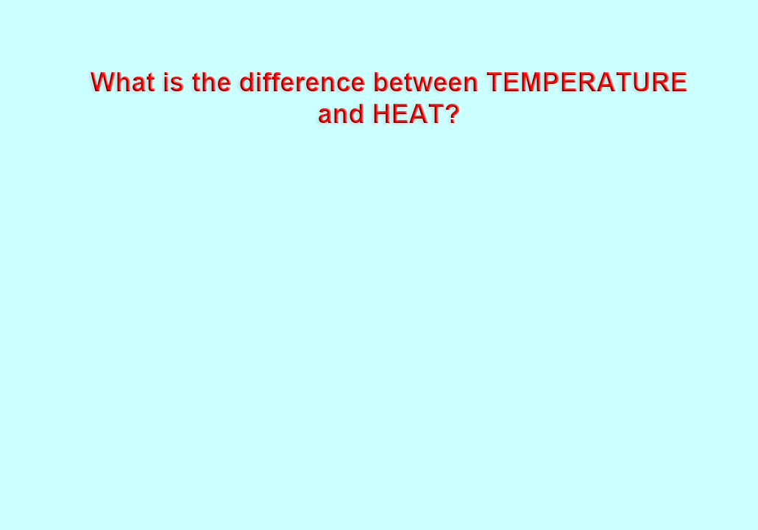

Slide 56
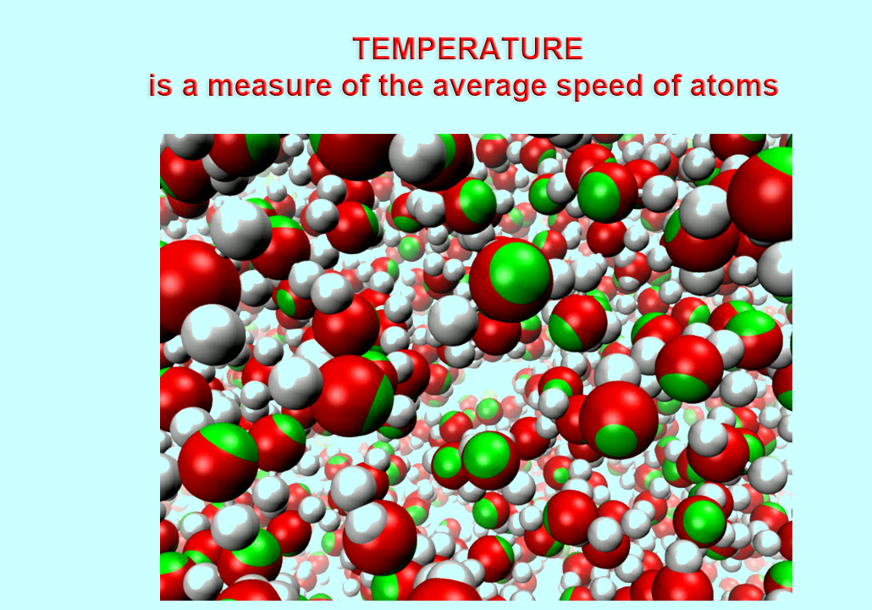

Slide 57
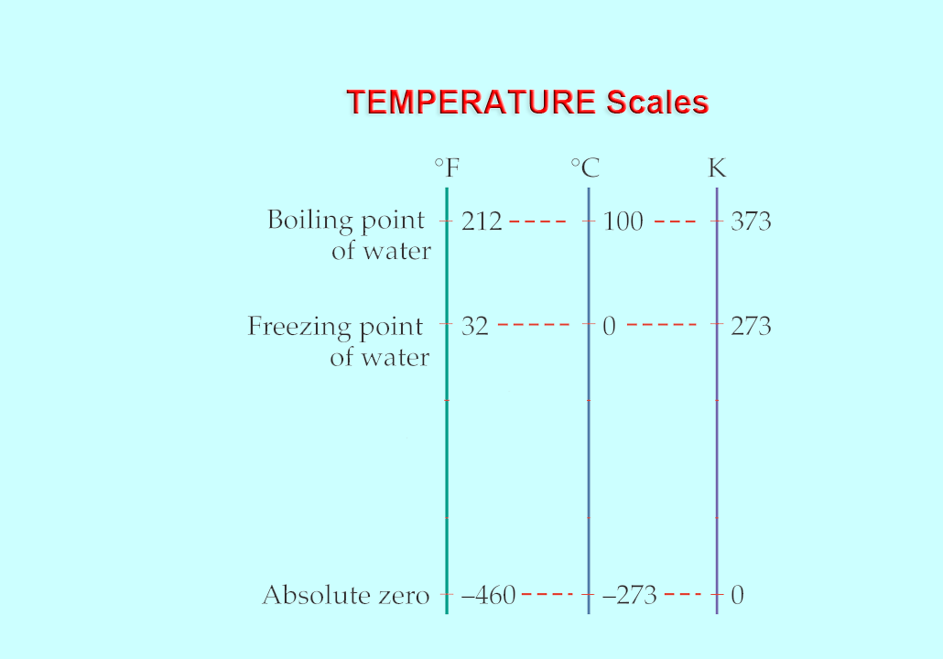

Slide 58
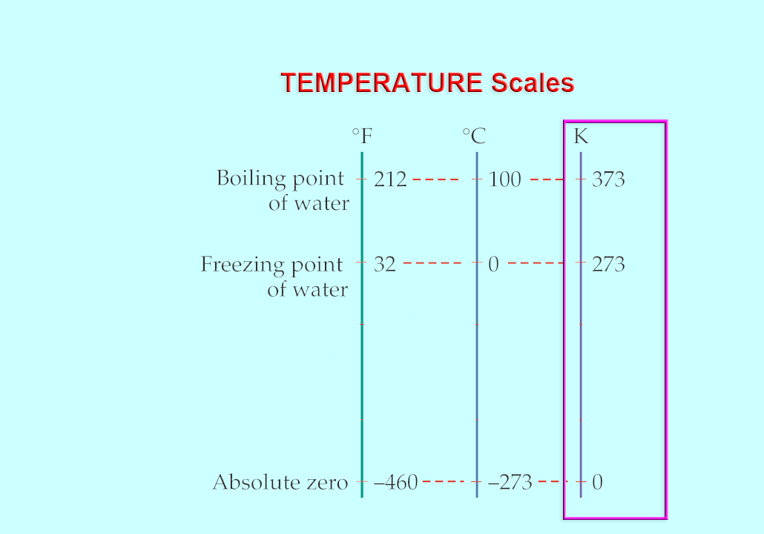

Slide 59
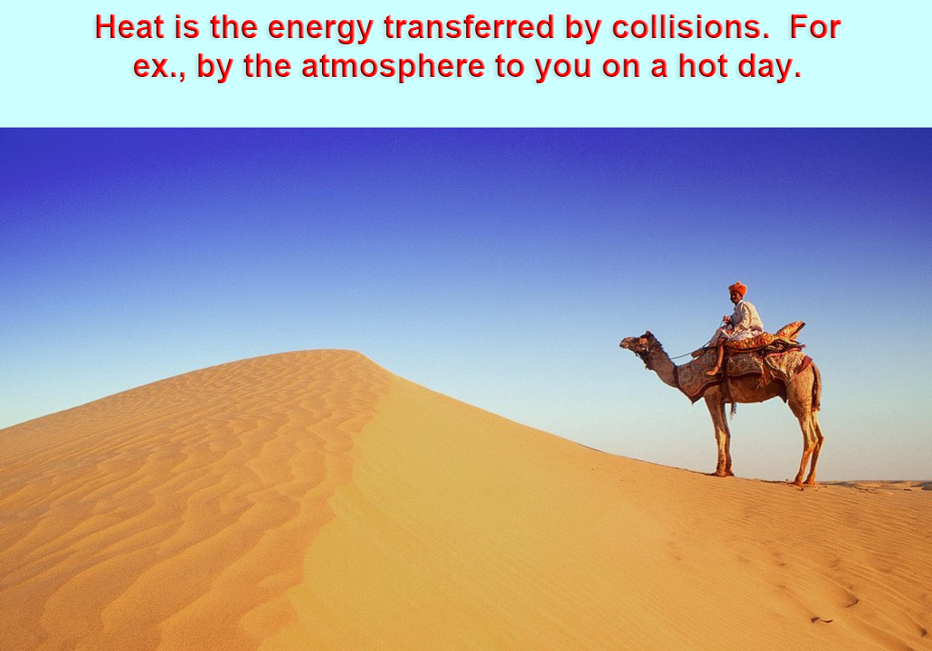

Slide 60
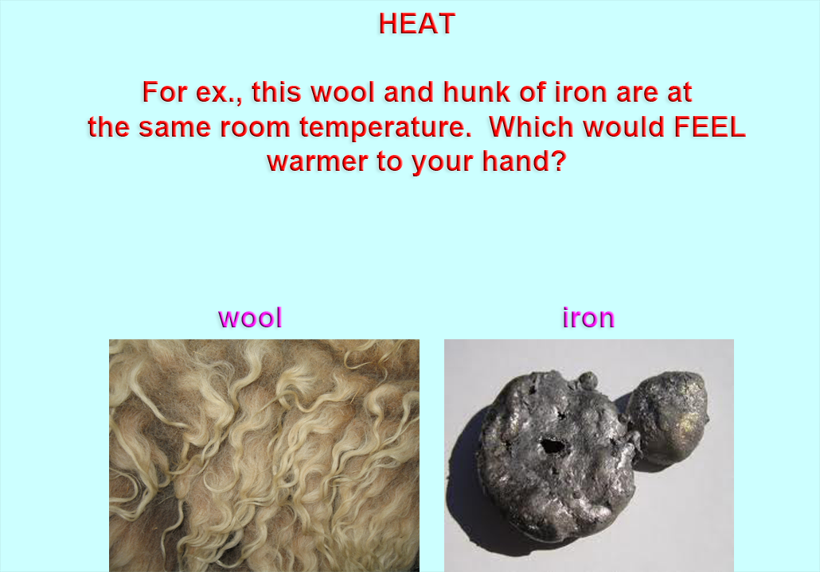

Slide 61
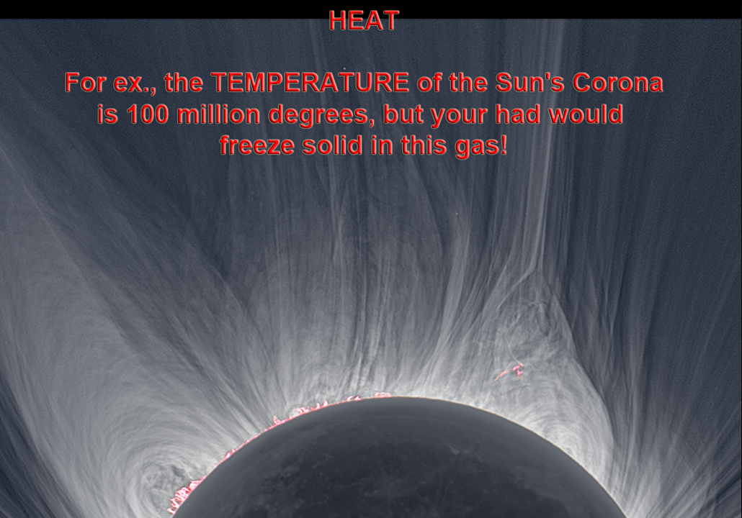
hand

Slide 62
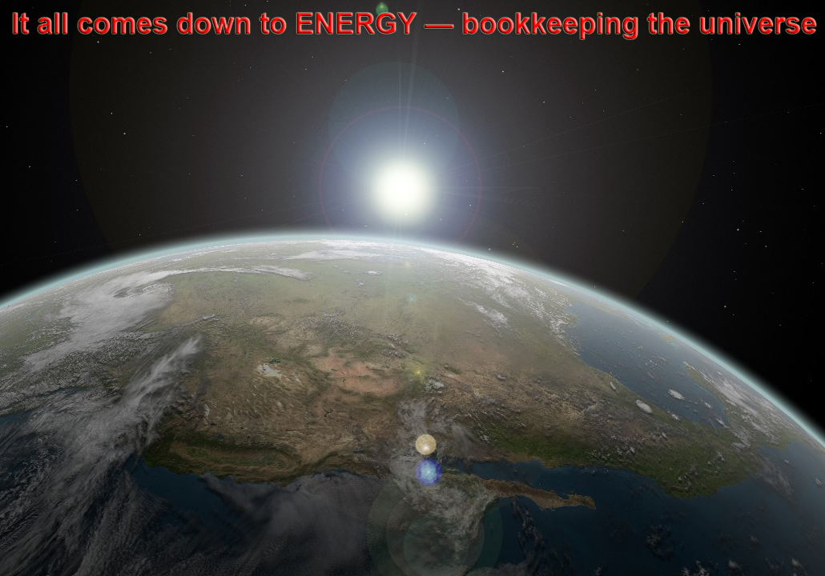

Slide 63
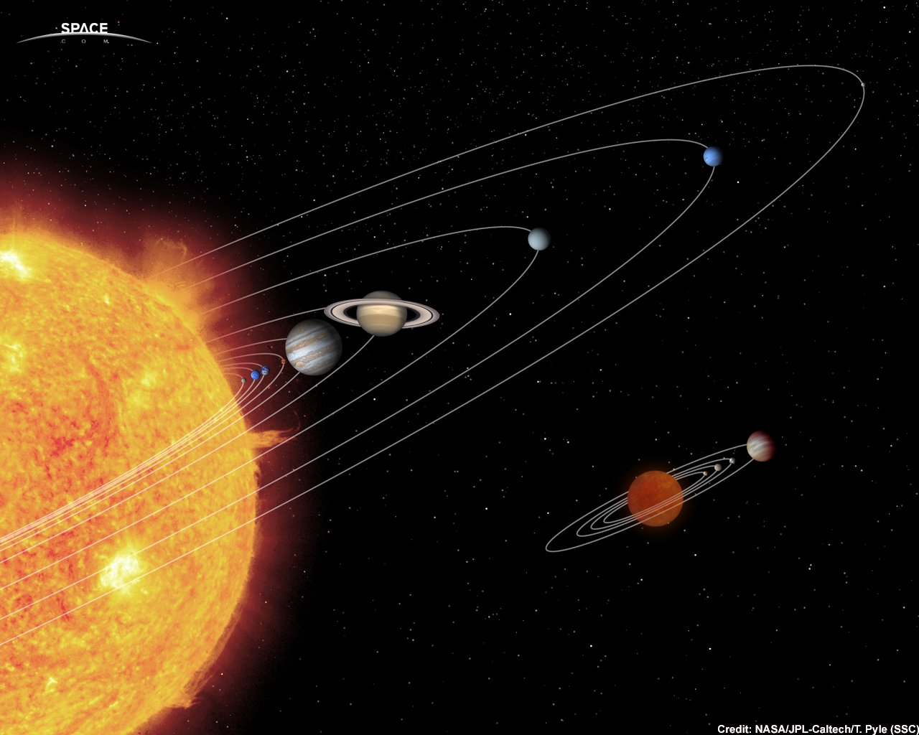
Solar Nebula Theory

Slide 64
Observations of Today’s Solar System
1. Sun and gas giants 74% H, 25% He 1% everything else. Not rocky planets

Slide 65
Observations of Today’s Solar System
1. Sun and gas giants 74% H, 25% He 1% everything else. Not rocky planets
2. All planets orbit in same plane: the ecliptic

Slide 66
Observations of Today’s Solar System
1. Sun and gas giants 74% H, 25% He 1% everything else. Not rocky planets
2. All planets orbit in same plane: the ecliptic
3. All planets orbit sun in same direction and Sun rotates in that direction, too

Slide 67
Observations of Today’s Solar System
1. Sun and gas giants 74% H, 25% He 1% everything else. Not rocky planets
2. All planets orbit in same plane: the ecliptic
3. All planets orbit sun in same direction and Sun rotates in that direction, too
4. Rocky planets are close in; gas giants far out

Slide 68
Observations of Today’s Solar System
1. Sun and gas giants 74% H, 25% He 1% everything else. Not rocky planets
2. All planets orbit in same plane: the ecliptic
3. All planets orbit sun in same direction and Sun rotates in that direction, too
4. Rocky planets are close in; gas giants far out
5. Debris throughout the ecliptic plane

Slide 69
Observations of Today’s Solar System
1. Sun and gas giants 74% H, 25% He 1% everything else. Not rocky planets
2. All planets orbit in same plane: the ecliptic
3. All planets orbit sun in same direction and Sun rotates in that direction, too
4. Rocky planets are close in; gas giants far out
5. Debris throughout the ecliptic plane
6. Craters everywhere

Slide 70
Observations of Today’s Solar System
1. Sun and gas giants 74% H, 25% He 1% everything else. Not rocky planets
2. All planets orbit in same plane: the ecliptic
3. All planets orbit sun in same direction and Sun rotates in that direction, too
4. Rocky planets are close in; gas giants far out
5. Debris throughout the ecliptic plane
6. Craters everywhere
7. Oort Cloud

Slide 71
Solar Nebula Theory
Gas Ball
50,000 AU

Slide 72
.
Gas Ball starts
to collapse
.
.
.
.
.
.
.
.
.
.
.
.
.
.
.
.
.
.
.
.
.
.
.
.
.
.
.
.
.
.

Slide 73
Gas Ball’s
temperature in
center rises
.
.
.
.
.
.
.
.
.
.
.
.
.
.
.
.
.
.
.
.
.
.
.
.
.
.
.
.
.
.
.
.
.
.
.
.
.
.
.
.
.
.
.

Slide 74
Gas Ball’s
temperature in
center rises
.
.
.
.
.
.
.
.
.
.
.
.
.
.
.
.
.
.
.
.
.
.
.
.
.
.
.
.
.
.
.
.
.
.
.
.
.
.
.
.
.
.
.
.
.
.
.
.
.
.
.
.
.
.
.
.
.
.
.
.
.
.
.
.
.
When temperature at center reaches about 15 x 10⁶ K,
FUSION of H to He happens and A STAR IS BORN

Slide 75
Gas Ball’s
temperature in
center rises
.
.
.
.
.
.
.
.
.
.
.
.
.
.
.
.
.
.
.
.
.
.
.
.
.
.
.
.
.
.
.
.
.
.
.
.
.
.
.
.
.
.
.
.
.
.
.
.
.
.
.
.
.
.
.
.
.
.
.
.
.
.
.
.
.
When temperature at center reaches about 15 x 10⁶ K,
FUSION of H to He happens and A STAR IS BORN

Slide 76
4 P He + E
When temperature at center reaches about 15 x 10⁶ K,
FUSION of H to He happens and A STAR IS BORN

Slide 77
Gas Ball’s
temperature in
center rises
.
.
.
.
.
.
.
.
.
.
.
.
.
.
.
.
.
.
.
.
.
.
.
.
.
.
.
.
.
.
.
.
.
.
.
.
.
.
.
.
.
.
.
.
.
.
.
.
.
.
.
.
.
.
.
.
.
.
.
.
.
.
.
.
.
The energy of FUSION pushes back on gravity and the collapse is stopped.

Slide 78
When mass moves inward, it starts to rotate.

Slide 79
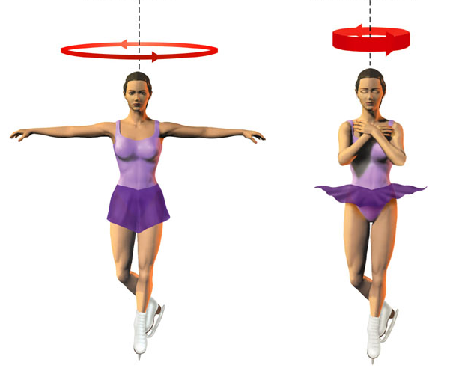
When a spinning object moves mass centrally, the object spins faster

Slide 80
And like making a pizza, spin-up flattens.

Slide 81
We are left with the remnants that did not move to the center and a flat disk with the sun in the middle.
planets will
form here
new born sun
Oort Cloud

Slide 82
Look at the very inner disk
planets will
form here
new born sun
Oort Cloud

Slide 83
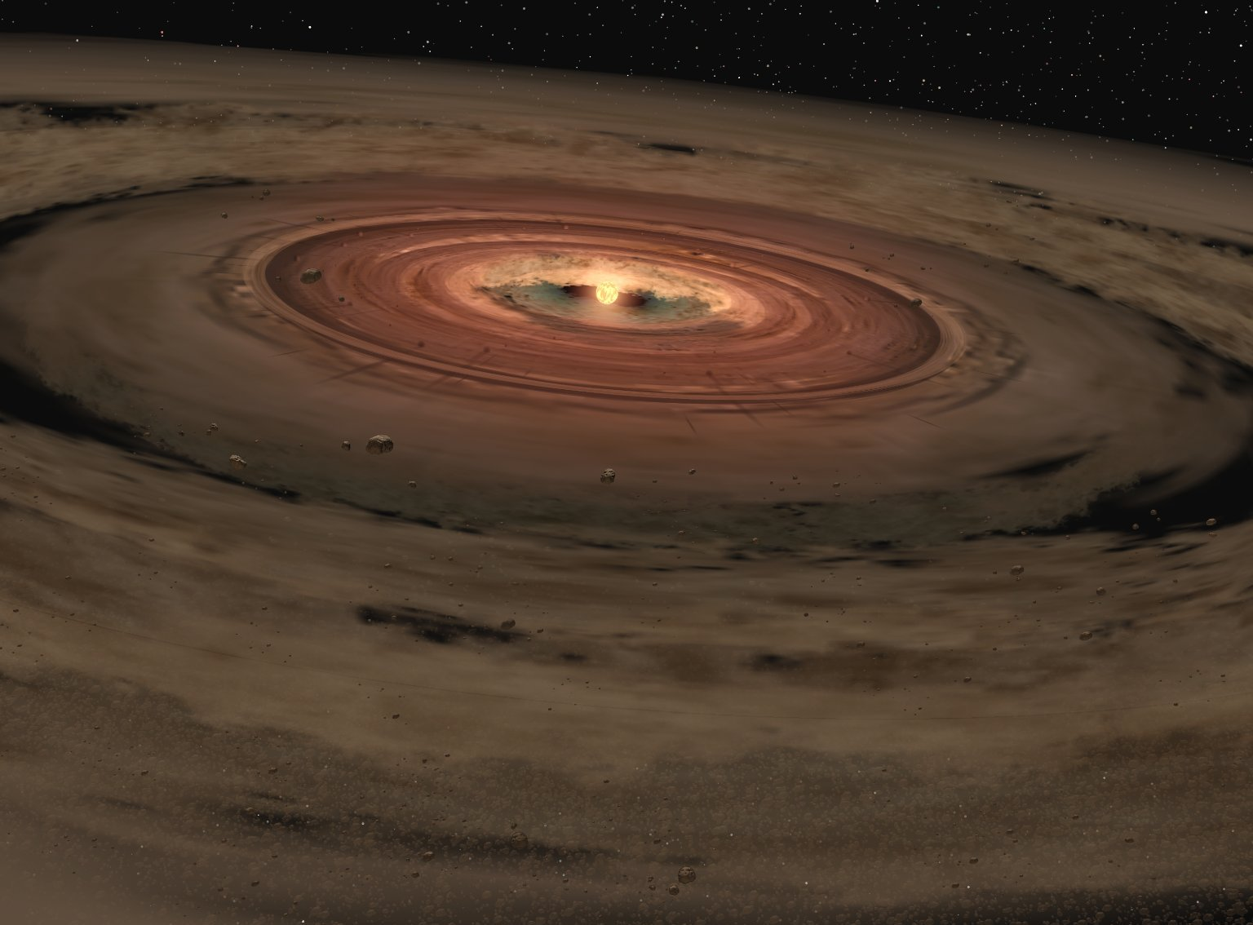

Slide 84
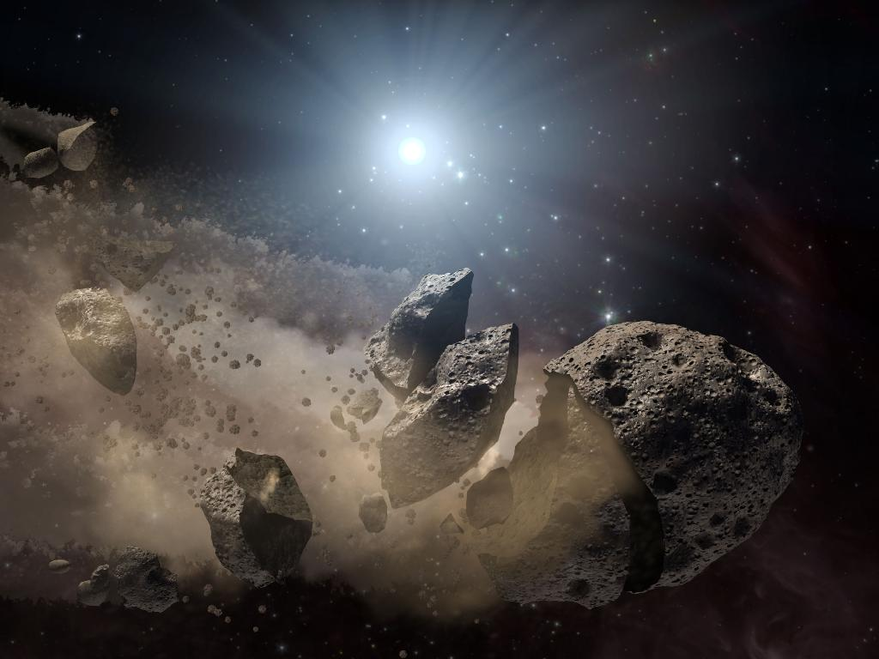
Planets build up by accretion:
colliding dust and gas stick together.

Slide 85
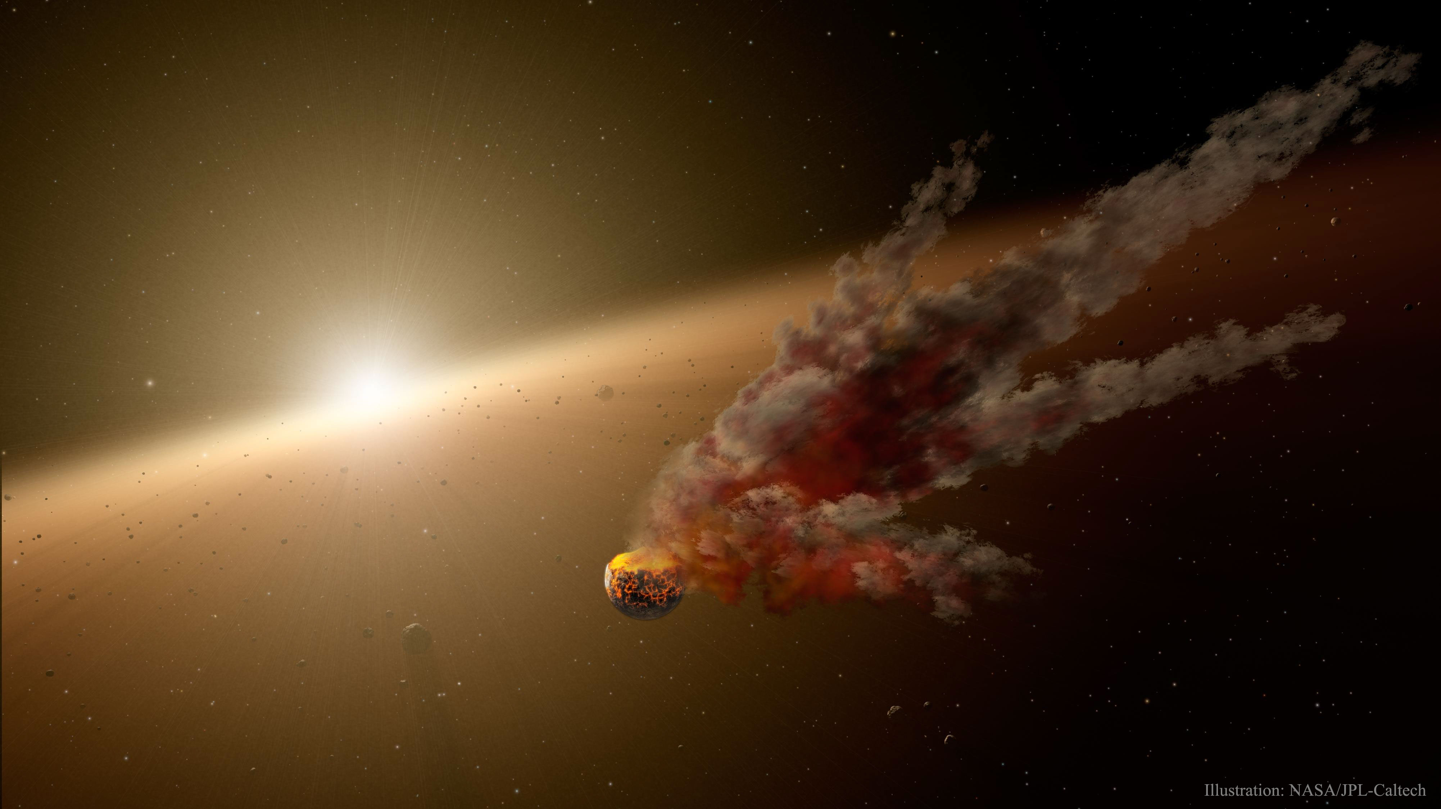
Computer models show that there were from 150 to 200 planets formed early on

Slide 86
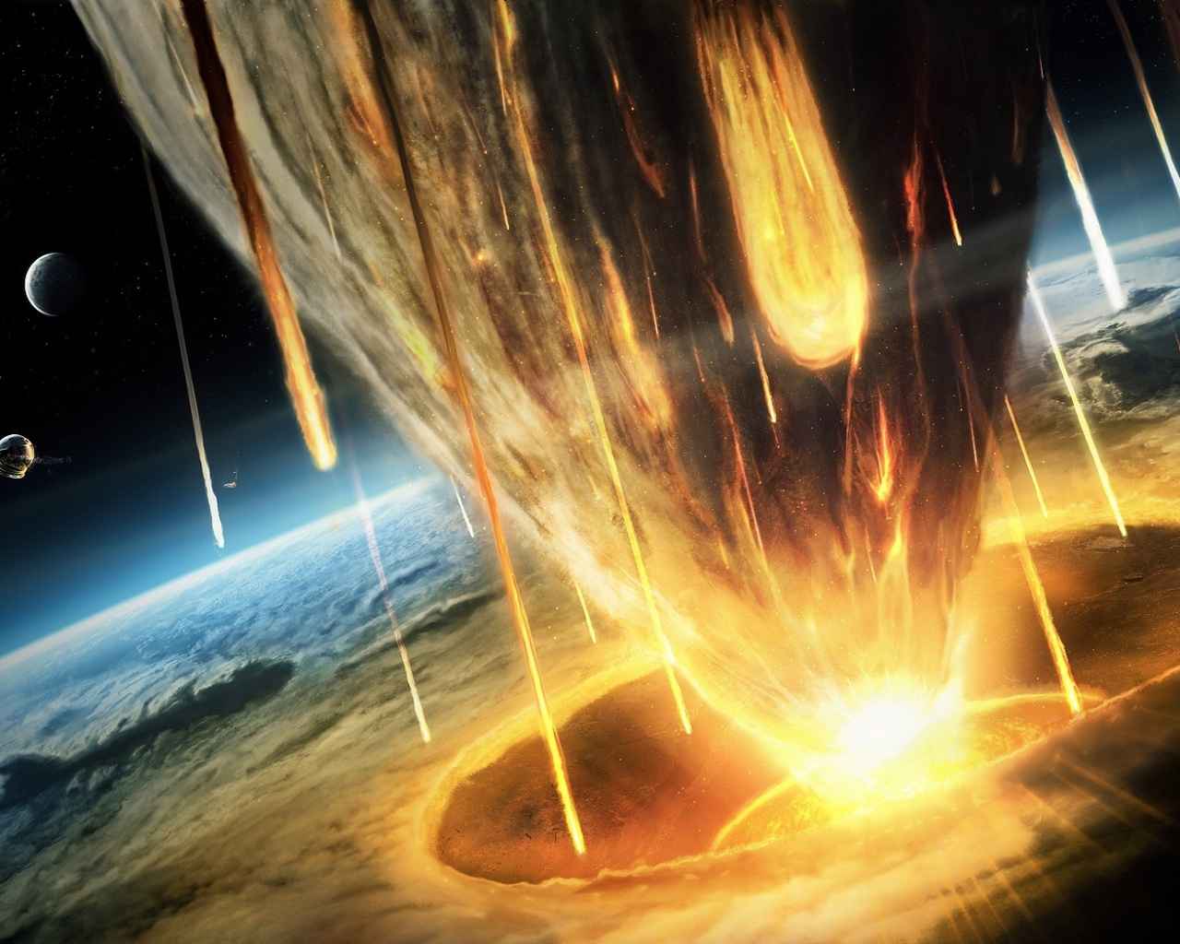
Once planets built up there were
one billion years of the Era of Bombardment

Slide 87
The rocky planets built up slowly in the inner region
sun
2000 K
too hot for ice, slow build up — rocky

Slide 88
The rocky planets built up slowly in the inner region
and large gas giants in the outer region
sun
50 K
2000 K
too hot for ice, slow build up — rocky
sticky ices, rapid build up — gas giants

Slide 89
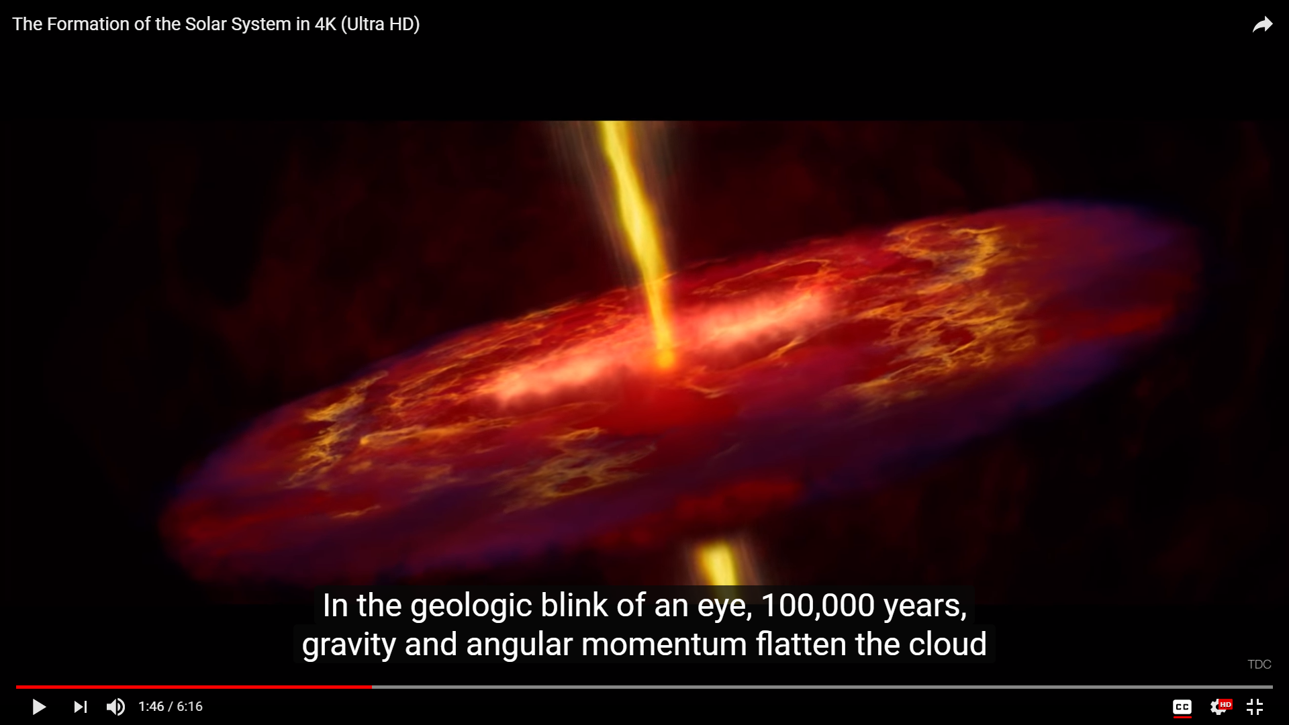
VIDEO: The Formation of the Solar System
https://www.youtube.com/watch?v=x1QTc5YeO6w

Slide 90
Why isn't the Earth made of mostly H gas?
Compare: V_{avg} with V_{esc}

Slide 91
Why isn't the Earth made of mostly H gas?
Compare: V_{avg} with V_{esc}
V_{avg H on Earth} > V_{esc Earth}

Slide 92
The rocky planets with high T,
V_{avg of gas} > V_{esc} so we can’t hold
onto H or He as the Sun can.

Slide 93
The Gas Giants with low T,
V_{avg of gas} < V_{esc} so they can hold
onto H and He as the sun can

Slide 94
Observations of Today’s Solar System
1. Sun and gas giants 74% H, 25% He 1% everything else. Not rocky planets
2. All planets orbit in same plane: the ecliptic
3. All planets orbit sun in same direction and Sun rotates in that direction, too
4. Rocky planets are close in; gas giants far out
5. Debris throughout the ecliptic plane
6. Craters everywhere
7. Oort Cloud

