Slide 1
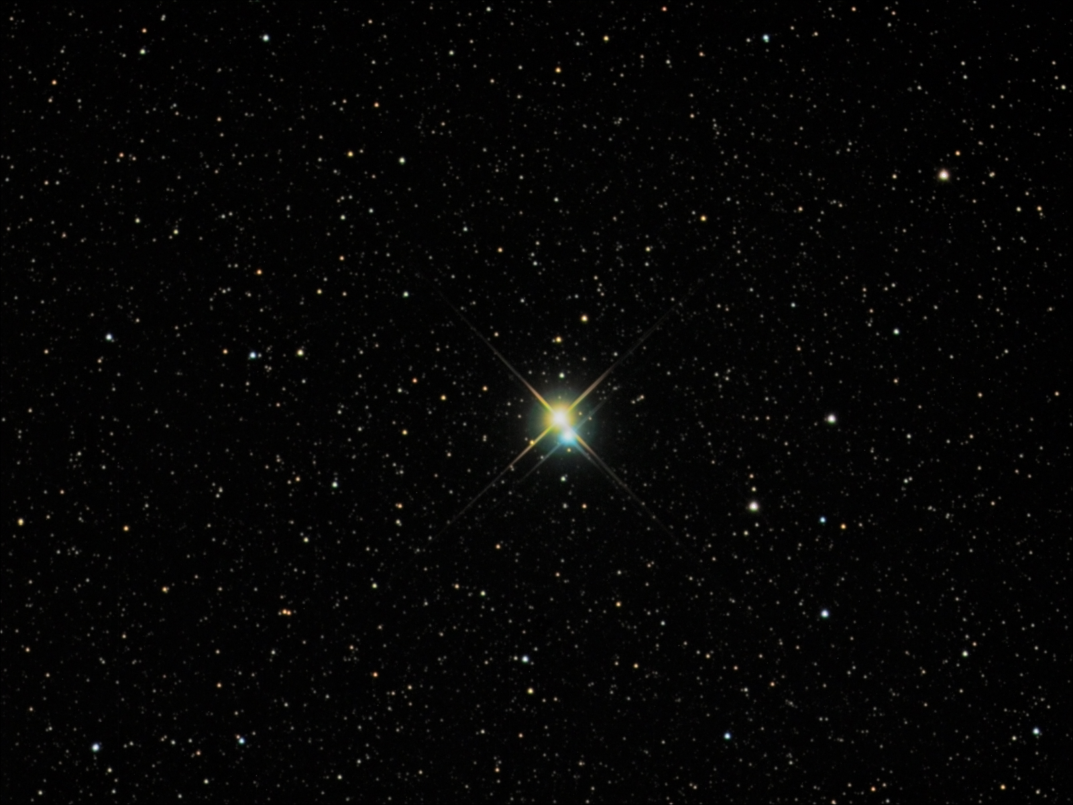
Stars are temporary.
Notes:
Albireo: A Bright and Beautiful Double
Credit & Copyright: Richard Yandrick (Cosmicimage.com)
Explanation: Sometimes, even a small telescope can help unlock a hidden beauty of the heavens. Such is the case of the bright double star Albireo. Seen at even slight magnification, Albireo unfolds from a bright single point into a beautiful double star of strikingly different colors. At 380 light years distant, the two bright stars of Albireo are comparatively far from each other and take about 75,000 years to complete a single orbit. The brighter yellow star is itself a binary star system, but too close together to be resolved even with a telescope. Albireo, pictured above, is the fifth brightest star system toward the constellation of the Swan (Cygnus) and easily visible to the unaided eye.

Slide 2
We know this because
— We see the remains of dead stars

Slide 3
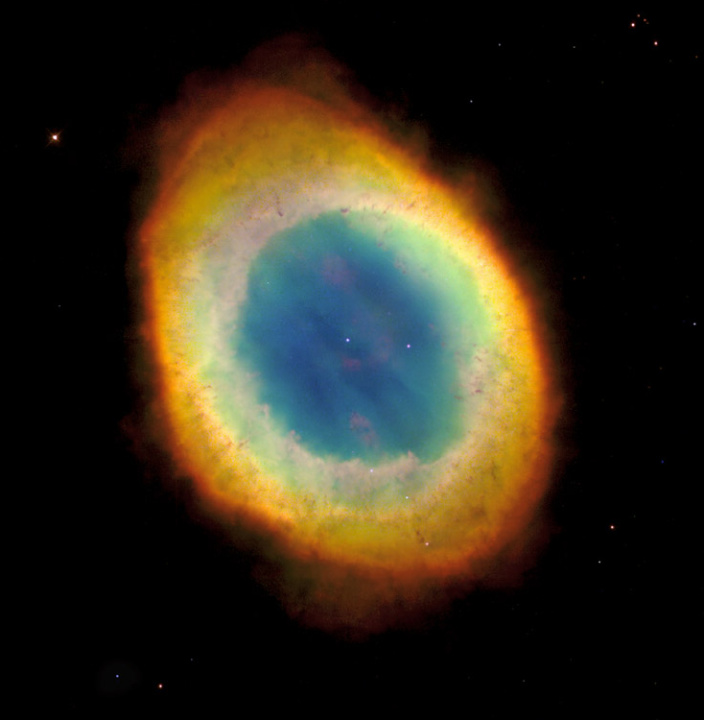

Slide 4
We know this because
— We see the remains of dead stars
— We are made of elements other than H and He

Slide 5
We know this because
— We see the remains of dead stars
— We are made of elements other than H and He
— Stars have only so much H fuel to fight gravity

Slide 6
We know this because
— We see the remains of dead stars
— We are made of elements other than H and He
— Stars have only so much H fuel to fight gravity
— HR diagram shows us what happens

Slide 7

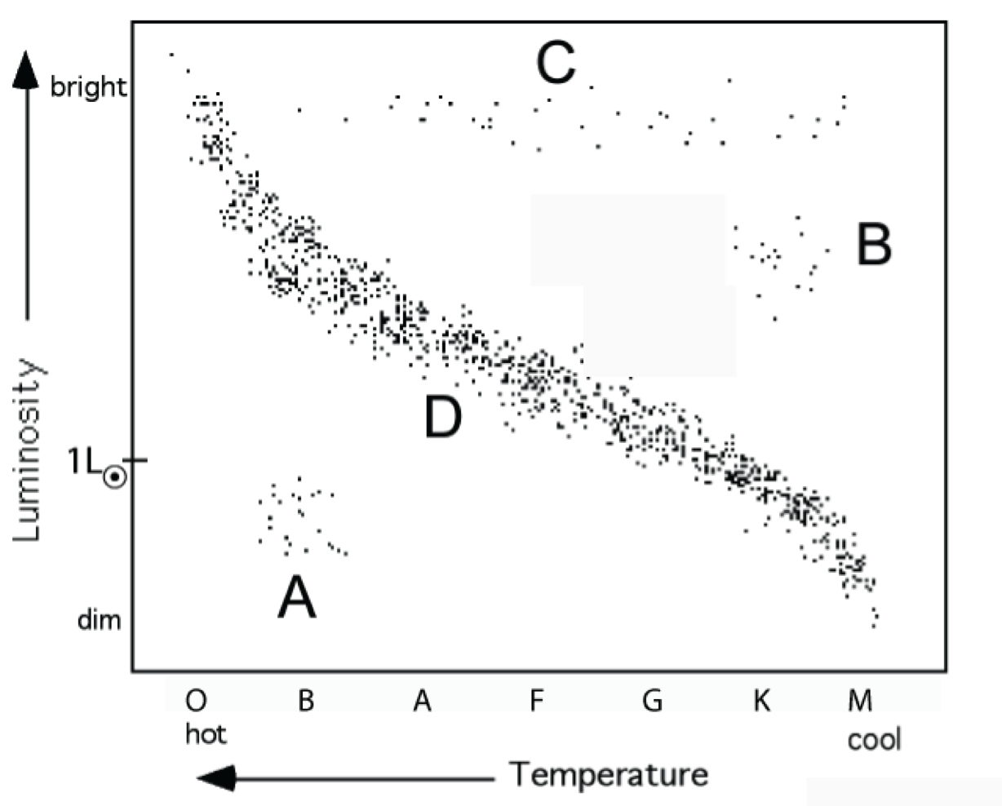
HR Diagram
main sequence

Slide 8
HR Diagram
main sequence
highmass,
short time for H-fusion
low mass,
long time for H-fusion

Slide 9
Stars Take different paths to their end depending on how MASSIVE they are.
1 to 3 M_{O} PN + white dwarf

Slide 10
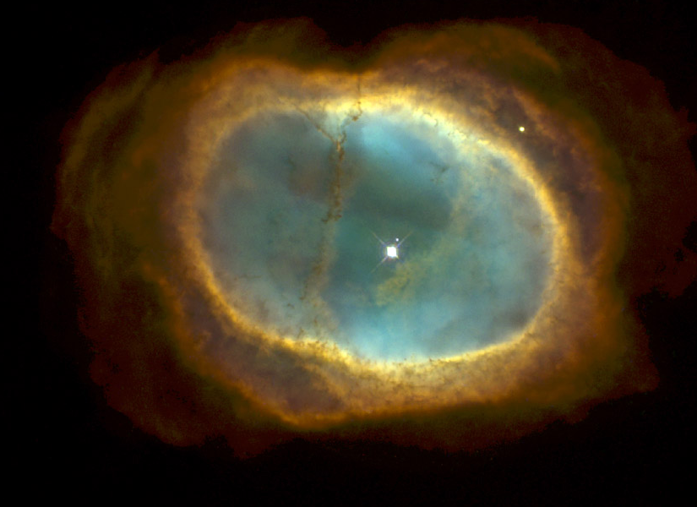

Slide 11
Stars Take different paths to their end depending on how MASSIVE they are.
3 to 8 M_{O} SN + neutron star
> 8 M_{O} SN + black hole
1 to 3 M_{O} PN + white dwarf

Slide 12
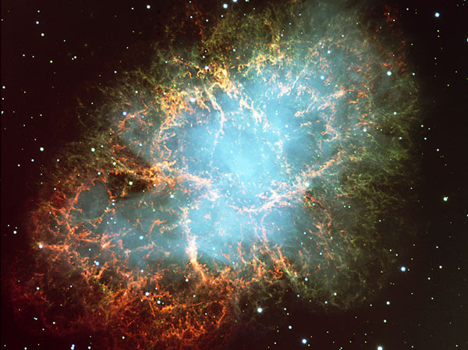
Notes:
The Crab Nebula from VLT
Credit: FORS Team, 8.2-meter VLT, ESO
Explanation: The Crab Nebula, filled with mysterious filaments, is the result of a star that was seen to explode in 1054 AD. This spectacular supernova explosion was recorded by Chinese and (quite probably) Anasazi Indian astronomers. The filaments are mysterious because they appear to have less mass than expelled in the original supernova and higher speed than expected from a free explosion. In the above picture taken recently from a Very Large Telescope, the color indicates what is happening to the electrons in different parts of the Crab Nebula. Red indicates the electrons are recombining with protons to form neutral hydrogen, while blue indicates the electrons are whirling around the magnetic field of the inner nebula. In the nebula's very center lies a pulsar: a neutron star rotating, in this case, 30 times a second.

Slide 13
Stars Take different paths to their end depending on how MASSIVE they are.
1 to 3 M_{O} PN + white dwarf
3 to 8 M_{O} SN + neutron star
> 8 M_{O} SN + black hole

Slide 14
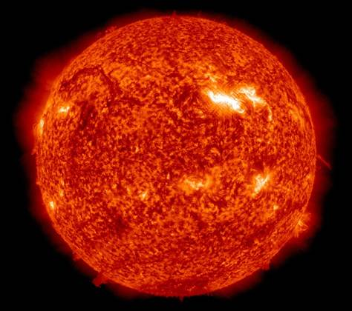

Slide 15
star surface
4 P He + light
Core of Star

Slide 16
star surface
4 P He + light
He
Core of Star

Slide 17
star surface
4 P He + light
He C + light
Core of Star

Slide 18
4 P He + light
star surface
He C + light
C
Core of Star

Slide 19
electron pressure
prevents further collapse and heating
e
e
C
e
e
C
C
C
e
e
e
e
C
C
e
C
e
C
e
C
C
C
e
C
e
e
C
C
e
e
C

Slide 20
star surface
C
Core of Star: White Dwarf

Slide 21


Slide 22
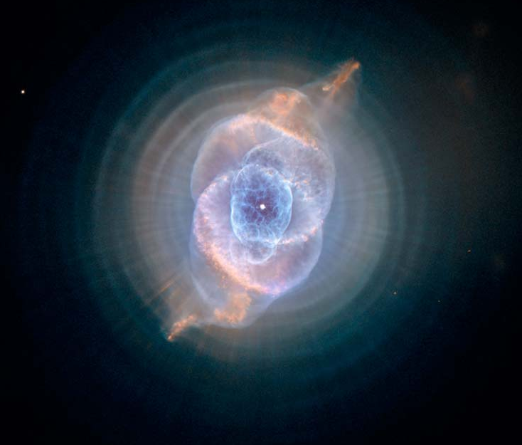
Notes:
Explanation: Three thousand light years away, a dying star throws off shells of glowing gas. This Hubble Space Telescope image reveals "The Cat's Eye Nebula" to be one of the most complex "planetary nebulae" known. In fact, the features seen in this image are so complex that astronomers suspect the visible central star may actually be a double star system. The term planetary nebula, used to describe this general class of objects, is misleading. Although these objects may appear round and planet-like in small telescopes, high resolution images reveal them to be stars surrounded by cocoons of gas blown off in the late stages of evolution.

Slide 23
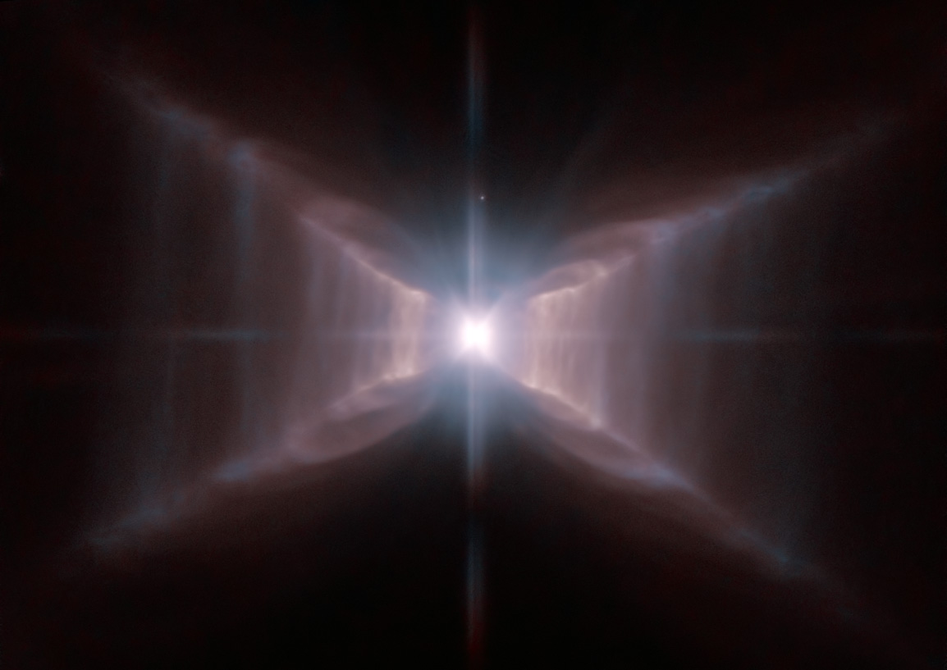

Slide 24
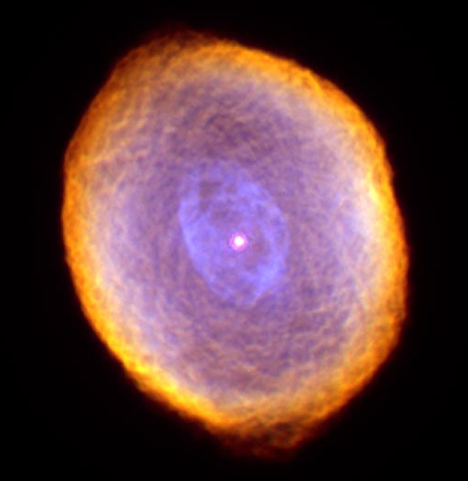
Notes:
IC 418: The Spirograph Nebula
Credit: R. Sahai (JPL) et al., Hubble Heritage Team (STScI/AURA), NASA
Explanation: What is creating the strange texture of IC 418? Dubbed the Spirograph Nebula for its resemblance to drawings from a cyclical drawing tool, planetary nebula IC 418 shows patterns that are not well understood. Perhaps they are related to chaotic winds from the variable central star, which changes brightness unpredictably in just a few hours. By contrast, evidence indicates that only a few million years ago, IC 418 was probably a well-understood star similar to our Sun. Only a few thousand years ago, IC 418 was probably a common red giant star. Since running out of nuclear fuel, though, the outer envelope has begun expanding outward leaving a hot remnant core destined to become a white-dwarf star, visible in the image center. The light from the central core excites surrounding atoms in the nebula causing them to glow. IC 418 lies about 2000 light-years away and spans 0.3 light-years across. This recently released false-color image taken from the Hubble Space Telescope reveals the unusual details.

Slide 25
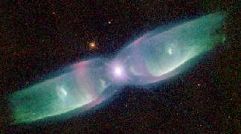

Slide 26
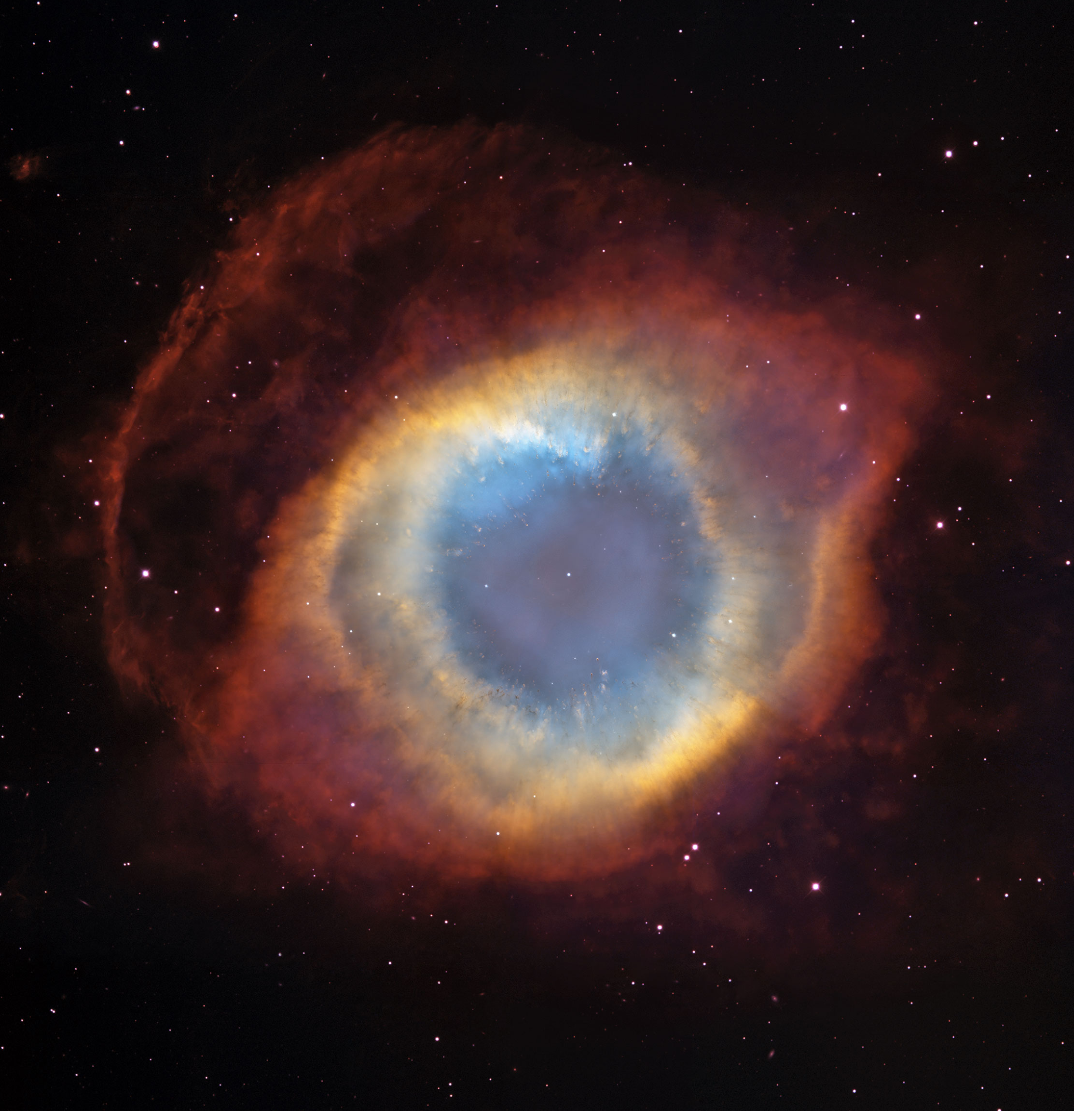
Notes:
How did a star create the Helix nebula? The shapes of planetary nebula like the Helix are important because they likely hold clues to how stars like the Sun end their lives. Recent observations by the orbiting Hubble Space Telescope and the 4-meter Blanco Telescope in Chile, however, have shown the Helix is not really a simple helix. Rather, it incorporates two nearly perpendicular disks as well as arcs, shocks, and even features not well understood. Even so, many strikingly geometric symmetries remain.

Slide 27
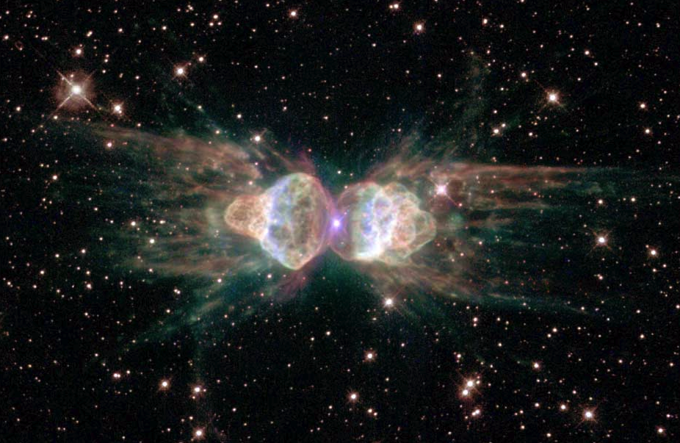

Slide 28
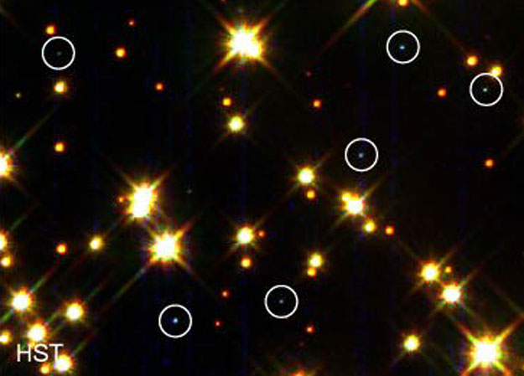

Slide 29
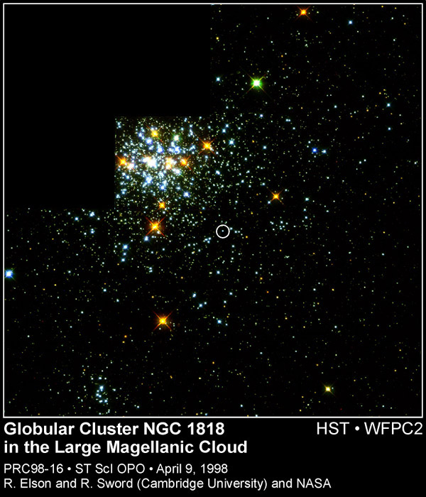

Slide 30
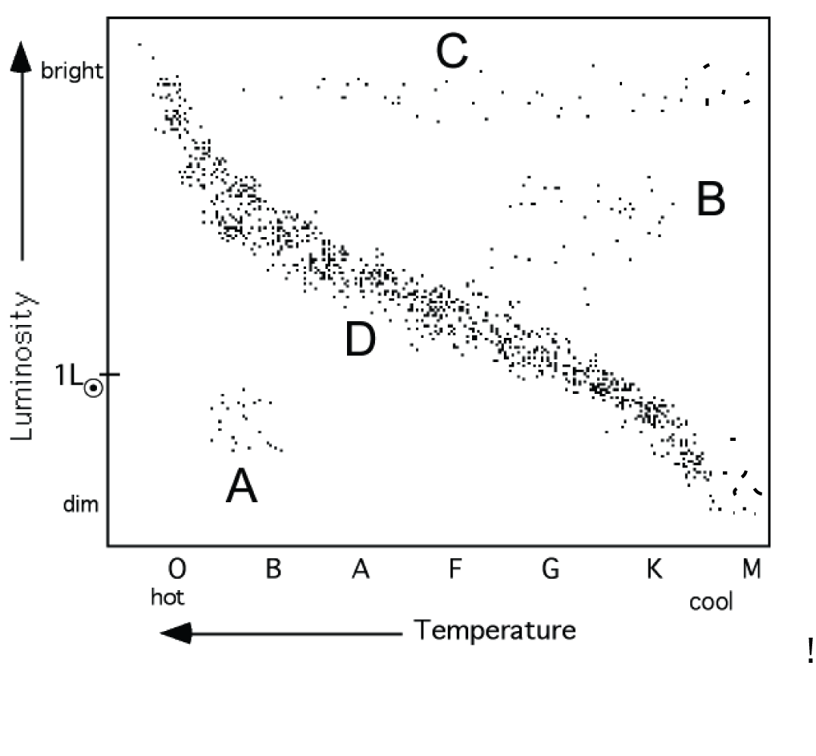
our
Sun
now
4.6x10⁹
yrs old

Slide 31
Our Sun in the Future
200 million years from now: too hot to live on earth

Slide 32
Our Sun in the Future
200 million years from now: too hot to live on earth
500 million years from now: atmosphere and oceans gone

Slide 33
Our Sun in the Future
200 million years from now: too hot to live on earth
500 million years from now: atmosphere and oceans gone
1 billion years from now: surface Sun near Jupiter

Slide 34
Our Sun in the Future
200 million years from now: too hot to live on earth
500 million years from now: atmosphere and oceans gone
1 billion years from now: surface Sun near Jupiter
4.5 billion yrs from now: Red giant (2,000 x Lsun)

Slide 35
Our Sun in the Future
200 million years from now: too hot to live on earth
500 million years from now: atmosphere and oceans gone
1 billion years from now: surface Sun near Jupiter
4.5 billion yrs from now: Red giant (2,000 x Lsun)
5.5 billion yrs from now: PN and WD

Slide 36
low mass star evolves

Slide 37
our
Sun
now
4.6x10⁹
yrs old

Slide 38
our
Sun
10⁸ yr
from now

Slide 39
our
Sun
10⁹ yr
from now

Slide 40
our
Sun
4x10⁹ yr from now

Slide 41
our
Sun
9x10⁹ yr old, start to end

Slide 42
The more MASSIVE the Star on the MAIN Sequence,
the hotter it is on its surface and inside its core, and
the faster it uses up its H fuel
Look at evolution of a star >>M than Sun.

Slide 43
Stars Take different paths to their end depending on how MASSIVE they are.
1 to 3 M_{O} PN + white dwarf
3 to 8 M_{O} SN + neutron star
> 8 M_{O} SN + black hole

Slide 44
3-8 M_{sun}
5 x 10⁹ on
MS

Slide 45
3-8 M_{sun}
3 x 10⁹ yrs

Slide 46
massive
star
½ x10⁹ yrs

Slide 47
Stars Take different paths to their end depending on how MASSIVE they are.
1 to 3 M_{O} PN + white dwarf
3 to 8 M_{O} SN + neutron star
> 8 M_{O} SN + black hole

Slide 48
massive
star
now

Slide 49
massive
star
20x10⁶ yrs

Slide 50
massive
star
25x10⁶ yrs

Slide 51
massive
star
30x10⁶ yrs

Slide 52
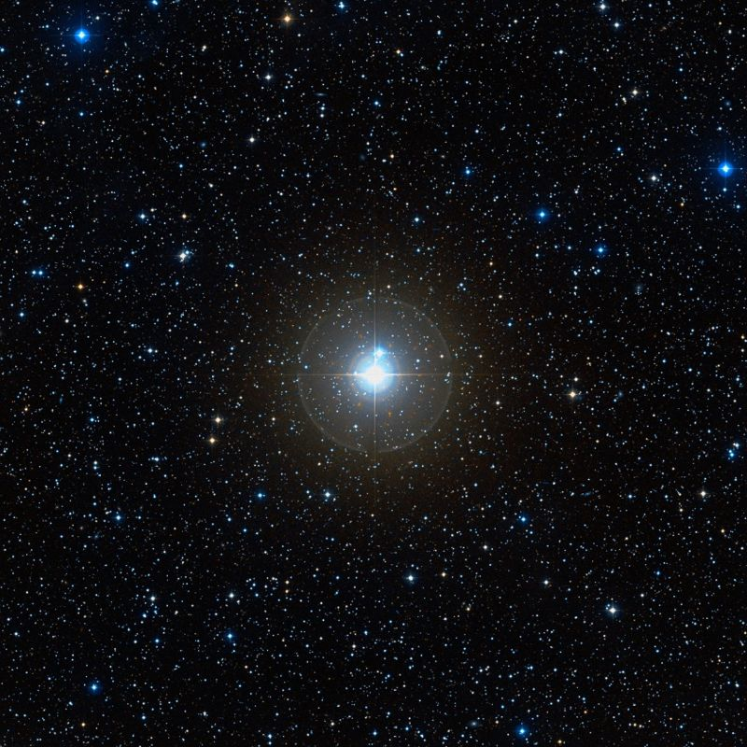
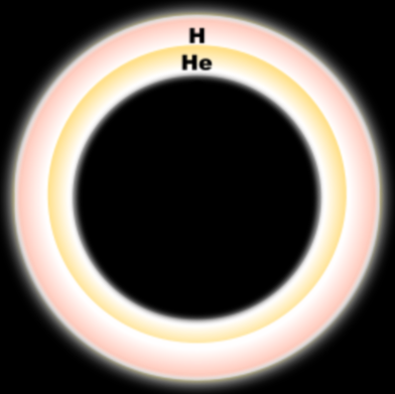
C
Massive Stars Continue Fusion Reactions until they make Iron (Fe)

Slide 53

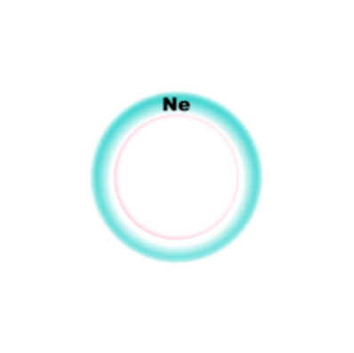
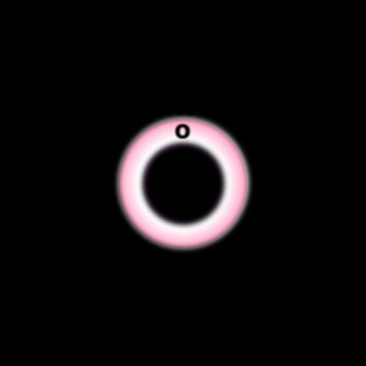
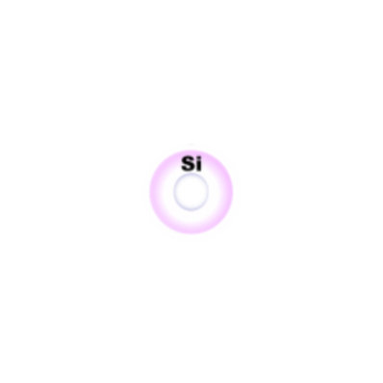
Fe
Ne
C
O
Si
Si ➔ Fe is the last reaction a massive star can make before it explodes.
Massive Stars Continue Fusion Reactions until they make Iron (Fe)

Slide 54
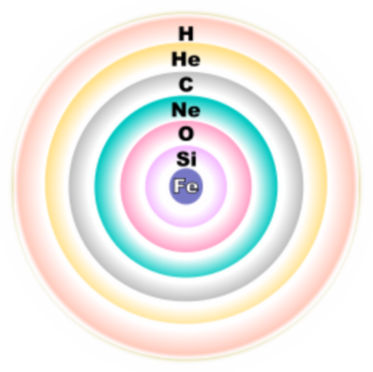
Fe
All the fusion reactions have caused the surface of this massive star to bloat up and cool.
Si ➔ Fe is the last reaction a massive star can make before it explodes
Let's zoom back out of the Star

Slide 55
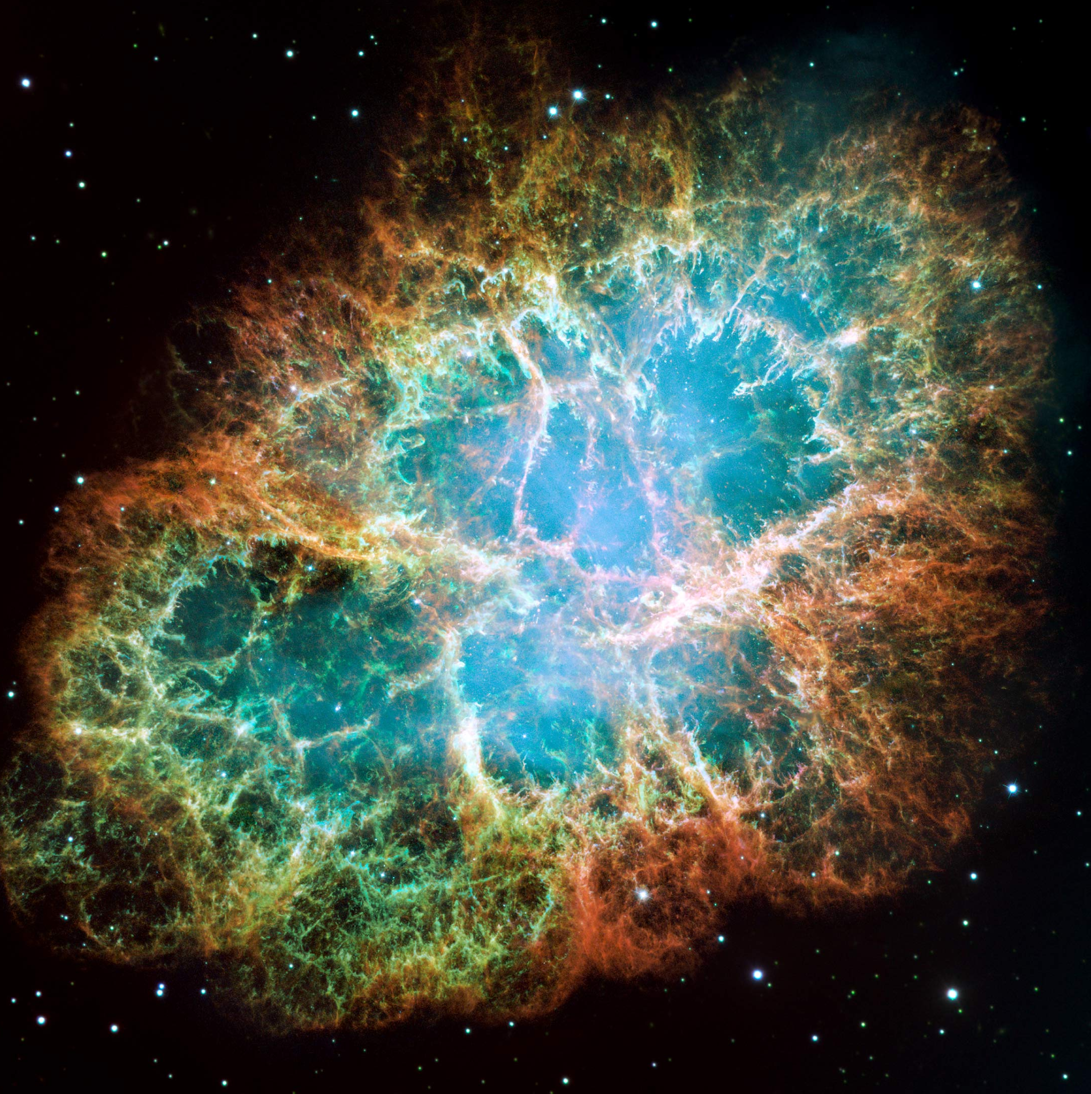
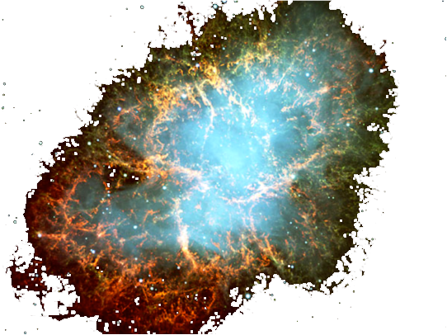
Ca
Tn
Ni
Cu
Pb
U
Ag
Cd
Ti
Au
V
Supernova!

Slide 56
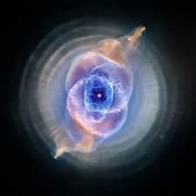
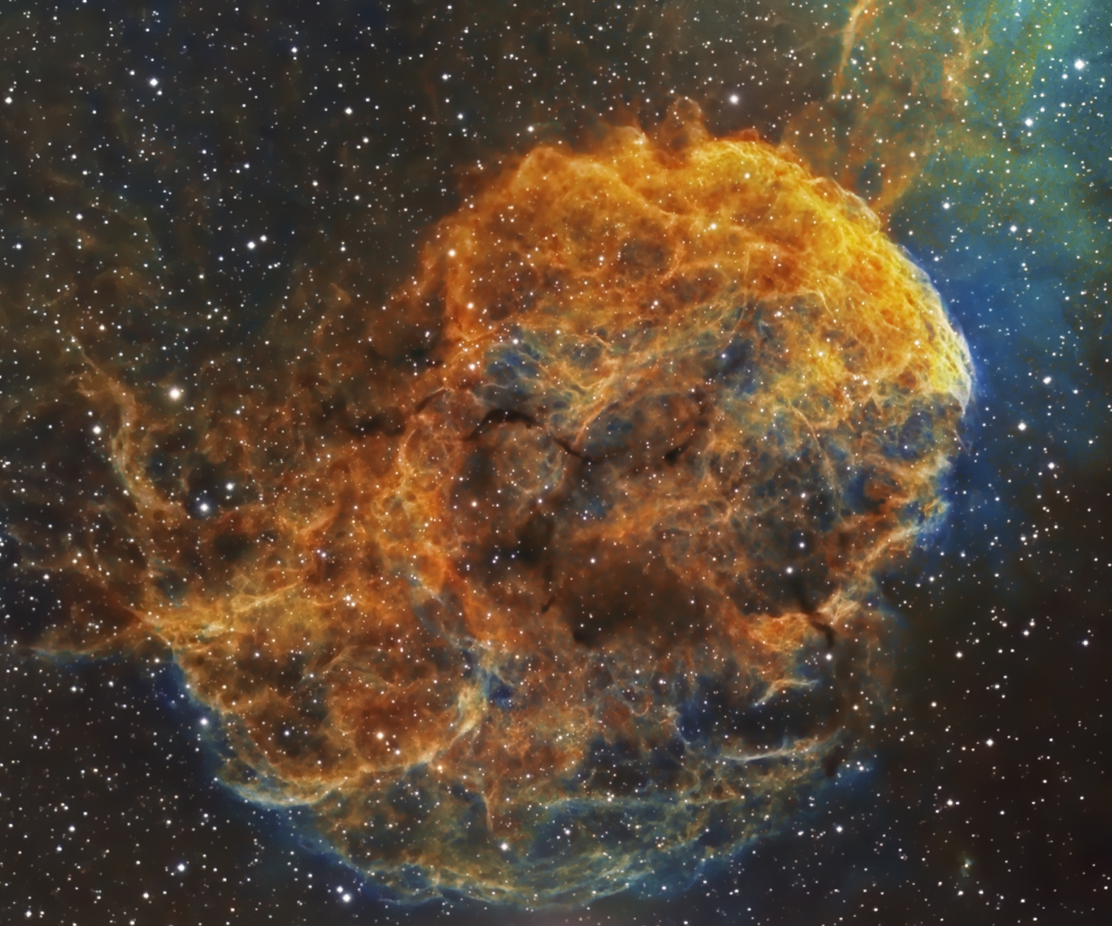
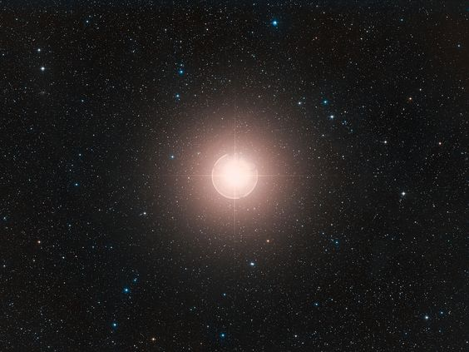
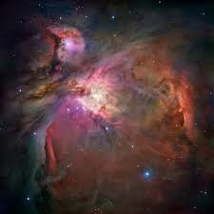
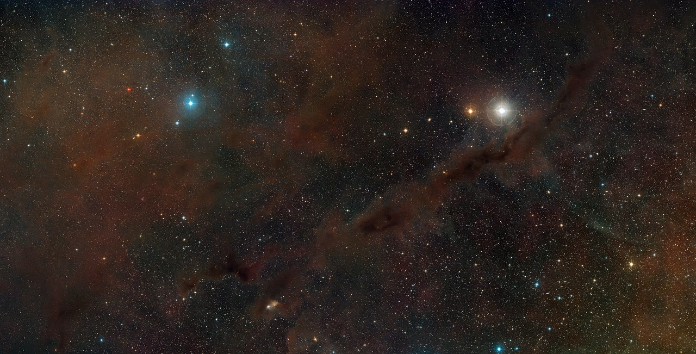
Cosmic Recycling

Slide 57
Due to stars that came and went billions of years before us, our Sun and Solar System contain:
Hydrogen 73.77% Helium 24.29%
Oxygen 0.77% Carbon 0.29%
Iron 0.16% Neon 0.12% Nitrogen 0.09% Silicon 0.07% Magnesium 0.05% Sulfur 0.04%
this is what we are made of!
this is what interstellar DUST is made of!

Slide 58
4 P He + light
He C + light
C
Core of Star 1 – 3 M_{sun}

Slide 59
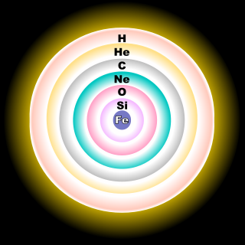
core of a massive star

Slide 60
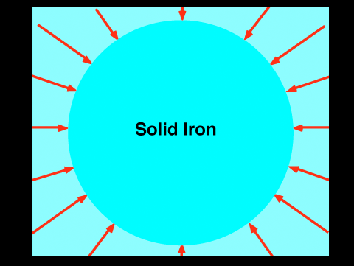

Slide 61
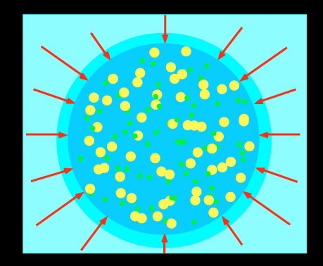

Slide 62
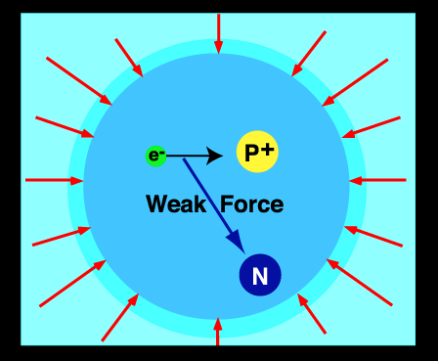
ν

Slide 63
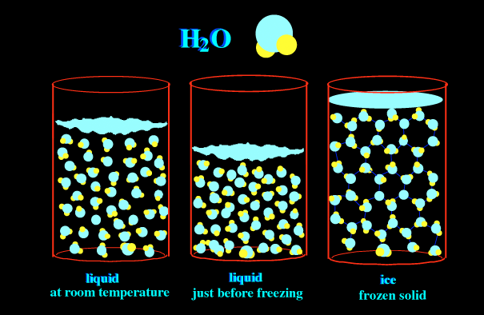

Slide 64
ν
ν
ν
ν
ν
ν
ν
ν
ν
ν
ν
ν
ν
ν
ν
ν

Slide 65
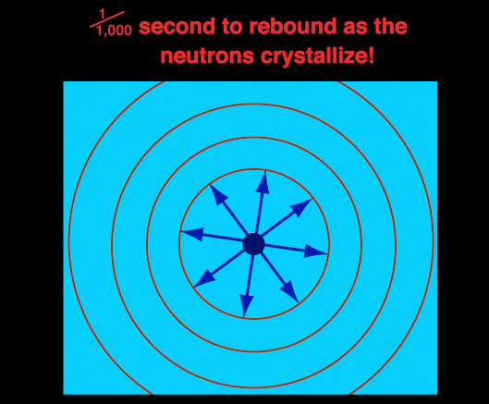

Slide 66

After the neutrino burst, it takes 3 hours for the blast to make it to the surface of the star

Slide 67
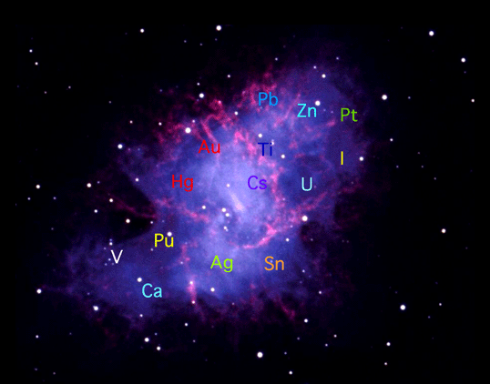
Supernova remnant (SNR)

Slide 68
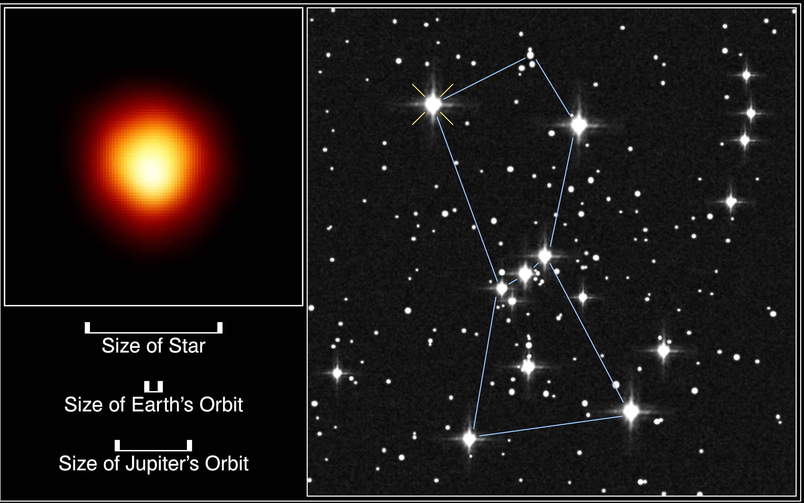
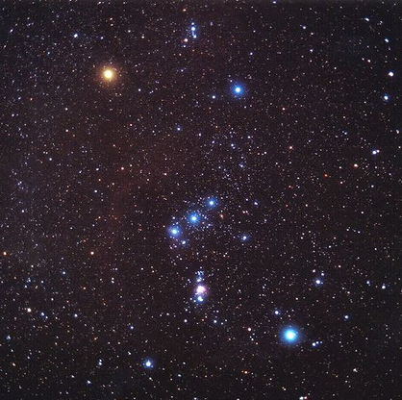
Betelgeuse
Orion Constellation

Slide 69
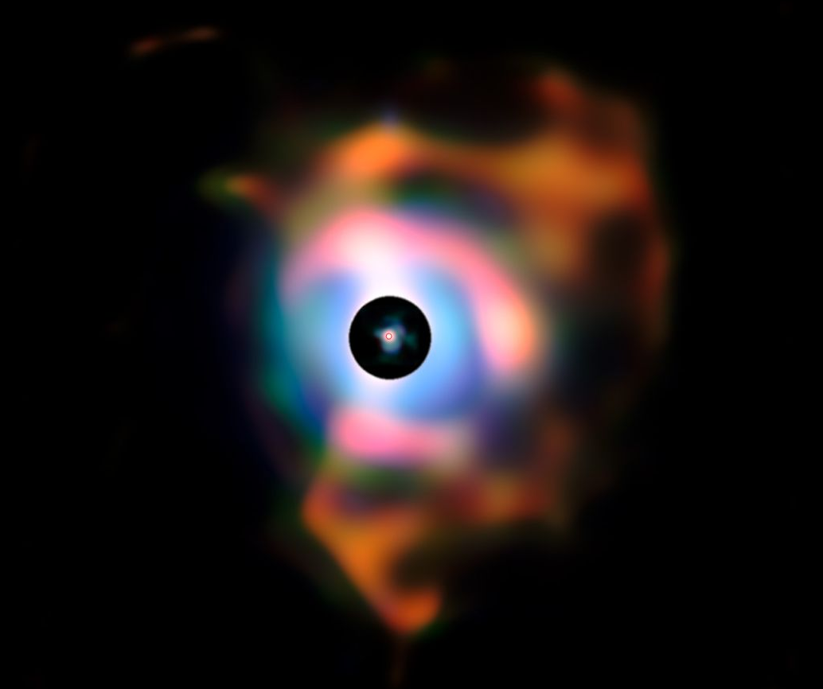
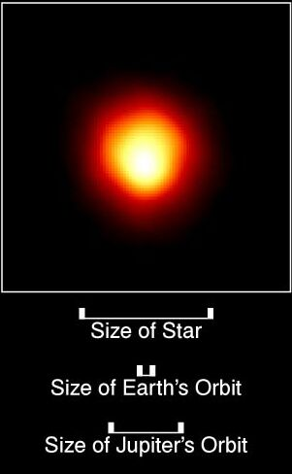
= 5 AU
400 AU
Cloud of Gas and Dust
Betelgeuse is ready to go Supernova!

Slide 70
Notes:
The Crab Nebula from VLT
Credit: FORS Team, 8.2-meter VLT, ESO
Explanation: The Crab Nebula, filled with mysterious filaments, is the result of a star that was seen to explode in 1054 AD. This spectacular supernova explosion was recorded by Chinese and (quite probably) Anasazi Indian astronomers. The filaments are mysterious because they appear to have less mass than expelled in the original supernova and higher speed than expected from a free explosion. In the above picture taken recently from a Very Large Telescope, the color indicates what is happening to the electrons in different parts of the Crab Nebula. Red indicates the electrons are recombining with protons to form neutral hydrogen, while blue indicates the electrons are whirling around the magnetic field of the inner nebula. In the nebula's very center lies a pulsar: a neutron star rotating, in this case, 30 times a second.

Slide 71
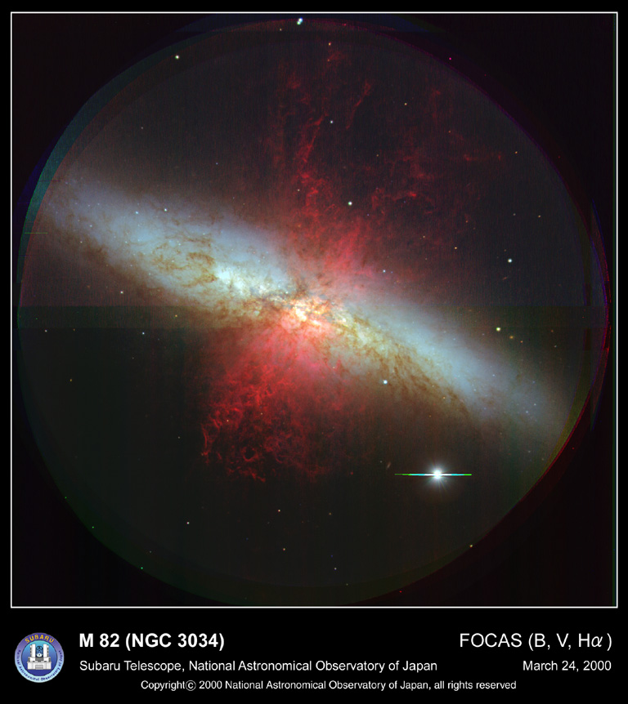
Notes:
m82

Slide 74
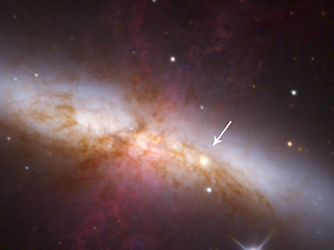
Notes:
m82 sn

Slide 75
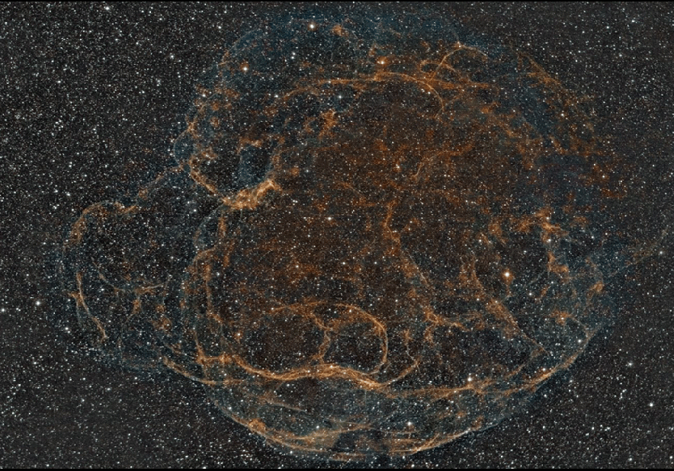

Slide 76
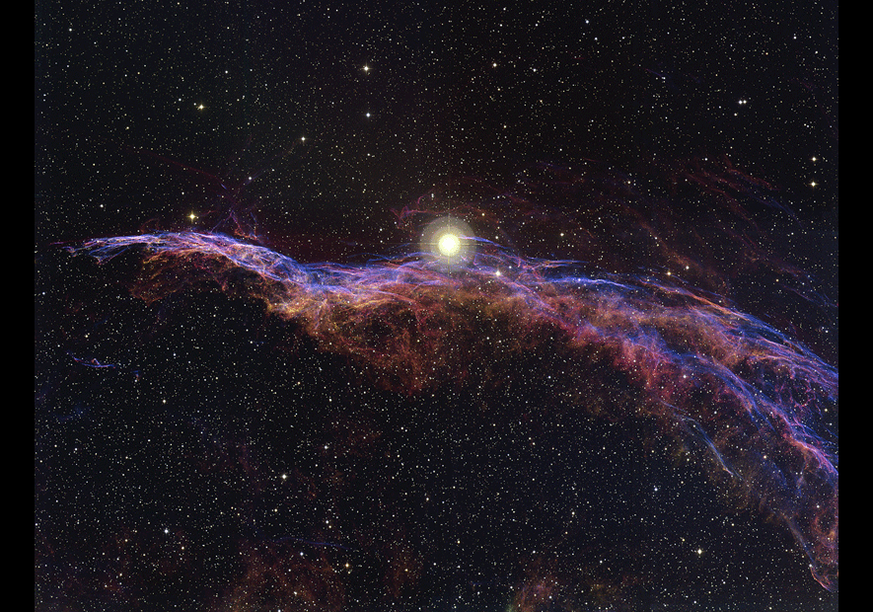

Slide 77
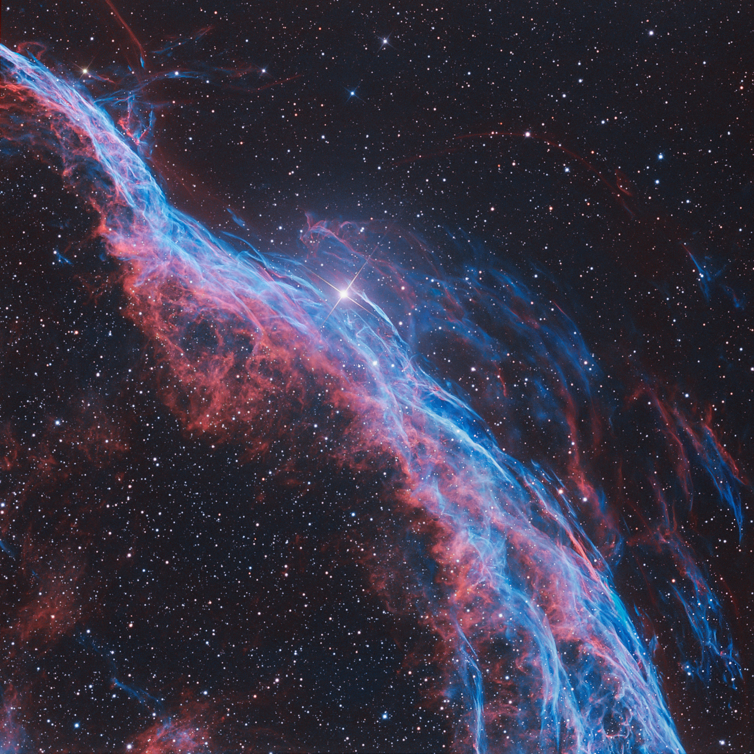

Slide 78
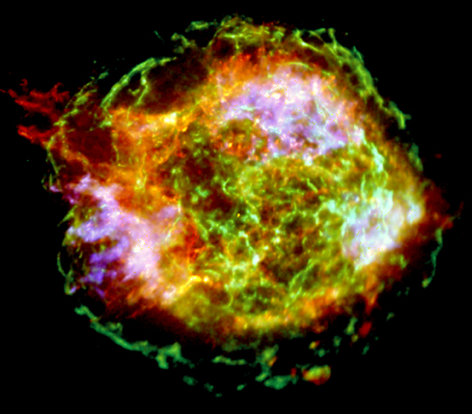
Supernova remnant (SNR) Cas A in x-rays
Notes:
Xray from chandra One million seconds of x-ray image data were used to construct this view of supernova remnant Cassiopeia A, the expanding debris cloud from a stellar explosion. The stunningly detailed image from the Chandra Observatory will allow an unprecedented exploration of the catastrophic fate that awaits stars much more massive than the Sun. Seen in false-color, Cas A's outer green ring, 10 light-years or so in diameter, marks the location of the expanding shock from the original supernova explosion. At about 10 o'clock around the ring, a structure extends beyond it, evidence that the initial explosion may have also produced energetic jets. Still glowing in x-rays, the tiny point source near the center of Cas A is a neutron star, the collapsed remains of the stellar core. While Cas A is about 10,000 light-years away, light from the supernova explosion first reached Earth just over 300 years ago.

Slide 79
Neutron
star
Supernova remnant (SNR) in x-rays
Notes:
Xray from chandra One million seconds of x-ray image data were used to construct this view of supernova remnant Cassiopeia A, the expanding debris cloud from a stellar explosion. The stunningly detailed image from the Chandra Observatory will allow an unprecedented exploration of the catastrophic fate that awaits stars much more massive than the Sun. Seen in false-color, Cas A's outer green ring, 10 light-years or so in diameter, marks the location of the expanding shock from the original supernova explosion. At about 10 o'clock around the ring, a structure extends beyond it, evidence that the initial explosion may have also produced energetic jets. Still glowing in x-rays, the tiny point source near the center of Cas A is a neutron star, the collapsed remains of the stellar core. While Cas A is about 10,000 light-years away, light from the supernova explosion first reached Earth just over 300 years ago.

Slide 80
Neutron
star
Supernova remnant (SNR) in x-rays
Notes:
Xray from chandra One million seconds of x-ray image data were used to construct this view of supernova remnant Cassiopeia A, the expanding debris cloud from a stellar explosion. The stunningly detailed image from the Chandra Observatory will allow an unprecedented exploration of the catastrophic fate that awaits stars much more massive than the Sun. Seen in false-color, Cas A's outer green ring, 10 light-years or so in diameter, marks the location of the expanding shock from the original supernova explosion. At about 10 o'clock around the ring, a structure extends beyond it, evidence that the initial explosion may have also produced energetic jets. Still glowing in x-rays, the tiny point source near the center of Cas A is a neutron star, the collapsed remains of the stellar core. While Cas A is about 10,000 light-years away, light from the supernova explosion first reached Earth just over 300 years ago.

Slide 81
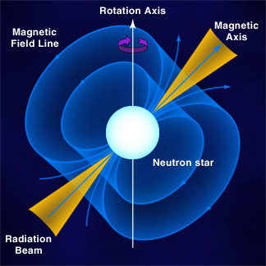

Slide 82
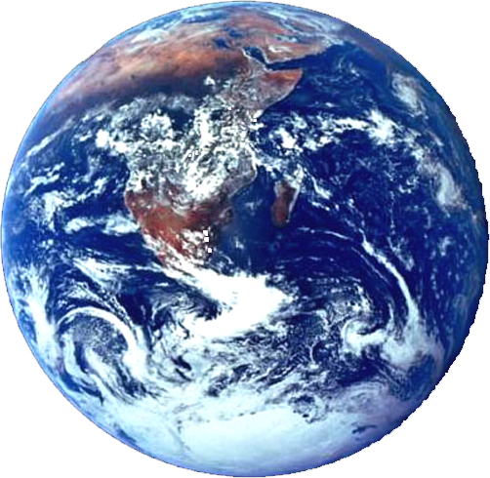
Earth
Will see a PULSAR

Slide 83
Earth
Will see a PULSAR
alien planet will see a neutron star

Slide 84
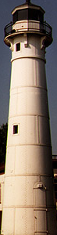

Slide 85
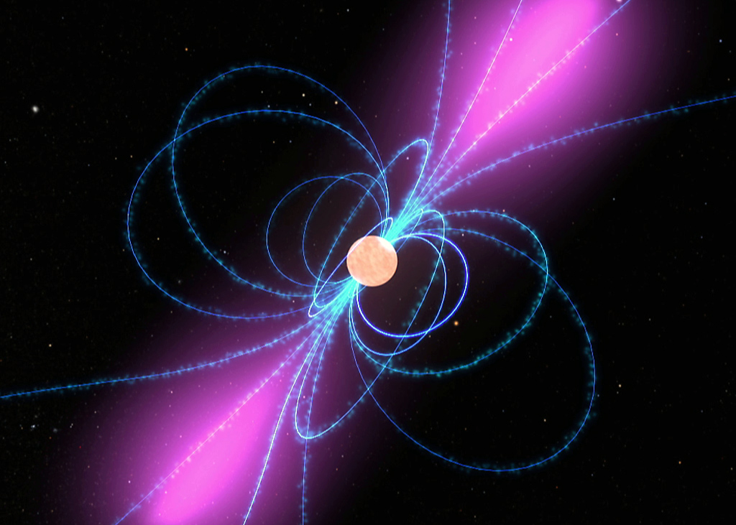

Slide 86
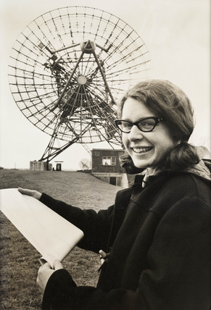
Jocelyn Bell 1969

Slide 87

Jocelyn Burnell-Bell

Slide 89


Slide 90

appeared in the sky as a new star in the year 1181
Notes:
3C58: Pulsar Power
Credit: P. Slane (Harvard-Smithsonian CfA) et al., CXC, NASA
Explanation: Light from a star that exploded some ten thousand light-years away first reached our fair planet in the year 1181. Now known as supernova remnant 3C58, the region seen in this false-color image glows in x-rays, powered by a rapidly spinning neutron star or pulsar - the dense remains of the collapsed stellar core. A cosmic dynamo with more mass than the sun, the pulsar's electromagnetic fields seem to accelerate particles to enormous energies, creating the jets, rings, and loop structures visible in this stunning x-ray view from the orbiting Chandra Observatory. While adding 3C58 to the list of pulsar powered nebulae explored with Chandra, astronomers have deduced that the pulsar itself is much too cool for its tender years, citing 3C58 as a show case of extreme physics not well understood. The close-up inset above spans about six light-years.

Slide 91


Slide 92

Notes:
Molecular Torus Surrounds Black Hole
Illustration Credit: V. Beckmann (NASA's GSFC) et al., ESA
Explanation: Why do some black hole surroundings appear brighter than others? In the centers of active galaxies, supermassive black holes at least thousands of times the mass of our Sun dominate. Many, called Seyfert Type I, are very bright in visible light. Others, called Seyfert Type II, are rather dim. The difference might be caused by some black holes accreting much more matter than others. Alternatively, the black holes in the center of Seyfert Type II galaxies might be obscured by a surrounding torus. To help choose between these competing hypotheses, the nearby Seyfert II galaxy NGC 4388 has been observed in X-ray light recently by many recent Earth-orbiting X-ray observatories, including CGRO, SIGMA, BeppoSAX, INTEGRAL, Chandra, and XMM-Newton. Recent data from INTEGRAL and XMM-Newton have found that the X-ray flux in some X-ray colors varies rapidly, while flux in other X-ray colors is quite steady. The constant flux and apparent absorption of very specific X-ray colors by cool iron together give evidence that the central black hole in NGC 4388 is seen through a thick torus composed of molecular gas and dust.

Slide 93

Notes:
A Lonely Neutron Star
Credit: F. Walter (SUNY Stony Brook), WFPC2, HST, NASA
Explanation: How massive can a star get without imploding into a black hole? These limits are being tested by the discovery of a lone neutron star in space. Observations by the Hubble Space Telescope have been combined with previous observations by the X-ray ROSAT observatory and ultraviolet EUVE observatory for the isolated star at the location of the arrow. Astronomers are able to directly infer the star's size from measurements of its unblended brightness, temperature, and an upper limit on the distance. Assuming that the object is a neutron star of typical mass, some previous theories of neutron star structure would have predicted an implosion that would have created a black hole. That this neutron star even exists therefore allows a window to the extreme conditions that exist in the interiors of neutron stars.

Slide 94
Stars Take different paths to their end depending on how MASSIVE they are.
1 to 3 M_{O} PN + white dwarf
3 to 8 M_{O} SN + neutron star
> 8 M_{O} SN + black hole

Slide 95
Stars Take different paths to their end depending on how MASSIVE they are.
1 to 3 M_{O} PN + white dwarf
3 to 8 M_{O} SN + neutron star
> 8 M_{O} SN + black hole
an object whose escape speed is > c

Slide 96


V_{escape} = 7 miles/second

Slide 97


V_{escape} = 7 miles/sec
V_{escape} = 619 miles/sec from the Sun!!

Slide 98


Slide 99
V_{esc} = 232,000 km/s
V_{esc} = 78% c
V_{esc} = 6,200 km/s

Slide 100

Light Paths
earth
neutron star

Slide 101
NEUTRON STAR
Mass in core of 5 M_{sun} Star: 1.0 M_{sun}
Crushed into size: 10 km
gravity canNOT overwhelm the Strong Force

Slide 102
BLACK HOLE
Mass in core of 8 M_{sun} Star: 1.5 M_{sun}
Crushed into size: 0 km
gravity overwhelms the Strong Force

Slide 103
∞
compactness
=
1
∞
Singularity !!
Density
Notes:
singularity

Slide 104
singularity
event horizon
V_{escape} = c
black hole

Slide 105
singularity
event horizon
R
V_{escape} = c
black hole

Slide 106
2 M G
R
V_{esc =} = c
Solve for R by squaring both sides

Slide 107
2 M G
R
V_{esc =} = c
Solve for R:
2 M G
c
Distance from the singularity where V_{esc} = c
EVENT HORIZON
R =
2

Slide 108
singularity
event horizon
V_{escape} = c
V_{escape} > c
V_{escape} < c
black hole

Slide 109
Light Paths
neutron star
black hole

Slide 110
1 M_{sun} G
D
V_{orbit} =

Slide 111
1 M_{sun} G
D
V_{orbit} =

Slide 113
How do we look for BLACK HOLES if LIGHT cannot escape them?
We look for how they interact with their envrironment.

Slide 114

any gas outside the event horizon will orbit VERY FAST.
this causes FRICTION ➔ x-rays

Slide 115
How do we look for BLACK HOLES if LIGHT cannot escape them?
1) a close binary system
1 M_{sun} 8 M_{sun}

Slide 116
1) a close binary system
the more massive star evolves first
1 M_{sun} 8 M_{sun}

Slide 117
1) a close binary system
the less massive evolves more slowly
black hole

Slide 118
1) a close binary system
the less massive later becomes a bloated red giant
black hole

Slide 119
1) a close binary system
if its surface gets too close to the event horizon, mass will swirl around the bh
black hole

Slide 120


Slide 121

1) a close binary system
the spectrum will show a cool star emitting x-rays!
x-rays!
amount of light
wavelength

Slide 122

Gamma-Ray Bursters
RADIO image of WR 104 at 8,000 l-y. dusty swirl caused by interaction with close companion star — you are looking down the pole of the star.
Notes:
WR 104 at 8,000 l-yr might have pole directly facing earth. star is ready to go sn—could happen in next 5 min or in next 500,000 yrs. But if such a GRB did hit earth’s atmosphere, says Adrian Melott, a physicist at the University of Kansas in Lawrence, it would likely cause a 50 percent increase in solar UVB radiation which would not only disrupt photosynthesis among marine and freshwater plankton, but also likely precipitate some sort of broader extinction event.“You would first notice a 10-second blue flash in the upper atmosphere,” said Melott, “but then the damage would be done.” ordovician mass extinction 400 million ya might have been caused by close GRB: a GRB may have triggered the Late Ordovician mass extinction some 440 million years ago — an era that saw the disappearance of 85 percent of earth’s marine life at the time.The hypothesis is simply that a 10 second pulse of high-energy x-rays and gamma-rays from a distant GRB from within our own galaxy, unexpectedly entered earth’s upper atmosphere and quickly destroyed the planet’s protective layer of stratospheric ozone.Not only would the destruction of the ozone open the door for lethal ultraviolet (UV) solar radiation to make it all the way down to earth’s land masses and shallow oceans, such an event would have also destroyed molecular nitrogen in our atmosphere. According to the hypothesis, this would have led to the creation of a brownish, nitrogen dioxide-based haze; one potentially capable of global cooling of the sort that could create continent-sized ice sheets.

Slide 123


GRB130427A dissipated in a few hundreds seconds 1000 times the energy our Sun will produce within its 10-billion years lifespan
xray image of GRB 130427
artist depiction of a SN beaming a GRB
Notes:
27 April 2013 – strongest GBR ever recorded, at about 4 billion l-y distant. total amount of gamma-ray energy produced by the GRB, which sums up to the astonishing value of 1054 erg. GRB130427A dissipated in a few hundreds seconds 1000 times the energy our Sun will produce within its 10-billion years lifespan. We can also determine what brightness it would have had if placed at the same distance of the brightest star in the sky, Sirius. It would have shone with a magnitude of -36, about 5000 times brighter than the Sun. the Spanish 10.4-m GTC telescope detected the signature of the supernova in the light of GRB130427A on the night of May 13th. But closer GRB have been MUCH weaker. why did this SN have a GRB with so much more energy? Most observed GRBs are believed to consist of a narrow beam of intense radiation released during a supernova as a rapidly rotating, high-mass star collapses

Slide 124

2) centers of galaxies
Galaxy M84

Slide 125


Slide 126
Take a spectrum at each loacation passing through the center of the galaxy
galactic center

Slide 127
galactic center
very high velocity stars

Slide 128










radio jet
supermassive black hole
Notes:
Optical milky way--sag a

Slide 129

radio jets
central core
of the galaxy, Cyg A
Notes:
MW sag, vis

Slide 130

us
cartoon of Milky Way

Slide 131

Inner Region of Milky Way

Slide 132

Galactic Center
30,000 light-years from us
10,000
light-years
100
light-years
1,000
light-years
Milky Way in infrared light (2μ)
Notes:
MW 2mass

Slide 133

Galactic Center in x-rays
Notes:
Center of mw in xray chandra

Slide 134

Notes:
At the Center of the Milky Way
Credit: Rainer Schödel (MPE) et al., NAOS-CONICA, ESO
Explanation: At the center of our Milky Way Galaxy lies a black hole with over 2 million times the mass of the Sun. Once a controversial claim, this astounding conclusion is now virtually inescapable and based on observations of stars orbiting very near the galactic center. Using one of the Paranal Observatory's very large telescopes and the sophisticated infrared camera NACO, astronomers patiently followed the orbit of a particular star, designated S2, as it came within about 17 light-hours of the center of the Milky Way (17 light-hours is only about 3 times the radius of Pluto's orbit). Their results convincingly show that S2 is moving under the influence of the enormous gravity of an unseen object which must be extremely compact -- a supermassive black hole. This deep NACO near-infrared image shows the crowded inner 2 light-years of the Milky Way with the exact position of the galactic center indicated by arrows. NACO's ability to track stars so close to the galactic center can accurately measure the black hole's mass and perhaps even provide an unprecedented test of Einstein's theory of gravity as astronomers watch a star orbit a supermassive black hole.

Slide 135

Galactic Center in radio light

Slide 136

remnants of an explosion 100,000 yrs ago
Galactic Center in radio light

