Slide 1

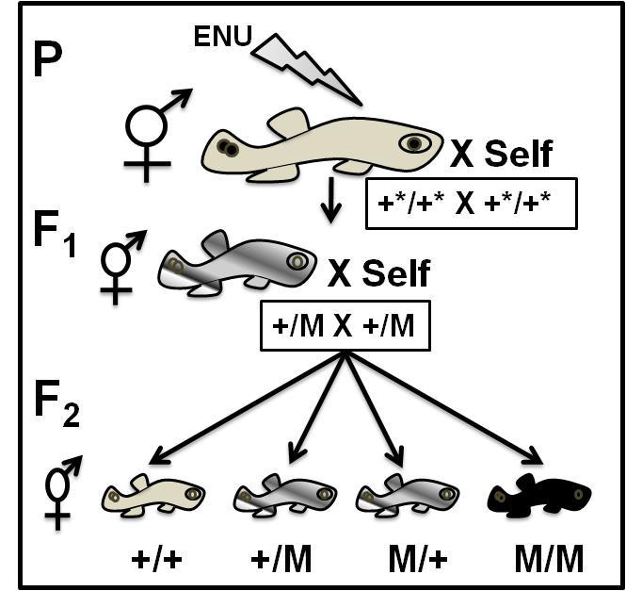
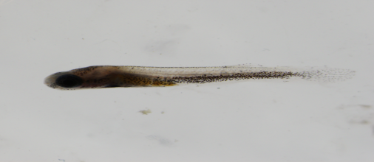
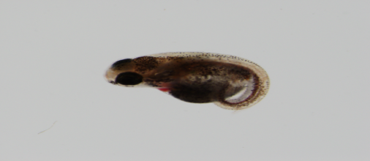
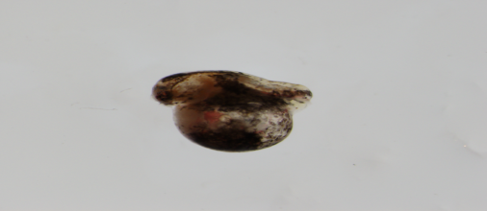
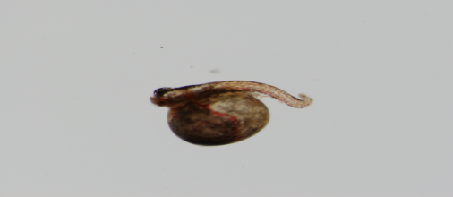
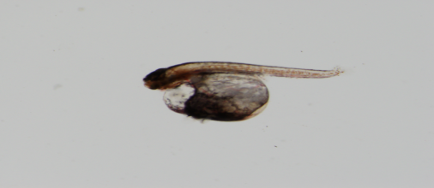
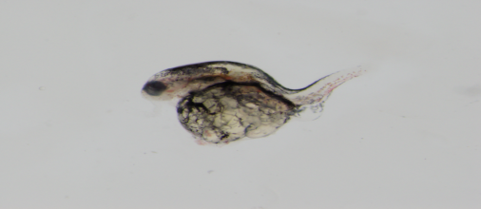
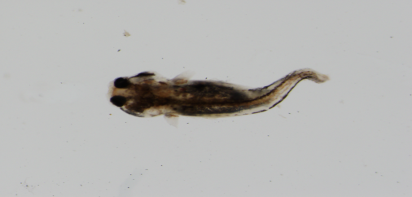
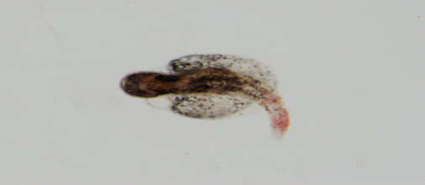
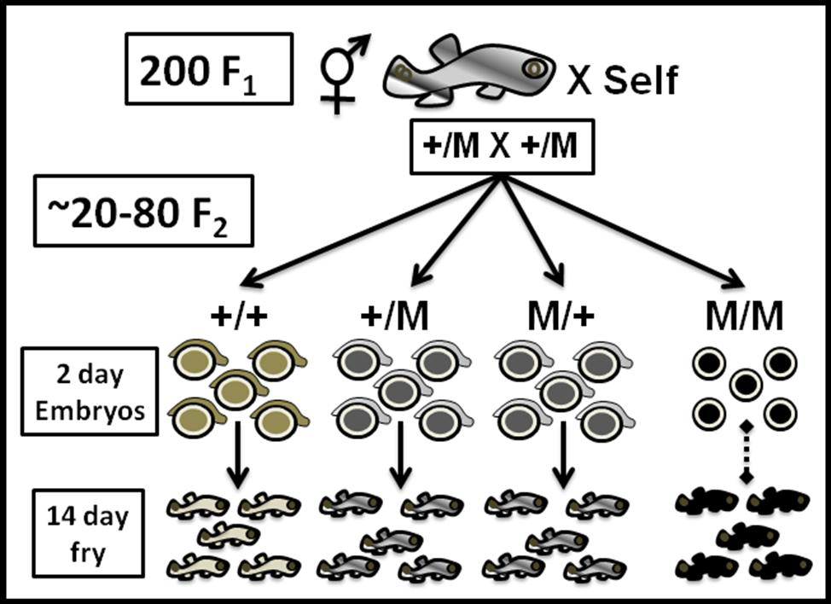
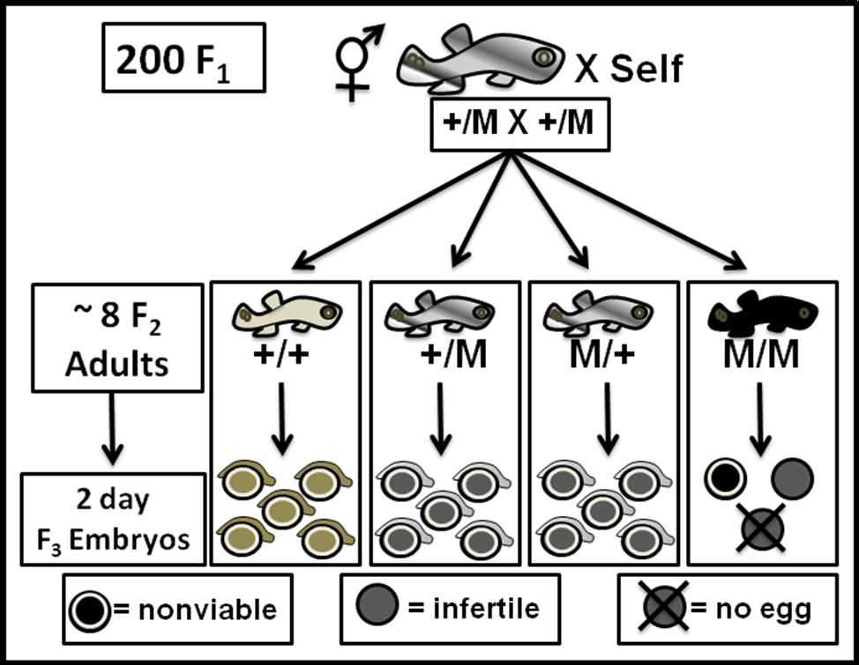
Zygotic Mutants of the Mangrove Killifish,
Kryptolebias marmoratus
The
Graduate School
Jennifer Newsome, Ginger Moore, Melissa Ard, and Sofìa Sucar
Faculty Mentor: Brian C. Ring, Ph.D. Department: Biology
Abstract
The mangrove killifish is unique among vertebrates due to its self-fertilizing mode of reproduction. Here, we describe a three generation forward genetic screen to identify zygotic mutants which show phenotypes that disrupt early embryonic development. We treated parental fish (P; N = 34) with increasing doses of N-Ethyl-N-Nitrosurea (ENU) which induces point mutations in the germ-line in other model organisms. These P fish were self-crossed, producing 7,350 F₁ progeny. 1,334 F₁ fish were hatched and raised to maturity (18%). From these F₁ fish, 284 were allowed to self-cross (284 genomes) and their F₂ offspring were observed during embryogenesis for mutant phenotypes disrupting early development (zygotic mutants). We are currently observing these zygotic mutants into the F₃ generation. Documented here are the types and frequencies of these zygotic mutants in our ongoing screen.
Results
P generation (n = 34) were treated with the mutagen ENU in concentrations of 2.8mM, 3.0mM, 3.3mM and 3.8mM.
These were allowed to self-cross to produce 7,350 F₁ progeny.
284 F₁ fish were selected and raised to adulthood, producing F₂ offspring with observable phenotypes.
F₂ progeny represent 511 mutant phenotypes in 8 classes.
A.
E.
B.
F.
Fig 1. Genetic Screen. Kmar hermaphroditic parents (P) are exposed to the mutagen ENU and progeny for three generations are screened.
Mutant | Number | Percent
No Tail/Short Tail | 28 | 5.48%
Curly/Crooked Tail | 58 | 11.35%
Skull/Eye | 57 | 11.15%
Jaw/Mouth | 5 | 0.98%
Dwarf | 58 | 11.35%
Lethal | 205 | 40.12%
Fluid Pouch | 27 | 5.28%
Other | 73 | 14.29%
Total identified | 511 | 100%
C.
G.
D.
D.
H.
A. Wild-type (without yolk sac) B. No tail/Short Tail C. Curly/Crooked Tail D. Skull/Eye E. Jaw/Mouth F. Small G. Fluid pouch H. Other (hemorrhage in tail, small, crooked tail, abnormal eyes.) Lethal mutant not shown.
Fig 5. Representative of Each Identified Mutant Class
Conclusion
In this genetic screen, we predict that 25% of the F₂ progeny will produce sterile mutants. We currently have identified 1 sterile mutant that has not laid eggs as well as 3 sterile mutants that are maternal-effect mutants laying 100% nonviable offspring (figures not shown). Additionally, we have found 511 mutant phenotypes in 8 classes (Table 1, Fig. 4).
We are currently in the F₃ generation. In this ongoing genetic screen, we hope to establish Kmar as a model for future genetic screens as well as demonstrate proof of principle using the mutagen ENU.
Purpose of Study
The purpose of this research is to elucidate the genes that dictate gonad development in Kryptolebias marmoratus, hereafter referred as Kmar. Kmar is a hermaphroditic vertebrate capable of internal self-fertilization. This teleost fish bears an ovotestis, a unique mixed gonad that contains both active ovarian and testicular components throughout its lifetime. To investigate the role of genes in gonad development, we conducted a forward genetic screen with the mutagen ENU. In our pilot screen, we treated P fish (n=34) with the mutagen ENU to induce point mutations that would produce sterile mutants lacking proper ovotestis function (Fig 1.). This generation was then allowed to self-cross, producing the F₁ generation. The F₁ generation was raised to adulthood and self-propagated to produce the F₂ generation (Fig 2.). The progeny of the F₂ generation were then screened for homozygous recessive phenotypes, including sterile mutants (Fig 3.). These phenotypes were classified and recorded. We are currently screening for these phenotypes in the F₃ generation.
Fig 2. F₁ zygotic screen of F₂ progeny.
Table 1: Classes of Identified Mutants
Funding for this research is provided by The National Institute of Child Health and Human Development. Many thanks to Melissa Ard, Lynda Bernhardt, & Brian Ring for their assistance with this project. Also, special thanks to Thomas Hodo, Sherquera Davidson, James Danielle, Allison Brown, Krystal Garcia for data collection. The expertise of Dr. Deborah Miller and Dr. Leslie Jones was also much appreciated.
Fig 3. F₂ adult screen for sterile mutants.
Fig 4. Classes of Identified Mutants (%)

