Slide 1
Energy in Waves - 2
Objective: Learning about different physical properties of waves and wave propagation.
Key concepts:
Heat and Thermal energy
Temperature and Temperature Scales
Laws of Thermodynamics
Entropy
Thermal expansion
Heat transfer methods
Change of Phase and Latent Heat

Slide 2
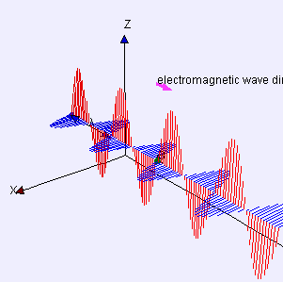
Electromagnetic waves
Electric and Magnetic Waves propagate together in Electromagnetic waves or EM waves.
EM waves are transverse waves.
All EM waves travel at 3 x 10⁸ m/s in a vacuum.
http://www.compadre.org/osp/items/detail.cfm?ID=7305

Slide 3
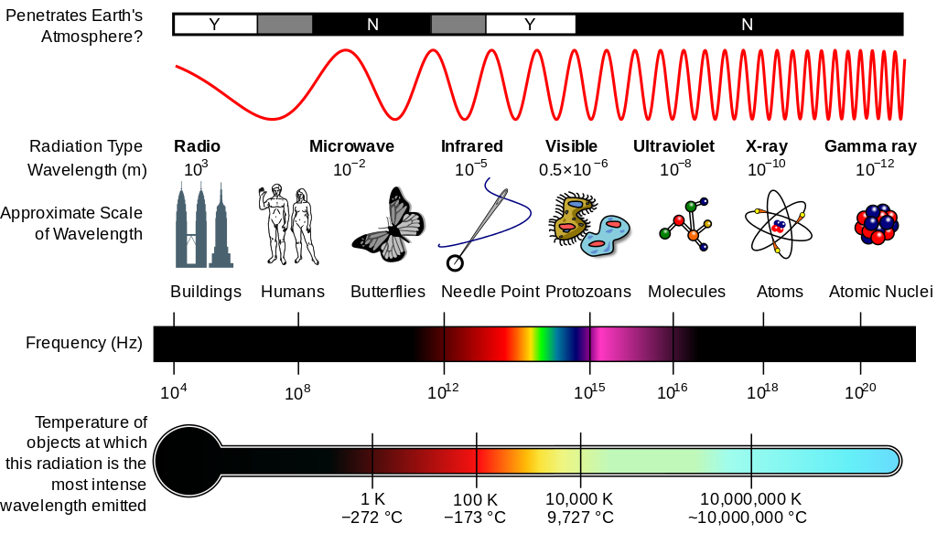
Electromagnetic Spectrum

Slide 4
Application of Electromagnetic waves

Slide 5
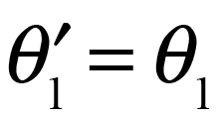
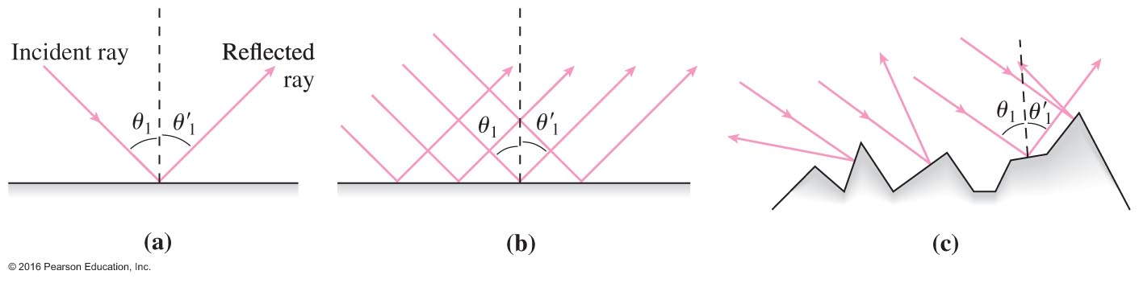
Reflection
When light reflects from a smooth or rough surface, the incident and reflected rays make the same angle with the normal to the surface (figure (a) below):
For smooth surfaces, parallel rays all reflect at the same angle (Law of Reflection)
The surface then looks shiny and can form images.
This is called specular reflection (figure (b) below).
For rough surfaces, parallel rays reflect at random angles.
This is called diffuse reflection (figure (c) below).

Slide 6
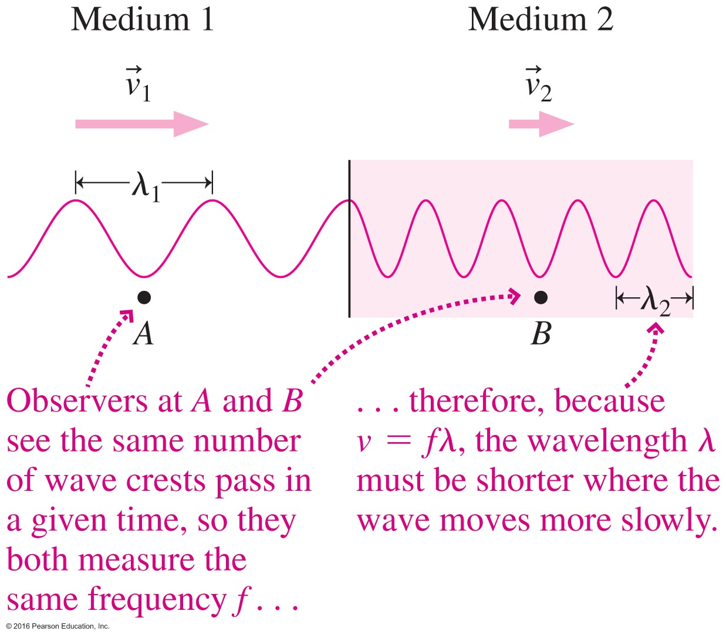
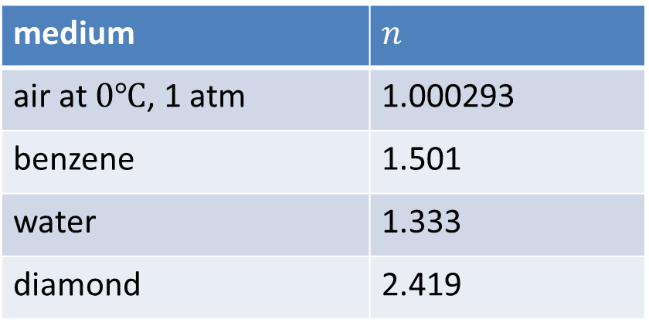
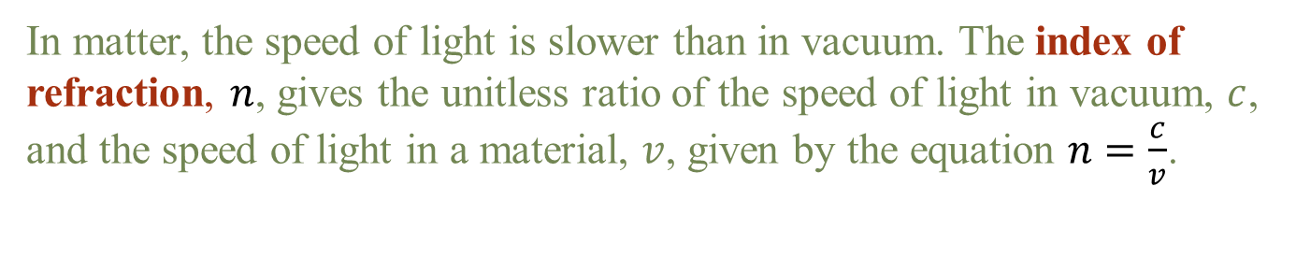
The Speed of EM wave (Light) in Matter
In matter, the speed of light is slower than in vacuum. The index of refraction, $n$, gives the unitless ratio of the speed of light in vacuum, $c$, and the speed of light in a material, $v$, given by the equation $n=\frac{c}{v}$.
medium | $$n$$
air at $0℃$, 1 atm | 1.000293
benzene | 1.501
water | 1.333
diamond | 2.419

Slide 7
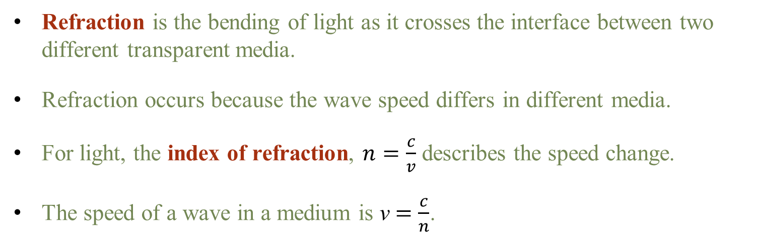
Refraction
Refraction is the bending of light as it crosses the interface between two different transparent media.
Refraction occurs because the wave speed differs in different media.
For light, the index of refraction, $n=\frac{c}{v}$ describes the speed change.
The speed of a wave in a medium is v $=\frac{c}{n}$.

Slide 8
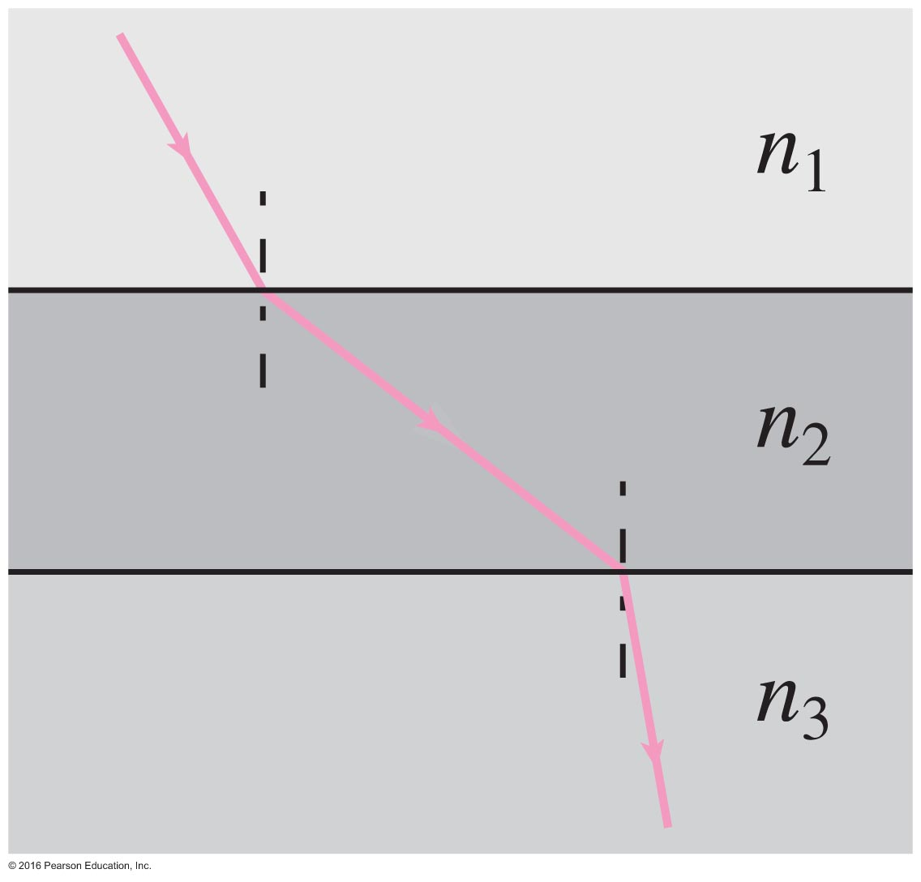
Concept Check!
The figure shows the path of a light ray through three different media. Rank the media according to their refractive indices, in decreasing order.

Slide 9
Dispersion
Dispersion: The refractive index depends on wavelength, and therefore refraction disperses the different wavelengths in slightly different directions. Dispersion is defined to be the spreading of white light into its full spectrum of wavelengths.

