Slide 1
Electrical Energy
Objective: Learning about Electric Force, Electric Field, Ohm’s Law, Simple Circuits and Electric Power.
Key concepts:
Electric charge and charge conservation
Electric force and fields
Voltage, Current and Resistance
Ohm’s law
Electric Power
Series and Parallel Circuit

Slide 2
Electric charge
Electric charge is a fundamental property of matter.
Charge comes in two varieties, positive and negative.
Protons carry the same positive charge, which is known as the elementary charge e = 1.6 x 10⁻¹⁶ C. Electrons carry the same negative charge, –e.
Any positive or negative charge q will be multiples of e, i.e. charge is quantized!
q = n e ; n = ± 1, ± 2, ±3 ….
Electric charge is conserved: the net charge of a closed region remains constant.
Law of conservation of charge states that charge can neither be created nor destroyed, and the total charge is constant in any process.
Like Charges repel one another
+
+
-
-
Unlike charges attract one another
+
-

Slide 3
How can materials be charged?
By rubbing against each other: One material loses electrons (get positively charged) while the other collects (captures) more electrons (get negatively charged)
Touching a charged object to a neutral object: The neutral object will acquire the same charge as the charged object.
Induction: By bringing the object closer (not touch) to an already
charged object
-
+ +
+ +
+ +
- +
- +
- +
Charges on the second object separates
Positively charged object

Slide 4
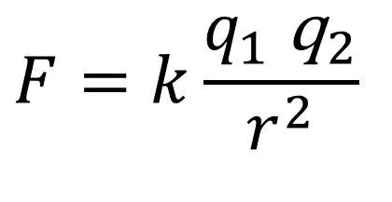
Electric Force
Electric force or Coulomb force is a fundamental force of nature and acts without physical contact between two objects.
The magnitude of the force depends on the magnitude of the charges and the inverse square of the distance between them.
Both gravity and coulomb force are inverse square law, but coulomb force is incredibly stronger!
$$F=k\frac{q_{1} {\text{q}}_{2}}{r^{2}}$$
k = 9 x 10⁹ Nm²/C²
F is repulsive
F is attractive

Slide 5

Electric Force
Relationship between charge and force is Coulomb's Law:
(A) Relationship between force of interaction F and charge (q₁ or q₂) is
(B) Relationship between force of interaction F and distance d between
charges is
(C) If either q₁ or q₂ is doubled, the force of interaction F will be
(D) If the distance between the charges is doubled, the force F will be
$$F=k\frac{q_{1} {\text{q}}_{2}}{r^{2}}$$

Slide 6
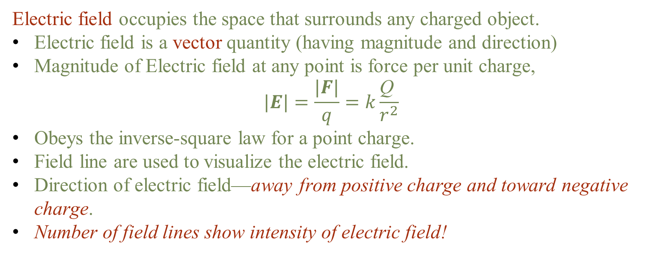
Electric Field and Field lines
Electric field occupies the space that surrounds any charged object.
  Electric field is a vector quantity (having magnitude and direction)
  Magnitude of Electric field at any point is force per unit charge,
  $$|E|=\frac{|F|}{q}=k\frac{\text{Q} }{r^{2}}$$
  Obeys the inverse-square law for a point charge.
  Field line are used to visualize the electric field.
  Direction of electric field—away from positive charge and toward negative charge.
  Number of field lines show intensity of electric field!

Slide 7
Electric Potential
When a charge q is accelerated by an electric field, its electric potential energy is converted to kinetic energy.
The potential difference ΔV between two points is defined as the ratio of the ΔP.E. and the charge q.
Just as gravitational PE can be converted to KE, electric PE is converted to KE of electrical charge.
Charges flow in a wire when there is a difference in electrical potential. Electrical voltage provides the energy to push the charges (Current) through the wire, and a Pump provides energy to create the flow of water through the water pipe.

Slide 8
Electric Current and Resistance
Electric Current: the rate at which flow of electric charge.
The SI unit for current is the ampere (A), an ampere is one coulomb per second or 6.25 billion billion electrons per second
The direction of conventional current is the direction that positive charge would flow.
Resistance: The electric property that impedes current (crudely similar to friction and air resistance) is called resistance R.
Collisions of moving charges with atoms and molecules in a substance transfer energy to the substance and limit current.
The SI unit for resistance is ohm (Ω).

Slide 9
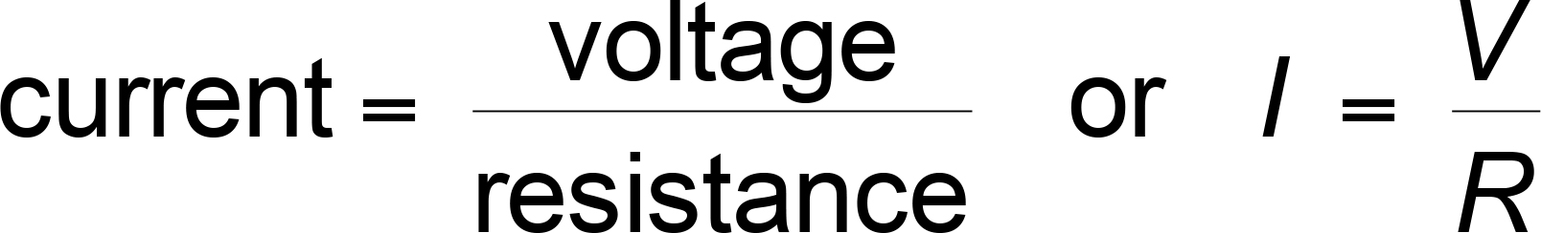
Ohm’s Law
Relationship between voltage, current and resistance is called Ohm's Law.
The current that flows through most substances is directly proportional to the voltage V applied to it.
The current that flows through most object is inversely proportional to the resistance of that object.
Ohm’s law is commonly expressed as,
Most substances for which Ohm’s law holds are called ohmic.
***Ohm’s law is not universally valid!

Slide 10
Ohm’s Law
Relationship between voltage, current and resistance is called Ohm's Law:
(A) Relationship between current and voltage is
(B) Relationship between current and resistance is
(C) Relationship between voltage and resistance is
(D) If you double the voltage, the current will be times ____
(E) If you double the resistance, the current will be times ____
** Try the tutorial to verify your understanding https://www.walter-fendt.de/html5/phen/ohmslaw_en.htm

Slide 11

Ohm’s Law
Practice problems:
How much current flows through a 12 V radio speaker having a resistance of 8 Ω?
(B) If an appliance draws a current of 20 A running off of a 120 V line, what is its resistance?

Slide 12
Electric Power
Electric Power: Rate of doing work.
Relationship between electric power, voltage and current is: P = IV
SI Unit for power: Watts (W) = amperes (A) x volts (V)
(A) Relationship between power and current is
(B) Relationship between power and voltage is
If you triple the voltage, the power will be times ____

Slide 13
Electric Power
Practice problems
P = IV
(A) A 50 W light bulb draws 0.40 A current. What is the voltage?
(B) A 6 V appliance draws 2 A of current. What is the power usage of this appliance?

Slide 14
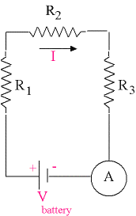
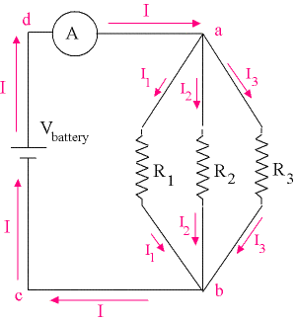
Electric circuits – series and parallel
Most electric circuits are series, parallel or a combination of them.
Series: Only one path for the current to flow.
Same current passes through all series resistors
Parallel: More than one path for the current to flow.
Same voltage difference between opposite end of each parallel path.
Series
Parallel
*At home we have more parallel
circuits

Slide 15
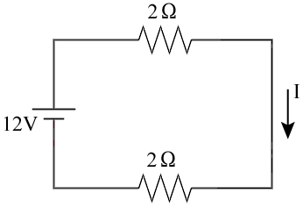
SERIES Circuit Example
First, Find the Total Resistance = _________
Second, Find the Net Current = I = ___________
** Try the tutorial to verify your understanding https://www.walter-fendt.de/html5/phen/combinationresistors_en.htm

Slide 16
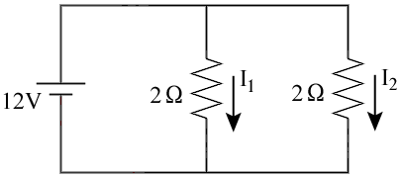
Parallel Circuit Example
First, Find I₁ = ___________
and also Find I₂ = ___________
Second, Find the Net Current = _________
and the effective combined R = V / I = ___________
** Try the tutorial to verify your understanding https://www.walter-fendt.de/html5/phen/combinationresistors_en.htm

Slide 17
Direct current (dc) and Alternating current (ac)
dc
Current flows in one
Direction (e.g. Batteries)
Current
Time
ac
Current changes direction
(e.g. Household Power Supply )
Current
Time
Frequency 60 Hertz (Hz) → current changes direction back and forth 60 times a second in U.S.

Slide 18
Electric Hazards and Safety
The current that flows through the body causes electric shock
Dry body ~ 500,000 Ω
Wet body ~ only few hundred Ω - easy to get an electric shock
Current (A) | Effect
0.001 | Can be felt
0.005 | Is painful
0.01 | Causes involuntary contractions
0.015 | Causes loss of muscle control
0.070 | Can be fatal
**When a circuit carry more than a safe amount of current the circuit is said to be overloaded. When too many appliances are used at once in parallel combination, it may cause overloading of the circuit. We use fuses or circuit breakers to prevent damages to appliances and the circuit.

Slide 19
Overloading
When a circuit carry more than a safe amount of current
the circuit is said to be overloaded
When too many appliances are used at once may
cause overloading of the circuit.
We use fuses or circuit breakers to prevent damages to
Appliances and the circuit.

