Slide 1
Symbolic Logic (Sentential)
Translation to Symbolic Language

Slide 2
Sentence Letters
Usually, sentence letters come from the main nouns, often “proper” nouns, in the sentences we translate
  For example, “Bob goes to the store” is symbolized with the letter B
If you have a sentence with two proper nouns that begin with the same letter, go to the next noun you can, or a verb:
  “Harris Bank has a discount and Harpers has a coupon” would be D and C
  “Lions sleep and leopards run” would be S and R

Slide 3
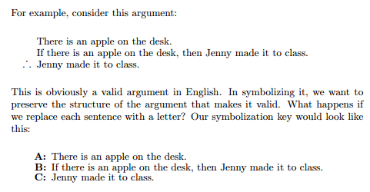
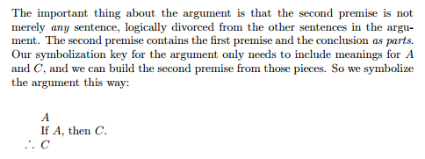
You might notice in ForAllX…
They start out with examples that don’t use proper sentence letters, just to show how important they are (page 17-18)
Letter choice matters

Slide 4
In addition to sentence letters,
We also have a set of five operator symbols, which represent specific kinds of sentences.
~ • v ⊃ ≡

Slide 5
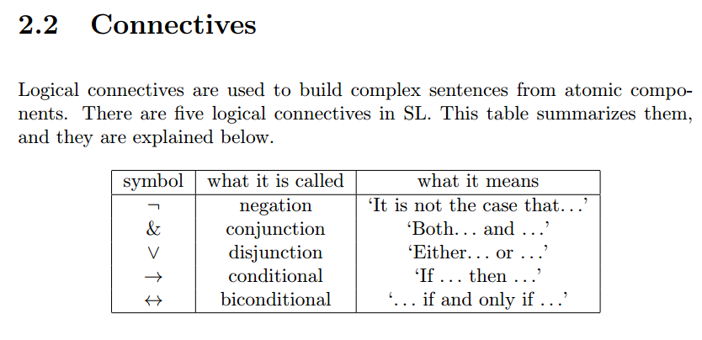
You might also notice in ForAllX…
The symbols used by logicians may change slightly depending on the text they like to use. Don’t worry, in all cases it is only 5 symbols:

Slide 6
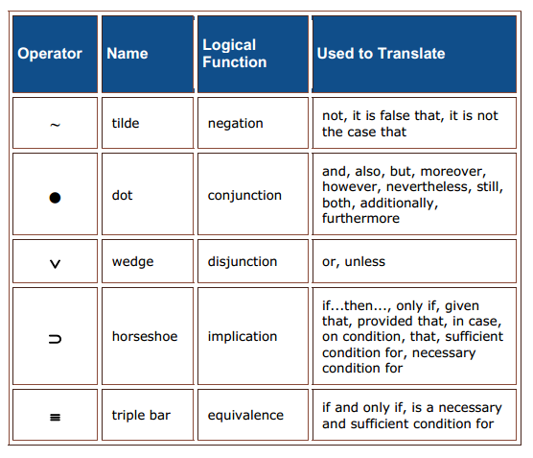
Operators (Both Sets)
Same as:
Hook ¬
Ampersand &
Wedge v
Arrow →
Double Arrow ⇔

Slide 7
~
This is called the “tilde”, and it represents a negation.
Negations in logic could be “not”, “it is not the case that.”
If you have a sentence that involves the positive and negative version of some description, use a negation:
“Marina is very healthy, but Tanya is so unhealthy” should involve a ~ on Tanya.
Important fact: the ~ is the only operator symbol that does not take a sentence or a sentence letter on both sides:
  ~B
  ~(A and C)
  ~[P or (if R then ~Q)]

Slide 8
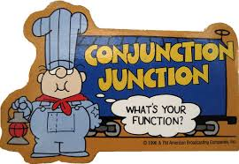
•
This is called the “dot” and it represents a conjunction.
In English, conjunctions are sentences with “and” or “but” or “at the same time”
(Note that in some other logic books, this may be an ampersand & an upside down karat mark ^ or a *)
Unlike the tilde, • does have to have sentences on each side:
  B•C
(A•D) • (M•N)
You can start combining now. Just be sure to add parentheses and square brackets when you have groups of sentence letters over two:
P • ~(R • Q)
(M•N)• ~O

Slide 9
v
This is called the wedge, and it represents a disjunction.
Disjunctions stand for “or” or “either or” in logic.
Must have sentences on both sides.
For our class we will use inclusive or, which means one side, the other side, or both sides of the sentence could be true.
When combined with the tilde, “neither nor”.
G v H
S v (T • U)
(~P•A) v (Q •~B)
Important fact: the v is the way to symbolize an “unless”:
“Pharrell does a video in the studio on Tuesday unless Future does a video in the studio on Tuesday.”
  P v F

Slide 10
⊃
This is called a horseshoe and it represents a conditional statement.
Conditional statements in English use if, only if, if…then…
  Note, if the sentence uses both if and only if together, it’s a biconditional (the last operator)
  R ⊃ G
  ~G ⊃ ~R
  (P ⊃ Q) v W
  W v (~P ⊃ Q)
  W v ~(P ⊃ Q)

Slide 11
≡
This is called a triple bar, and it represents a biconditional.
Biconditionals are conditionals that go in both directions.
In English: “If and only if” all together as one phrase, a necessary and a sufficient condition at the same time.
G ≡ H
S v (T ≡ U)
(~P≡A) v (Q ≡~B)

Slide 12
Conditions
There is a difference between sentences that include if, only if, and if and only if phrases.
  The “if” item always goes in front of the horseshoe.
  The “only if” item is always after the horseshoe. Read every “only if” as “then” in your mind.
  “If and only if” all together as one phrase is really a biconditional.
There is a difference between necessary and sufficient conditions.

Slide 13
Necessary Conditions
If we say that "x is a necessary condition for y," we mean that if we don't have x, then we won't have y. Or put differently, without x, you won't have y. To say that x is a necessary condition for y does not mean that x guarantees y.
Some examples will help here:
Having gasoline in my car (I have a gasoline engine) is a necessary condition for my car to start. Without gasoline (x) my car (y) will not start. Of course, having gasoline in the car does not guarantee that my car will start. There are many other conditions needed for my car to start: turning the key, a fully charged battery, etc.
Having oxygen in the earth's atmosphere is a necessary condition for human life. Certainly, having oxygen will not guarantee human life. There are many other conditions needed for human life other than oxygen in the atmosphere.
Being 18 years of age is a necessary condition for being able to buy cigarettes legally in North Carolina. Of course, being 18 does not guarantee that a person will buy cigarettes. There are many other conditions that lead to a person buying cigarettes than being 18 years of age.
Having four paws is necessary for being a tiger, but there are other qualities that are necessary too.

Slide 14
Sufficient Conditions
If we say that "x is a sufficient condition for y," then we mean that if we have x, we know that y must follow. In other words, x guarantees y.
Consider the following examples:
Earning a total of 950 points (95%) in a Critical Thinking class is a sufficient condition for earning a final grade of A. If you have 950 points for the course, then it must follow that you will have a final grade of A.
Pouring a gallon of freezing water on a sleeping roommate is sufficient to wake her up. If I pour the gallon of freezing water on a roommate, then it is guaranteed that she will wake up.
Rain pouring from the sky is a sufficient condition for the ground to be wet.
Please note that in none of these examples is the sufficient condition also a necessary condition.
For example, it is not necessary to earn 950 points to earn an A in that course. You can earn 920 points to earn an A. (We cannot say that if you do not have 950 points then you can't have an A.)
It is not necessary to pour a gallon of freezing water on a roommate to wake her up. (A wrecking ball against the wall will do it as well.)
Similarly, it is not necessary for rain to be pouring from the sky for the ground to be wet. The sprinkler could be on as well.

Slide 15
Examples for if vs. only if
I caught a fish only if I baited my hook.
  If I caught a fish, then I must have baited the hook.
  Caught only if Hook.
  Caught then Hook.
  C ⊃ H
If I baited my hook then I caught a fish.
  H ⊃ C

Slide 16
Which of the following are not well-formed formulas (WFF's)? For the statements below that are not WFFs, point out where the problem is. For statements that are WFFs, what is the “main connective”?
Example: ~(D ⊃ ~T) v [(S • R) ⊃ V]
“Either it is not the case that if D then not T or, if S and R then V”
It is well formed, and its main connector is the wedge v between the first parentheses and the square brackets.
1. ~L v (⊃ X • M)
2. (M v N) • v (P v ~Q)
3. (R ⊃ S) ⊃ (~T ⊃ ~V)
4. (X ⊃ Y) ⊃ ~[V • (L • M)]
5. (M v N v O) ⊃ P
6. ~A • (~B ⊃ C)
7. [(D • E) v F ≡ G] • (H v ~I)
8. ~(R ~ S) ⊃ T
9. ~R v ~S ⊃ ~T
10. ~(C v D) ≡ [(S ⊃ ~T) v (E ⊃ ~F)]

Slide 17
Translate the following statements into symbolic form using capital letters to represent affirmative English statements. Be sure to use well-formed formulas.
1. If Jesse is late, Bekki will be mad.
2. Either the Cardinals or the Braves will win the pennant.
3. The President is Head of State; but, she is also Commander in Chief.
4. Abortion is exactly the same as murder.
5. If Kathy and Dorothy go on vacation, then Jerome will not stay home.
6. The economy improves whenever auto sales increase.
7. Neither Steve nor Joshua are Hindu.
8. AIDS will decrease only if AZT becomes inexpensive and that won't happen.
9. If either the House and the Senate vote against it or the president vetoes it, the bill will fail.
10. If you are both unhappy and underpaid, you should quit. If you are happy and well paid, you should stay. (Remember to use “not happy”, etc. --you should be using some ~'s)
11. Only if the University of Georgia raises its admissions standards will VSU raise its admissions standards. (Think of it as “If you see that VSU raised admissions standards, then you know U of G already did.”)

Slide 18
Why should logic focus on propositions?
Logic studies the preservation of truth, and propositions or statements are the bearers of truth and falsity.
The truth of a compound statement is systematically dependent upon the truth of the component statements.
Argument forms that reflect this systematic dependence can be shown to be valid or invalid.

Slide 19


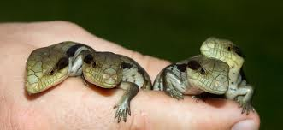
A funny example about Robin Thicke

Slide 20
Propositions in Arguments
How are the simple pieces of information related to each other?
How can we break down the complex information offered in the premises to find the simple piece of information in the conclusion that Robin Thicke is human?
Robin Thicke is a reptile only if he can have reptilean offspring.
If he is not a reptile, then he is either human or an alien.
Thicke can't have reptilean offspring.
And he is not an alien.
So, is Robin Thicke human?

Slide 21
The Premises of the Argument
This argument has four premises, each offering different pieces of information.
No one premise tells us whether Thicke is a human.
1. Robin Thicke is a reptile only if he can have reptilean offspring.
2. If he is not a reptile, then he is either human or an alien.
3. Thicke can't have reptilean offspring.
4. And he is not an alien.

Slide 22
Complex Information in the Premises
Premise 2 expresses relationships among three different statements.
Thicke is a reptile.
Thicke is a human.
Thicke is an alien.
If the first statement is not true, then either the second or the third is true
2. If he is not a reptile, then he is either human or an alien.

Slide 23
Simple and Compound Statements
A simple statement does not contain any other statement as a component.
Thicke is a reptile.
A compound statement contains at least one simple statement as a component and at least one operator or connective:
Thicke is not a reptile.
If Thicke is a reptile, then he has reptilean offspring.

Slide 24
Symbolizing Compound Statements
To display the relationships among statements we abstract the content and use special symbols for the operators and connectives.
In this way we can focus on the form apart from the content.
Use capital letters to stand for particular simple statements.

Slide 25
Therefore…
If Robin Thicke is not a reptile, then he is either human or an alien.
R = Robin Thicke is a reptile.
H = Robin Thicke is a human.
A = Robin Thicke is an alien.
If not-R, then either H or A.
~ R ⊃ (H v A)

Slide 26
Symbolic Logic is the Language of Modern Logic
Technique for analysis of deductive arguments
English (or any) language: can make any argument appear vague, ambiguous; especially with use of things like metaphors, idioms, emotional appeals, etc.
Avoid these difficulties to move into logical heart of argument: use symbolic language
  Now can formulate an argument with precision
  Symbols facilitate our thinking about an argument
    These are called “logical connectives”

Slide 27
Logical Connectives
The relations between elements that every deductive argument must employ
Helps us focus on internal structure of propositions and arguments
  We can translate arguments from sentences and propositions into symbolic logic form
“Simple statement”: does not contain any other statement as a component
  “Charlie is neat”
“Compound statement”: does contain another statement as a component
  “Charlie is neat and Charlie is sweet”

Slide 28
Conjunction
Conjunction of two statements: “…and…”
  Each statement is called a conjunct
    “Charlie is neat” (conjunct 1)
    “Charlie is sweet” (conjunct 2)
The symbol for conjunction is a dot •
  (Can also be “&”)
  p • q
    p and q (2 conjuncts)

Slide 29
Truth Values
Truth value: every statement is either T or F; the truth value of a true statement is true; the truth value of a false statement is false

Slide 30
Truth Values of Conjunction
Truth value of conjunction of 2 statements is determined entirely by the truth values of its two conjuncts
  A conjunction statement is truth-functional compound statement
  Therefore our symbol “•” (or “&”) is a truth-functional connective

Slide 31
Truth Table of Conjunction •
Given any two statements, p and q
p | q | p • q
T | T | T
T | F | F
F | T | F
F | F | F
A conjunction is true if and only if both conjuncts are true

Slide 32
Abbreviation of Statements
“Charlie’s neat and Charlie’s sweet.”
  N • S
  Dictionary: N=“Charlie’s neat” S=“Charlie’s sweet”
    Can choose any letter to symbolize each conjunct, but it is best to choose one relating to the content of that conjunct to make your job easier
“Byron was a great poet and a great adventurer.”
  P • A
“Lewis was a famous explorer and Clark was a famous explorer.”
  L • C

Slide 33
“Jones entered the country at New York and went straight to Chicago.”
  “and” here does not signify a conjunction
  Can’t say “Jones went straight to Chicago and entered the country at New York.”
  Therefore cannot use the • here
Some other words that can signify conjunction:
  But
  Yet
  Also
  Still
  However
  Moreover
  Nevertheless
  (comma)
  (semicolon)

Slide 34
Negation
Negation: contradictory or denial of a statement
“not”
  i.e. “It is not the case that…”
The symbol for negation is tilde ~
  If M=“All humans are mortal,” then
    ~M=“It is not the case that all humans are mortal.”
    ~M=“Some humans are not mortal.”
    ~M=“Not all humans are mortal.”
    ~M=“It is false that all humans are mortal.”
      All these can be symbolized with ~M

Slide 35
Truth Table for Negation
Where p is any statement, its negation is ~p
p | ~p
T | F
F | T

Slide 36
Disjunction
Disjunction of two statements: “…or…”
Symbol is “ v ” (wedge) (i.e. A v B = A or B)
  Weak (inclusive) sense: can be either case, and possibly both
    Ex. “Salad or dessert” (well, you can have both)
    We will treat all disjunctions in this sense (unless a problem explicitly says otherwise)
  Strong (exclusive) sense: one and only one
    Ex. “A or B” (you can have A or B, at least one but not both)
  The two component statements so combined are called “disjuncts”

Slide 37
Disjunction Truth Table
p | q | p v q
T | T | T
T | F | T
F | T | T
F | F | F
A (weak) disjunction is false only in the case that both its disjuncts are false

Slide 38
Disjunction
Translate:
“You will do poorly on the exam unless you study.”
  P=“You will do poorly on the exam.”
  S=“You study.”
P v S
“Unless” = v

Slide 39
Punctuation
As in mathematics, it is important to correctly punctuate logical parts of an argument
  Ex. (2x3)+6 = 12 whereas 2x(3+6)= 18
  Ex. p • q v r (this is ambiguous)
To avoid ambiguity and make meaning clear
Make sure to order sets of parentheses when necessary:
  Example: { A • [(B v C) • (C v D)] } • ~E
    { [ ( ) ] }

Slide 40
Punctuation
“Either Fillmore or Harding was the greatest American president.”
  F v H
To say “Neither Fillmore nor Harding was the greatest American president.” (the negation of the first statement)
  ~(F v H) OR (~F) • (~H)

Slide 41
Punctuation
“Jamal and Derek will both not be elected.”
  ~J • ~D
    In any formula the negation symbol will be understood to apply to the smallest statement that the punctuation permits
    i.e. above is NOT taken to mean “~[J • (~D)]”
“Jamal and Derek both will not be elected.”
  ~(J •D)

Slide 42
Example
Rome is the capital of Italy or Rome is the capital of Spain.
  I=“Rome is the capital of Italy”
  S=“Rome is the capital of Spain”
  I v S
  Now that we have the logical formula, we can use the truth tables to figure out the truth value of this statement
    When doing truth values, do the innermost conjunctions/disjunctions/negations first, working your way outwards

Slide 43
I v S
We know that Rome is the capital of Italy and that Rome is not the capital of Spain.
  So we know that “I” is True, and that “S” is False. We put these values directly under their corresponding letter
I v S
T | F
We know that for a disjunction, if at least one of the disjuncts is T, this is enough to make the whole disjunction T
  We put this truth value (that of the whole disjunction) under the v (wedge)
I v S
T | F
T

Slide 44
Note:
  There is an “Order of Operations” in Logic
  In general, when doing truth values, do the innermost conjunctions/disjunctions/negations first, working your way outwards
      Ex. Do ( ) first, then [ ], then finally { }
      Here’s another listing of the order of operations:

Slide 45
~ • v ⊃ ≡
1) Tilde ~ on single letters should be done after the letters themselves are already done.
2) Connectors inside parentheses should be done next, after each side in the parentheses is done.
3) Tilde ~ outside of parentheses should be done next. Make sure you are changing the truth value of the connector column, not a side column.
4) Connectors that are in between two sets of parentheses should be done next.
5) Tilde ~ on big brackets, larger brackets [] and {}

Slide 46
~[(A ⊃ N) • (S ⊃ C)]
There is no ~ on a single letter here
Do the A, the N, the S, and the C
Do the connectors inside the () in this case they are both ⊃
Do the connector outside the () in this case it is the •
Last, do the ~ outside the [] by changing the values under the •

Slide 47
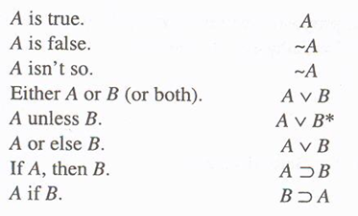
Types of sentences part 1:

Slide 48
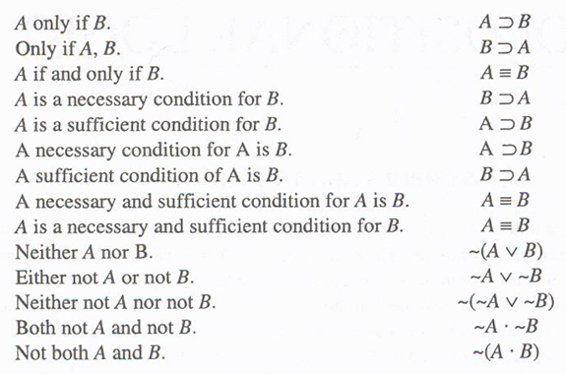
Types of sentences part 2:

Slide 49
Sample translations:
If Al or Betty goes to town, Cathy does not go.
(A v B) ⊃ ~ C
Al’s and Betty’s going to town is a necessary condition for either Cathy’s or David’s going to town.
(C v D) ⊃ (A • B)
Al or Betty goes to town unless both Cathy and David go to town.
(A v B) v (C • D)

Slide 50
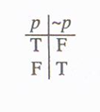
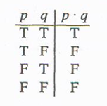
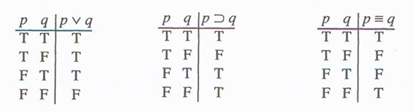
~ • v ⊃ ≡
Truth Functions (how the operators are true or false)

Slide 51
Constructing a Truth Table
The number of lines in the truth table relates to the number of different letters in your sentence.
2 to the n power 2^{n} where n is the number of different letters
2 different letters = 2x2 = 4 lines
3 different letters = 2x2x2 = 8 lines
The first letter has half the lines true, and half the lines false.
The next letter divides those in half again, so if you have an 8 line table with a first letter with four true lines, the second letter will be two true lines, two false lines, and so on.

Slide 52
What are the values of the column for the “dot”?
C | S |  | C | • | S
T | T |  | T |  | T
F | T |  | F |  | T
T | F |  | T |  | F
F | F |  | F |  | F

Slide 53
The complete table for our example:
C | S |  | C | • | S
T | T |  | T | T | T
F | T |  | F | F | T
T | F |  | T | F | F
F | F |  | F | F | F

Slide 54
The basic truth table for conjunction:
p | q |  | p | • | q
T | T |  | T | T | T
F | T |  | F | F | T
T | F |  | T | F | F
F | F |  | F | F | F

Slide 55
What are the values in the column for the “v”?
C | S |  | C | v | S
T | T |  | T |  | T
F | T |  | F |  | T
T | F |  | T |  | F
F | F |  | F |  | F

Slide 56
The complete truth table for our example:
C | S |  | C | v | S
T | T |  | T | T | T
F | T |  | F | T | T
T | F |  | T | T | F
F | F |  | F | F | F

Slide 57
The basic truth table for disjunction:
p | q |  | p | v | q
T | T |  | T | T | T
F | T |  | F | T | T
T | F |  | T | T | F
F | F |  | F | F | F

